Slide 1
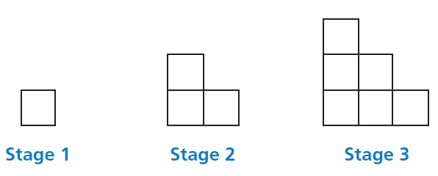
Mathematics Unit 26: Step Pattern
QUESTION 26.1
Robert builds a step pattern using squares.
Here are the stages he follows.
As you can see, he uses one square for Stage 1, three squares for Stage 2 and six for Stage 3.
How many squares should he use for the fourth stage?
What do we want to find out?
What useful information do we know?
What other mathematical techniques do we need to apply?
What have we learned?

Slide 2
Mathematics Unit 26: Step Pattern
QUESTION 26.1
Robert builds a step pattern using squares.
Here are the stages he follows.
As you can see, he uses one square for Stage 1, three squares for Stage 2 and six for Stage 3.
How many squares should he use for the fourth stage?
What do we want to find out?
What useful information do we know?
What other mathematical techniques do we need to apply?
What have we learned?
Back to start

Slide 3
Mathematics Unit 26: Step Pattern
QUESTION 26.1
Robert builds a step pattern using squares.
Here are the stages he follows.
As you can see, he uses one square for Stage 1, three squares for Stage 2 and six for Stage 3.
How many squares should he use for the fourth stage?
What do we want to find out?
What useful information do we know?
What other mathematical techniques do we need to apply?
What have we learned?
Back to start

Slide 4
Mathematics Unit 26: Step Pattern
QUESTION 26.1
Robert builds a step pattern using squares.
Here are the stages he follows.
As you can see, he uses one square for Stage 1, three squares for Stage 2 and six for Stage 3.
How many squares should he use for the fourth stage?
What do we want to find out?
What useful information do we know?
What other mathematical techniques do we need to apply?
What have we learned?
Back to start

Slide 5
Mathematics Unit 26: Step Pattern
QUESTION 26.1
Robert builds a step pattern using squares.
Here are the stages he follows.
As you can see, he uses one square for Stage 1, three squares for Stage 2 and six for Stage 3.
How many squares should he use for the fourth stage?
What do we want to find out?
What useful information do we know?
What other mathematical techniques do we need to apply?
What have we learned?
Back to start

