Slide 1
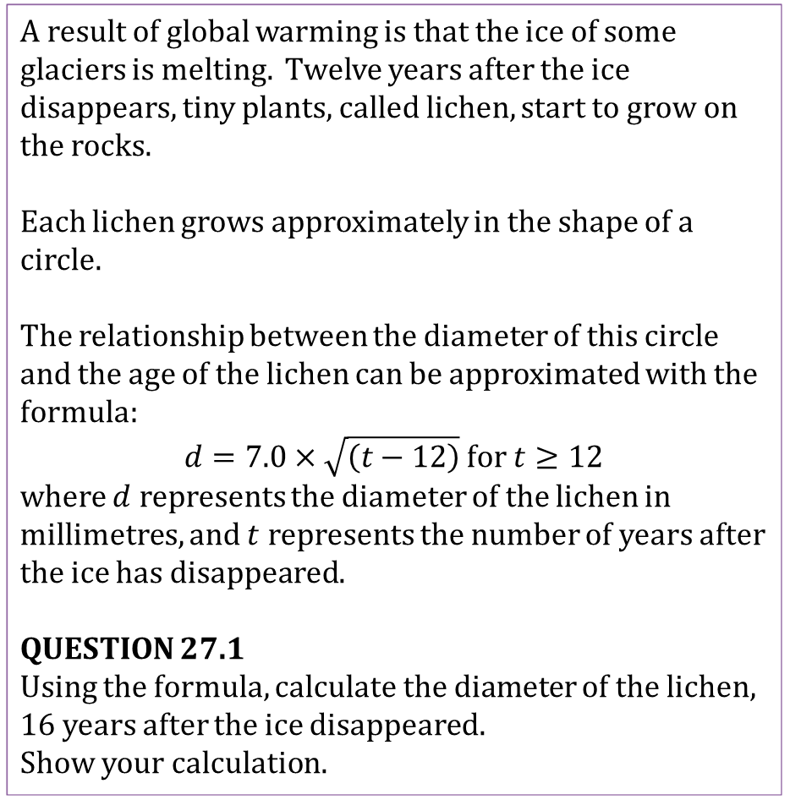
Mathematics Unit 27: Lichen
A result of global warming is that the ice of some glaciers is melting. Twelve years after the ice disappears, tiny plants, called lichen, start to grow on the rocks.
Each lichen grows approximately in the shape of a circle.
The relationship between the diameter of this circle and the age of the lichen can be approximated with the formula:
$d=7.0×\sqrt{\left(t−12\right)}$ for $t≥12$
where $d$ represents the diameter of the lichen in millimetres, and $t$ represents the number of years after the ice has disappeared.
QUESTION 27.1
Using the formula, calculate the diameter of the lichen, 16 years after the ice disappeared.
Show your calculation.
What do we want to find out?
What useful information do we know?
What other mathematical techniques do we need to apply?
What have we learned?

Slide 2
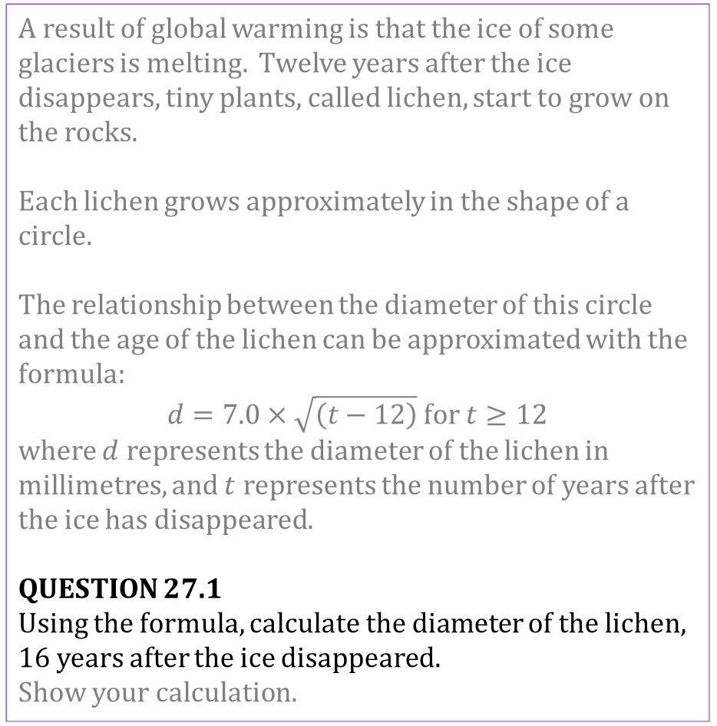
Mathematics Unit 27: Lichen
A result of global warming is that the ice of some glaciers is melting. Twelve years after the ice disappears, tiny plants, called lichen, start to grow on the rocks.
Each lichen grows approximately in the shape of a circle.
The relationship between the diameter of this circle and the age of the lichen can be approximated with the formula:
$d=7.0×\sqrt{\left(t−12\right)}$ for $t≥12$
where $d$ represents the diameter of the lichen in millimetres, and $t$ represents the number of years after the ice has disappeared.
QUESTION 27.1
Using the formula, calculate the diameter of the lichen, 16 years after the ice disappeared.
Show your calculation.
What do we want to find out?
What useful information do we know?
What other mathematical techniques do we need to apply?
What have we learned?
Back to start

Slide 3
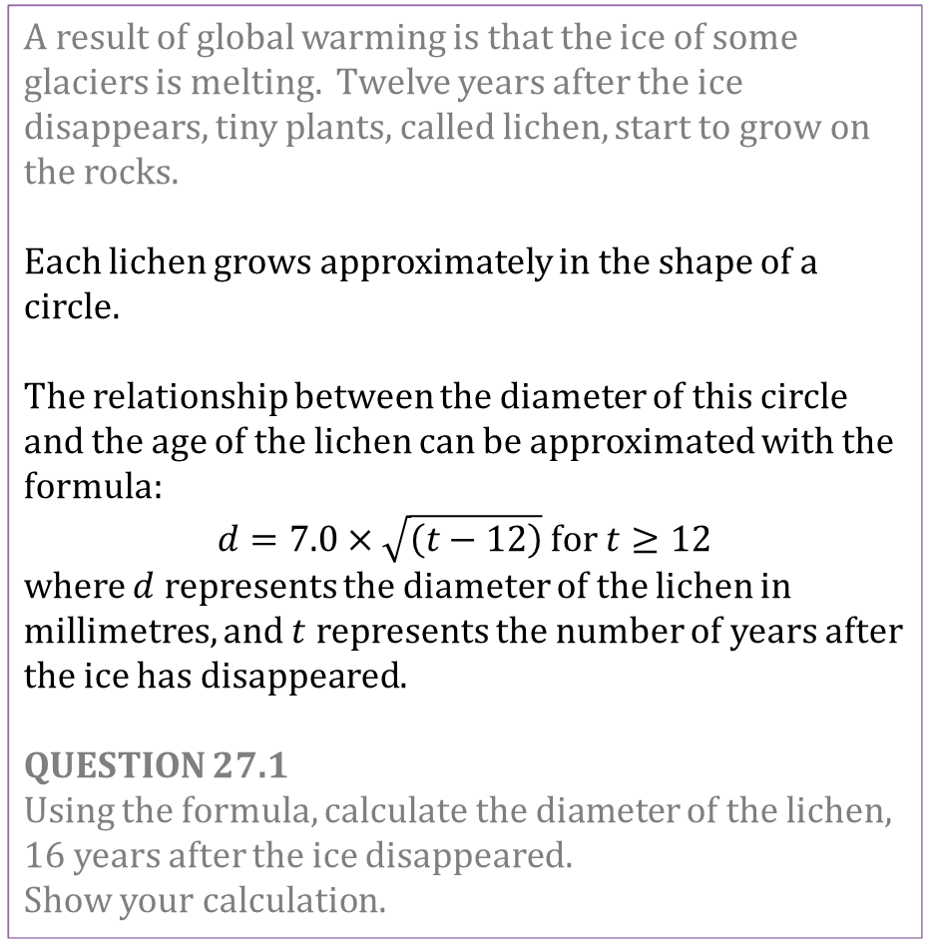
Mathematics Unit 27: Lichen
A result of global warming is that the ice of some glaciers is melting. Twelve years after the ice disappears, tiny plants, called lichen, start to grow on the rocks.
Each lichen grows approximately in the shape of a circle.
The relationship between the diameter of this circle and the age of the lichen can be approximated with the formula:
$d=7.0×\sqrt{\left(t−12\right)}$ for $t≥12$
where $d$ represents the diameter of the lichen in millimetres, and $t$ represents the number of years after the ice has disappeared.
QUESTION 27.1
Using the formula, calculate the diameter of the lichen, 16 years after the ice disappeared.
Show your calculation.
What do we want to find out?
What useful information do we know?
What other mathematical techniques do we need to apply?
What have we learned?
Back to start

Slide 4
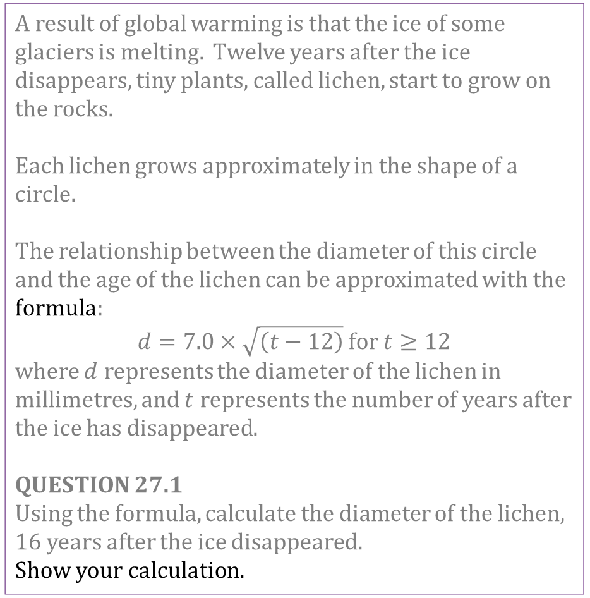
Mathematics Unit 27: Lichen
A result of global warming is that the ice of some glaciers is melting. Twelve years after the ice disappears, tiny plants, called lichen, start to grow on the rocks.
Each lichen grows approximately in the shape of a circle.
The relationship between the diameter of this circle and the age of the lichen can be approximated with the formula:
$d=7.0×\sqrt{\left(t−12\right)}$ for $t≥12$
where $d$ represents the diameter of the lichen in millimetres, and $t$ represents the number of years after the ice has disappeared.
QUESTION 27.1
Using the formula, calculate the diameter of the lichen, 16 years after the ice disappeared.
Show your calculation.
What do we want to find out?
What useful information do we know?
What other mathematical techniques do we need to apply?
What have we learned?
Back to start

Slide 5
Mathematics Unit 27: Lichen
A result of global warming is that the ice of some glaciers is melting. Twelve years after the ice disappears, tiny plants, called lichen, start to grow on the rocks.
Each lichen grows approximately in the shape of a circle.
The relationship between the diameter of this circle and the age of the lichen can be approximated with the formula:
$d=7.0×\sqrt{\left(t−12\right)}$ for $t≥12$
where $d$ represents the diameter of the lichen in millimetres, and $t$ represents the number of years after the ice has disappeared.
QUESTION 27.1
Using the formula, calculate the diameter of the lichen, 16 years after the ice disappeared.
Show your calculation.
What do we want to find out?
What useful information do we know?
What other mathematical techniques do we need to apply?
What have we learned?
Back to start

Slide 6
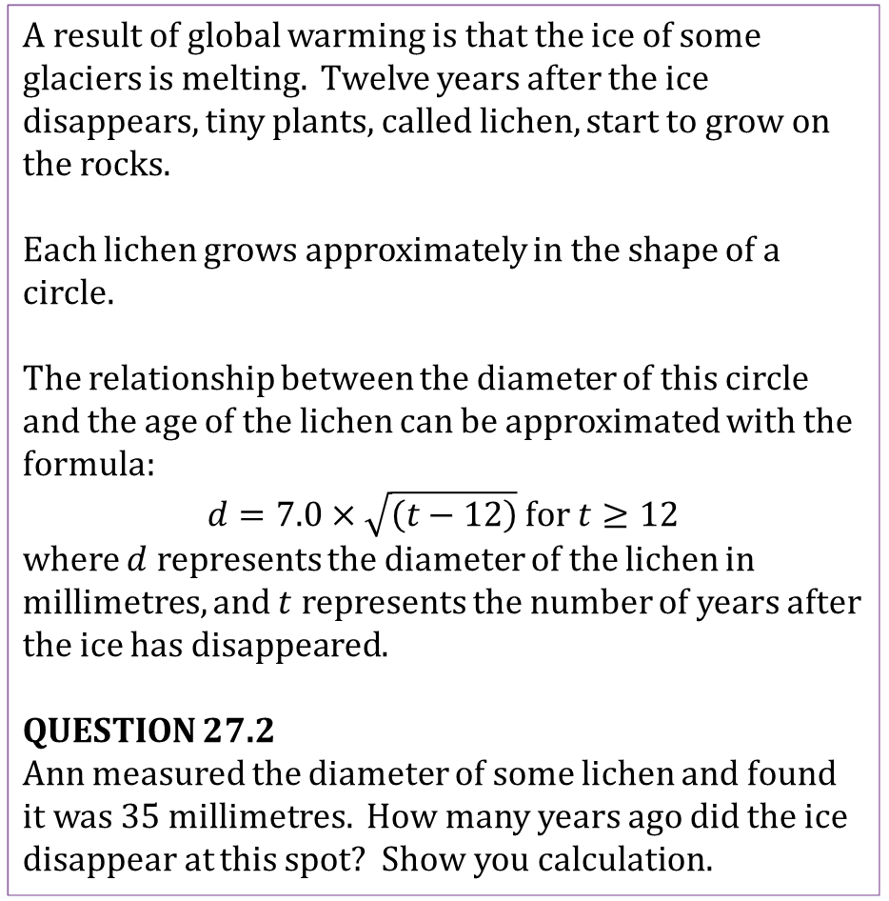
Mathematics Unit 27: Lichen
A result of global warming is that the ice of some glaciers is melting. Twelve years after the ice disappears, tiny plants, called lichen, start to grow on the rocks.
Each lichen grows approximately in the shape of a circle.
The relationship between the diameter of this circle and the age of the lichen can be approximated with the formula:
$d=7.0×\sqrt{\left(t−12\right)}$ for $t≥12$
where $d$ represents the diameter of the lichen in millimetres, and $t$ represents the number of years after the ice has disappeared.
QUESTION 27.2
Ann measured the diameter of some lichen and found it was 35 millimetres. How many years ago did the ice disappear at this spot? Show you calculation.
What do we want to find out?
What useful information do we know?
What other mathematical techniques do we need to apply?
What have we learned?

Slide 7
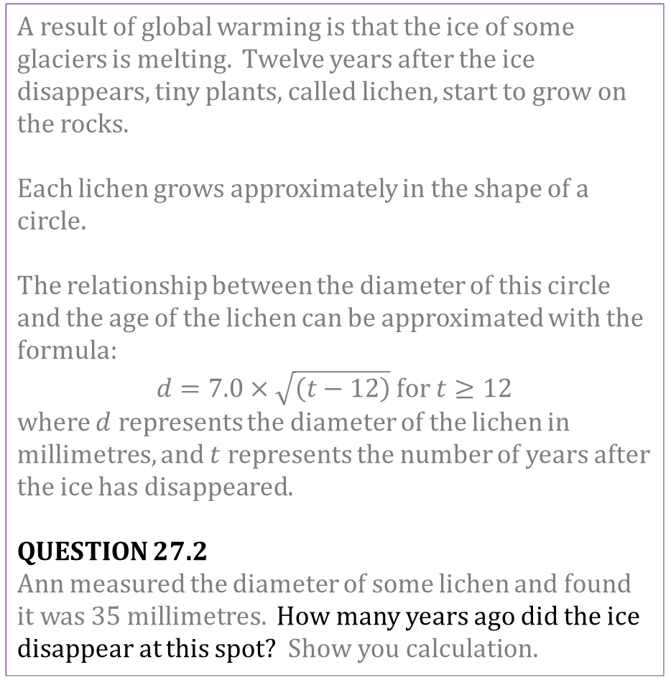
Mathematics Unit 27: Lichen
A result of global warming is that the ice of some glaciers is melting. Twelve years after the ice disappears, tiny plants, called lichen, start to grow on the rocks.
Each lichen grows approximately in the shape of a circle.
The relationship between the diameter of this circle and the age of the lichen can be approximated with the formula:
$d=7.0×\sqrt{\left(t−12\right)}$ for $t≥12$
where $d$ represents the diameter of the lichen in millimetres, and $t$ represents the number of years after the ice has disappeared.
QUESTION 27.2
Ann measured the diameter of some lichen and found it was 35 millimetres. How many years ago did the ice disappear at this spot? Show you calculation.
What do we want to find out?
What useful information do we know?
What other mathematical techniques do we need to apply?
What have we learned?
Back to start

Slide 8
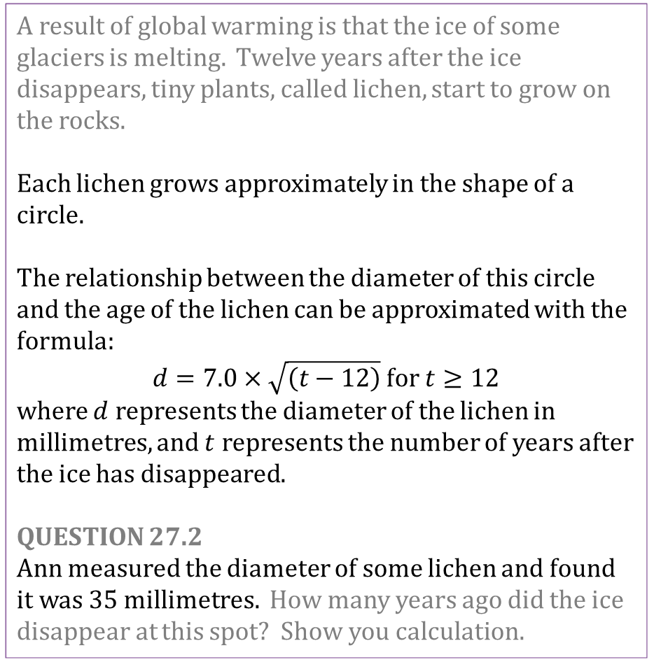
Mathematics Unit 27: Lichen
A result of global warming is that the ice of some glaciers is melting. Twelve years after the ice disappears, tiny plants, called lichen, start to grow on the rocks.
Each lichen grows approximately in the shape of a circle.
The relationship between the diameter of this circle and the age of the lichen can be approximated with the formula:
$d=7.0×\sqrt{\left(t−12\right)}$ for $t≥12$
where $d$ represents the diameter of the lichen in millimetres, and $t$ represents the number of years after the ice has disappeared.
QUESTION 27.2
Ann measured the diameter of some lichen and found it was 35 millimetres. How many years ago did the ice disappear at this spot? Show you calculation.
What do we want to find out?
What useful information do we know?
What other mathematical techniques do we need to apply?
What have we learned?
Back to start

Slide 9
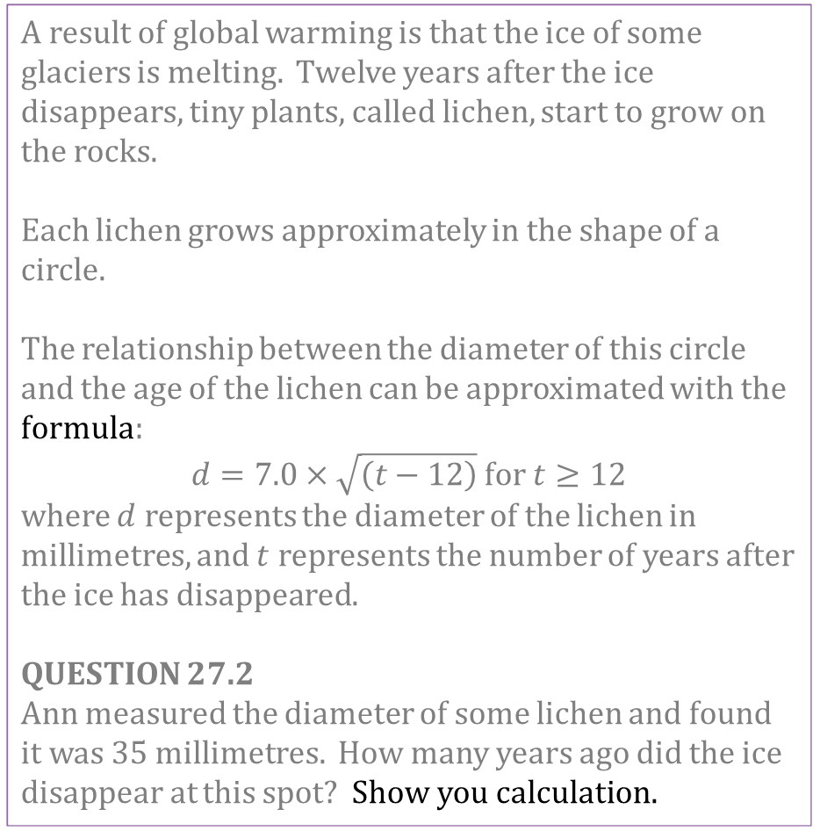
Mathematics Unit 27: Lichen
A result of global warming is that the ice of some glaciers is melting. Twelve years after the ice disappears, tiny plants, called lichen, start to grow on the rocks.
Each lichen grows approximately in the shape of a circle.
The relationship between the diameter of this circle and the age of the lichen can be approximated with the formula:
$d=7.0×\sqrt{\left(t−12\right)}$ for $t≥12$
where $d$ represents the diameter of the lichen in millimetres, and $t$ represents the number of years after the ice has disappeared.
QUESTION 27.2
Ann measured the diameter of some lichen and found it was 35 millimetres. How many years ago did the ice disappear at this spot? Show you calculation.
What do we want to find out?
What useful information do we know?
What other mathematical techniques do we need to apply?
What have we learned?
Back to start

Slide 10
Mathematics Unit 27: Lichen
A result of global warming is that the ice of some glaciers is melting. Twelve years after the ice disappears, tiny plants, called lichen, start to grow on the rocks.
Each lichen grows approximately in the shape of a circle.
The relationship between the diameter of this circle and the age of the lichen can be approximated with the formula:
$d=7.0×\sqrt{\left(t−12\right)}$ for $t≥12$
where $d$ represents the diameter of the lichen in millimetres, and $t$ represents the number of years after the ice has disappeared.
QUESTION 27.2
Ann measured the diameter of some lichen and found it was 35 millimetres. How many years ago did the ice disappear at this spot? Show you calculation.
What do we want to find out?
What useful information do we know?
What other mathematical techniques do we need to apply?
What have we learned?
Back to start

