Slide 1
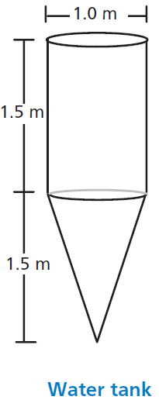
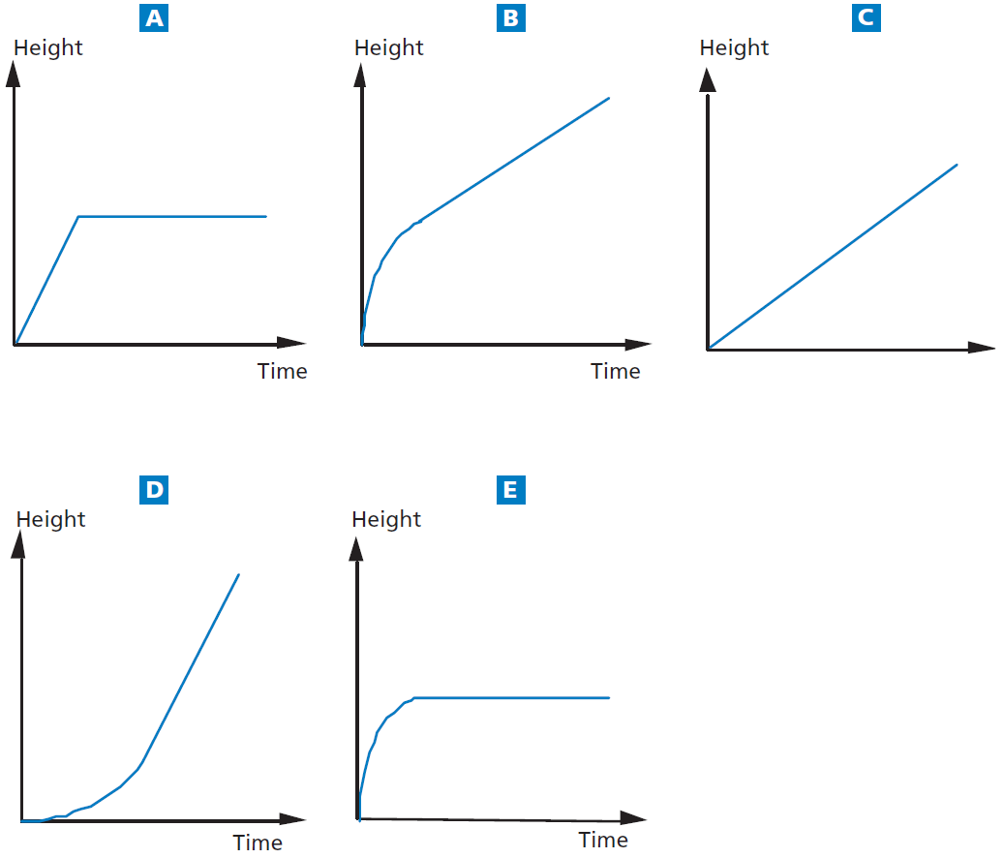
Mathematics Unit 36: Water Tank
QUESTION 36.1
A water tank has shape and
dimensions as shown in the diagram.
At the beginning the tank is empty.
Then it is filled with water at the rate
of one litre per second.
Which of the following graphs shows
how the height of the water surface
changes over time?
What do we want to find out?
What useful information do we know?
What other mathematical techniques do we need to apply?
What have we learned?

Slide 2
Mathematics Unit 36: Water Tank
QUESTION 36.1
A water tank has shape and
dimensions as shown in the diagram.
At the beginning the tank is empty.
Then it is filled with water at the rate
of one litre per second.
Which of the following graphs shows
how the height of the water surface
changes over time?
What do we want to find out?
What useful information do we know?
What other mathematical techniques do we need to apply?
What have we learned?
Back to start

Slide 3
Mathematics Unit 36: Water Tank
QUESTION 36.1
A water tank has shape and
dimensions as shown in the diagram.
At the beginning the tank is empty.
Then it is filled with water at the rate
of one litre per second.
Which of the following graphs shows
how the height of the water surface
changes over time?
What do we want to find out?
What useful information do we know?
What other mathematical techniques do we need to apply?
What have we learned?
Back to start

Slide 4
Mathematics Unit 36: Water Tank
QUESTION 36.1
A water tank has shape and
dimensions as shown in the diagram.
At the beginning the tank is empty.
Then it is filled with water at the rate
of one litre per second.
Which of the following graphs shows
how the height of the water surface
changes over time?
What do we want to find out?
What useful information do we know?
What other mathematical techniques do we need to apply?
What have we learned?
Back to start

Slide 5
Mathematics Unit 36: Water Tank
QUESTION 36.1
A water tank has shape and
dimensions as shown in the diagram.
At the beginning the tank is empty.
Then it is filled with water at the rate
of one litre per second.
Which of the following graphs shows
how the height of the water surface
changes over time?
What do we want to find out?
What useful information do we know?
What other mathematical techniques do we need to apply?
What have we learned?
Back to start

