Slide 1
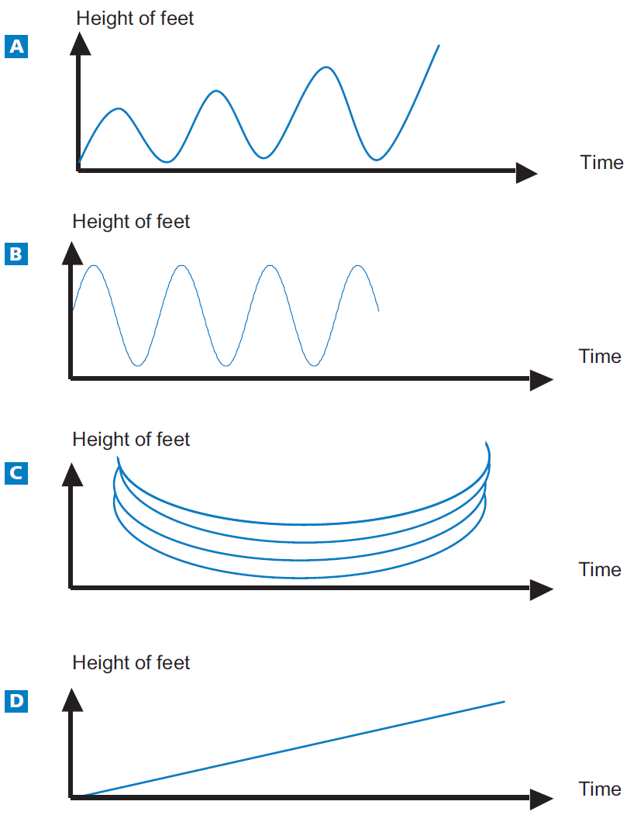
Mathematics Unit 38: Swing
QUESTION 38.1
Mohammed is sitting on a swing. He starts to swing. He is trying to go as high as possible.
Which diagram best represents the height of his feet above the ground as he swings?
What do we want to find out?
What useful information do we know?
What other mathematical techniques do we need to apply?
What have we learned?

Slide 2
Mathematics Unit 38: Swing
QUESTION 38.1
Mohammed is sitting on a swing. He starts to swing. He is trying to go as high as possible.
Which diagram best represents the height of his feet above the ground as he swings?
What do we want to find out?
What useful information do we know?
What other mathematical techniques do we need to apply?
What have we learned?
Back to start

Slide 3
Mathematics Unit 38: Swing
QUESTION 38.1
Mohammed is sitting on a swing. He starts to swing. He is trying to go as high as possible.
Which diagram best represents the height of his feet above the ground as he swings?
What do we want to find out?
What useful information do we know?
What other mathematical techniques do we need to apply?
What have we learned?
Back to start

Slide 4
Mathematics Unit 38: Swing
QUESTION 38.1
Mohammed is sitting on a swing. He starts to swing. He is trying to go as high as possible.
Which diagram best represents the height of his feet above the ground as he swings?
What do we want to find out?
What useful information do we know?
What other mathematical techniques do we need to apply?
What have we learned?
Back to start

Slide 5
Mathematics Unit 38: Swing
QUESTION 38.1
Mohammed is sitting on a swing. He starts to swing. He is trying to go as high as possible.
Which diagram best represents the height of his feet above the ground as he swings?
What do we want to find out?
What useful information do we know?
What other mathematical techniques do we need to apply?
What have we learned?
Back to start

