Slide 1
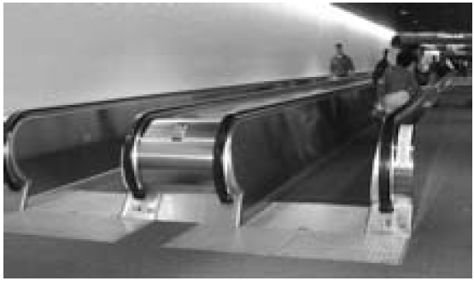
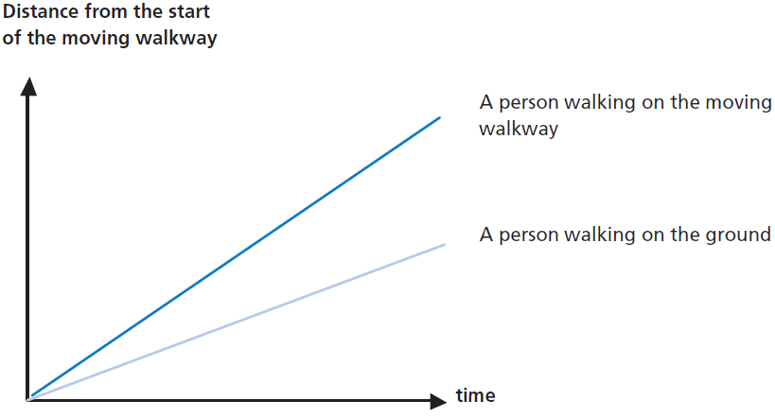
Mathematics Unit 49: Moving Walkways
QUESTION 49.1
On the right is a photograph of
moving walkways.
The following Distance-Time
graph shows a comparison between “walking on the moving walkway” and “walking on the ground next to the moving walkway.”
Assuming that, in the above graph, the walking pace is about the same for both persons, add a line to the graph that would represent the distance versus time for a person who is standing still on the moving walkway.
What do we want to find out?
What useful information do we know?
What other mathematical techniques do we need to apply?
What have we learned?

Slide 2
Mathematics Unit 49: Moving Walkways
QUESTION 49.1
On the right is a photograph of
moving walkways.
The following Distance-Time
graph shows a comparison between “walking on the moving walkway” and “walking on the ground next to the moving walkway.”
Assuming that, in the above graph, the walking pace is about the same for both persons, add a line to the graph that would represent the distance versus time for a person who is standing still on the moving walkway.
What do we want to find out?
What useful information do we know?
What other mathematical techniques do we need to apply?
What have we learned?
Back to start

Slide 3
Mathematics Unit 49: Moving Walkways
QUESTION 49.1
On the right is a photograph of
moving walkways.
The following Distance-Time
graph shows a comparison between “walking on the moving walkway” and “walking on the ground next to the moving walkway.”
Assuming that, in the above graph, the walking pace is about the same for both persons, add a line to the graph that would represent the distance versus time for a person who is standing still on the moving walkway.
What do we want to find out?
What useful information do we know?
What other mathematical techniques do we need to apply?
What have we learned?
Back to start

Slide 4
Mathematics Unit 49: Moving Walkways
QUESTION 49.1
On the right is a photograph of
moving walkways.
The following Distance-Time
graph shows a comparison between “walking on the moving walkway” and “walking on the ground next to the moving walkway.”
Assuming that, in the above graph, the walking pace is about the same for both persons, add a line to the graph that would represent the distance versus time for a person who is standing still on the moving walkway.
What do we want to find out?
What useful information do we know?
What other mathematical techniques do we need to apply?
What have we learned?
Back to start

Slide 5
Mathematics Unit 49: Moving Walkways
QUESTION 49.1
On the right is a photograph of
moving walkways.
The following Distance-Time
graph shows a comparison between “walking on the moving walkway” and “walking on the ground next to the moving walkway.”
Assuming that, in the above graph, the walking pace is about the same for both persons, add a line to the graph that would represent the distance versus time for a person who is standing still on the moving walkway.
What do we want to find out?
What useful information do we know?
What other mathematical techniques do we need to apply?
What have we learned?
Back to start

