Slide 1
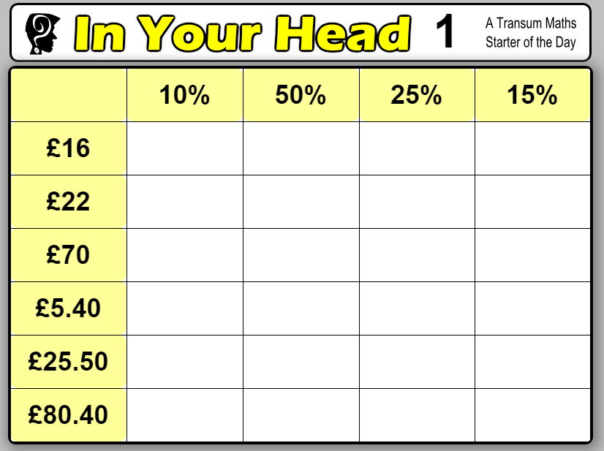
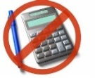
The Price is Right
Mae’r Pris yn Iawn
http://www.transum.org/Software/SW/Starter_of_the_day/starter_September29.ASP
Notes:
Starter Task (10 mins) – Individual work then answers as whole class. Practice and review calculating percentages mentally.

Slide 2
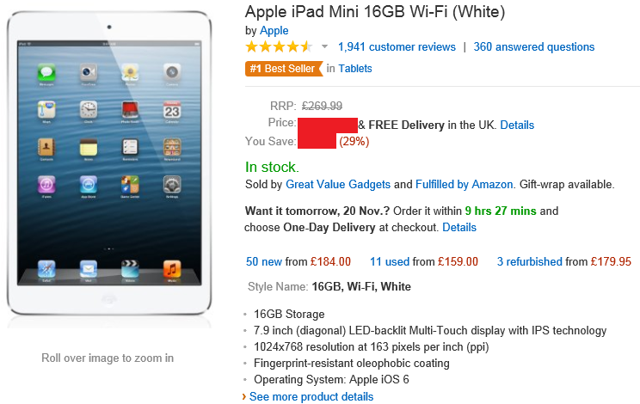
The Price is Right
Mae’r Pris yn Iawn
How much money do you save and what is the sale price?
Saving: 29% of £269.99 = £78.30
Sale price: £269.99 - £78.30 = £191.69
Notes:
Real life question to think about decreasing by a specified percentage

Slide 3
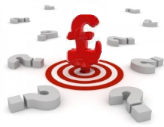
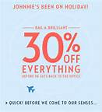
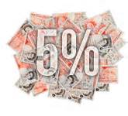
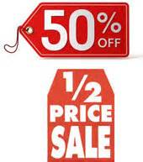
The Price is Right
Mae’r Pris yn Iawn
MLO: Learn to calculate percentage increase and decrease quickly.
Notes:
MLO

Slide 4
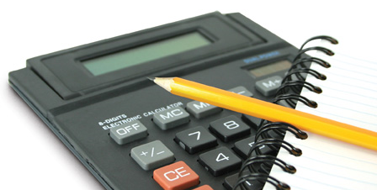
In groups, investigate which calculation is correct. Explain why the calculation works.
The Price is Right
Mae’r Pris yn Iawn
Notes:
Investigation into multipliers when increasing by a percent. Encourage learners to think about where the ‘1.23’ has come from once they have identified the correct calculation.

Slide 5
In groups, investigate which calculation is correct. Explain why the calculation works.
The Price is Right
Mae’r Pris yn Iawn
Notes:
Investigation into multipliers when decreasing by a percent. Encourage learners to think about where the ‘0.77’ has come from once they have identified the correct calculation.

Slide 6
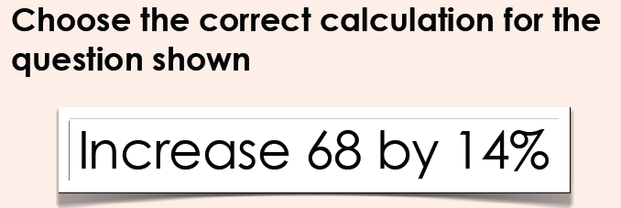
The Price is Right
Mae’r Pris yn Iawn
Notes:
practice

Slide 7
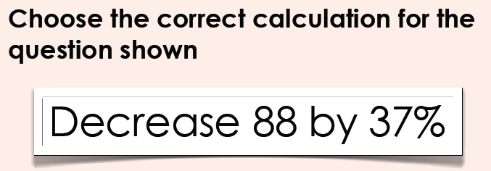
The Price is Right
Mae’r Pris yn Iawn
Notes:
practice

Slide 8
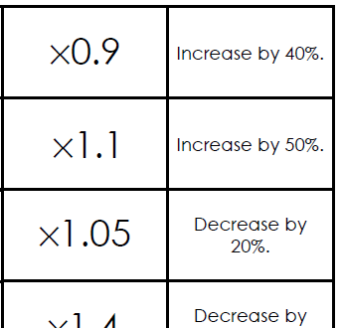
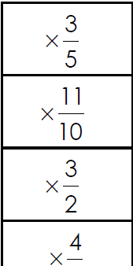
TASK: Match the worded explanation to the decimal multiplier. EXT: Match the fractional multiplier to your pairs.
The Price is Right
Mae’r Pris yn Iawn
Notes:
Matching task to embed the learning. Extension – using fractional equivalences to the decimal multipliers.

Slide 9
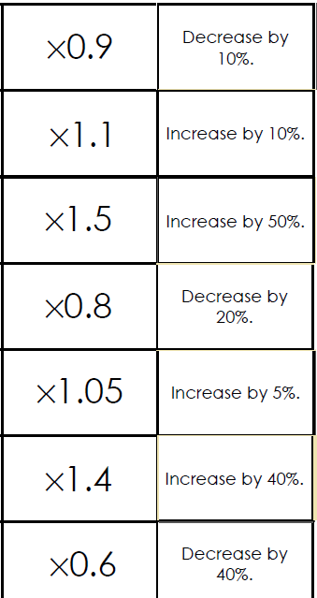
Answers:
The Price is Right
Mae’r Pris yn Iawn
Notes:
Quick summary of answers for assessment and reflection purposes.

Slide 10
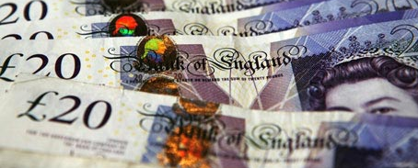
Which would you prefer?
The Price is Right
Mae’r Pris yn Iawn
80% of £20
20% of £80
Does this always happen?
Research this for next lesson.
Notes:
Plenary to encourage further thought about the way we calculate percentages.

