Slide 1
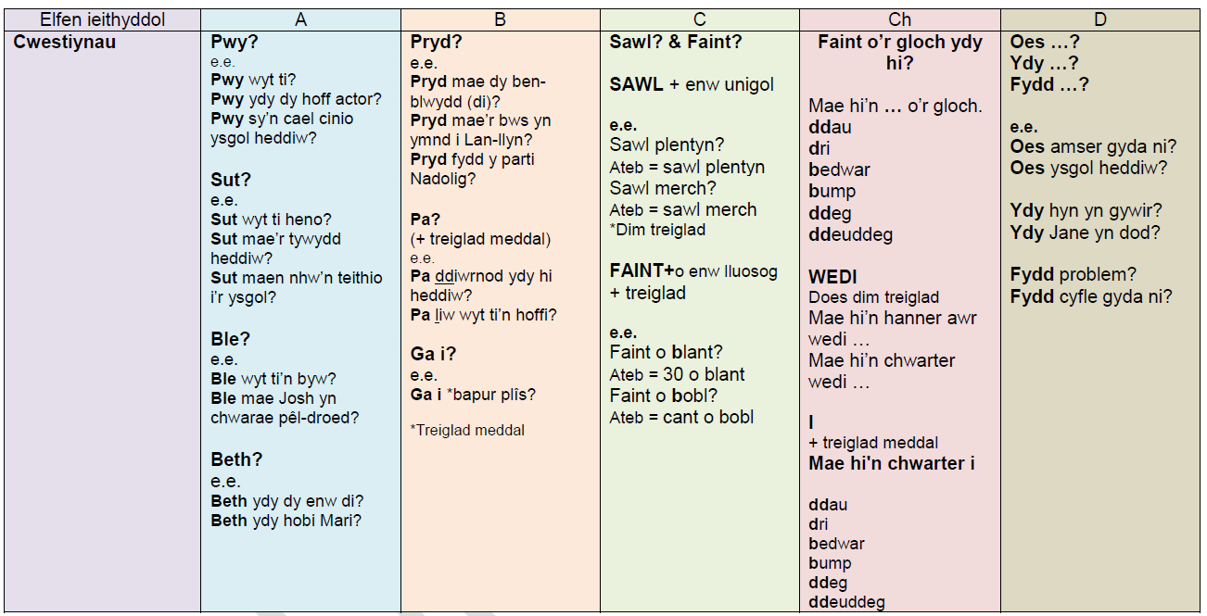

Slide 2
Sawl / Faint o (How many)
Sawl… = How many…
Faint o… = How many…

Slide 3
Sawl (How many) + singular
3
Sawl diwrnod? How many days?
Ateb = number diwrnod (tri diwrnod)
Sawl merch?
Ateb = saith merch
Sawl tîm pel droed?
Ateb = un tîm pel droed
Sawl athro?
Ateb = dau athro

Slide 4
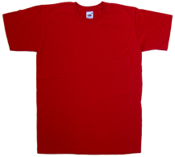
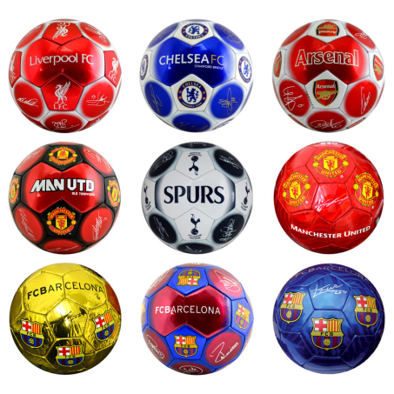
Sawl… How many…
Please write the following questions – and answer them.
Sawl crys t?
Sawl Nando’s?
Sawl paced o greision?
Sawl pêl droed?
Sawl mwnci?

Slide 5
Sawl (How many) – Atebion Answers
Please write the following questions – and answer them.
Sawl crys t? Tri crys t
Sawl Nandos? Pump Nandos
Sawl paced o greision? Pedwar paced o greision
Sawl pêl droed? Naw pêl droed
Sawl mwnci? Wyth mwnci

Slide 6
Faint… (How many…) + plural
Faint o = How many (Faint o gemau xbox oes gen ti? How many xbox games do you have?)
Faint also means = How much (Faint mae’n gostio = How much does it cost)
Faint is ALSO used as (Faint o’r gloch)
We will only focus on the ‘How many’ rule today.

