Slide 1
Learning Outcomes
To investigate the social and political developments, of the Weimar, between 1924-29
To consider how Weimar paintings and cinema can explain life in Weimar Germany

Slide 2
Political Developments

Slide 3
Weimar Election results 1924-28
 | May 1924 | December 1924 | May 1928
Social Democrats | 100 | 131 | 153
National Party (DNVP) | 95 | 103 | 73
Communist Party (KPD) | 62 | 45 | 54
Nazi Party (NSDAP) | 32 | 14 | 12
What can you learn about the Weimar Republic from the election results above?

Slide 4
The period 1924-29 saw greater political stability with the Social Democrats winning most of the votes, although still no majority!
There was less support for extremist groups such as the Communist and the Nazis.

Slide 5
Why was there political stability between 1924-29?
Economic recovery
Success abroad
Stresemann
Hindenburg

Slide 6
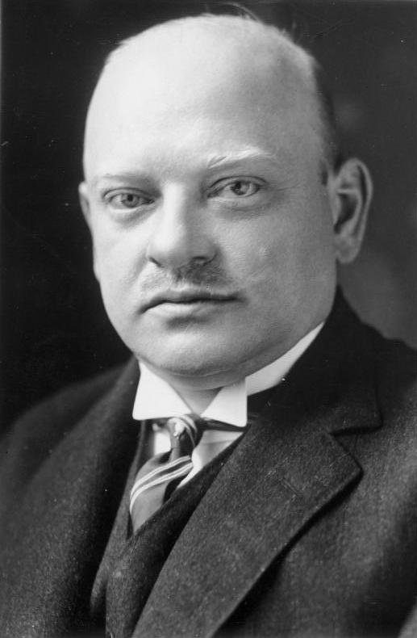
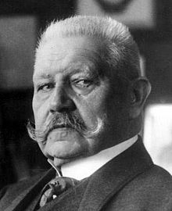
Stresemann & Hindenburg
Stresemann’s successes abroad made him the most popular political leader of the Weimar Republic
Hindenburg had been one of Germany’s war leaders. In 1925 he was elected president, which demonstrated that the old conservative order now accepted the Republic.

Slide 7
Social Developments The period 1924-29 is described as a ‘golden age’ in the Weimar Republic due to significant changes in the standard of living, the position of women and in culture.

Slide 8
Standard of living
Wages
For many Germans these years saw an improvement in wages. By 128 there had been an increase in real wages of over 10 percent which meant Germany had some of the best paid workers in Europe.
However, many of the middle classes did not share in this increased prosperity; many of them had been bankrupted by the hyperinflation of 1923. Whilst unemployment fell generally it remained high for those who worked in the professions such as lawyers.

Slide 9
Standard of living
Housing
The Weimar worked hard to deal with the housing shortage in Germany. They employed architects and planners to devise ways of reducing housing shortages.
Between 1924 and 1931 more than two million new homes were built, while almost 200,000 more were renovated or expanded. By 1928 homelessness had been reduced by more than 60%

Slide 10
Standard of living
Unemployment insurance
The Weimar government created the Unemployment Insurance Law in 1927. This required workers and employees to make contributions to a national scheme for unemployment welfare.
Other reforms provided benefit and assistance to war veterans, wives and dependants of the war dead, single mothers and the disabled.

Slide 11
The position of women
Table showing women in employment in Germany between 1907 – 25. The figures show the percentage of the workforce that was female
Type of employment | 1907 | 1925
Domestic servants | 16 | 11.4
Farm workers | 14.5 | 9.2
Industrial workers | 18.3 | 23
White collar and public employment | 6.5 | 12.6
Percentage of women in employment | 31.2 | 35.6
What can you learn, from the table above, about changes in the employment of women in the years 1907 -25?

Slide 12
The position of women
In 1919 women over 20 were given the vote and took an increasing interest in politics.
The Weimar Constitution introduced equality in education for the sexes, equal opportunity in civil service appointments and equal pay in the professions.
By 1933 there were 100,000 women teachers and 3000 doctors

Slide 13
Cultural changes
What do we meant by culture?
Art
Architectures
Cinema
Literature

Slide 14
Cultural changes
The Golden age of the Weimar Republic (1924-1929) saw many changes to the cultural life in Germany. There was a resurgence of creative flair that made Berlin the centre of art and culture of the world.
Many new movements such as expressionism and modernism shaped the culture of the time and this is represented in, among other things, the architecture of the time.

Slide 15
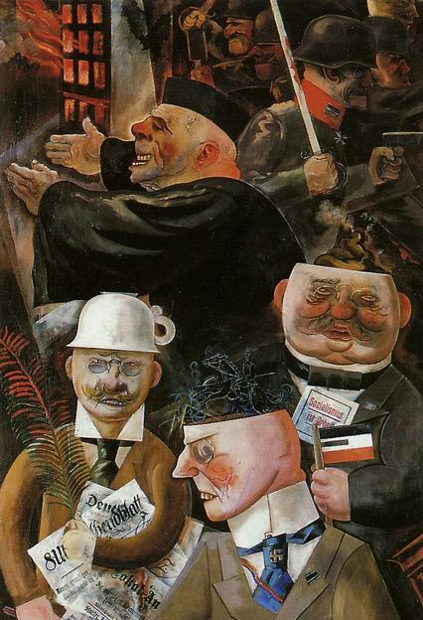
Art
Pre war censorship was removed by the Weimar government and this period saw the emergence of some of the most exciting art in Europe.
Most Weimar artists tried to show everyday life commenting on the society of the time. This approach was called ‘new objectivity’ and was associated with painters such as George Grosz and Otto Dix.

Slide 16
Architecture
New architectural designs brought on by the cultural and societal ideas especially modernism
These new designs challenged the traditions of architecture
In 1919 Walter Gropius founded the famous Bauhaus School for architecture.
At this new school Gropius taught that art should work with the new technology and that there should be an emphasis on functional design in buildings.

Slide 17
Architecture
Architecture flourished under the Bauhaus which meant ‘school of building’.
Their approach was very different from the elaborate and decorative style of pre war Germany.
Their slogan was ‘art and technology- a new unity.’
https://prezi.com/myya5xarl6mo/architecture-in-the-weimar-republic/

Slide 18

Cinema
Like in art Berlin became the world leader of Cinema. In fact Germany in the 1920’s produced more films than the rest of Europe put together.
This period was the home to many brilliant directors, such as Fritz Lang, Joseph von Sternberg and Ernst Lubitsch.

Slide 19
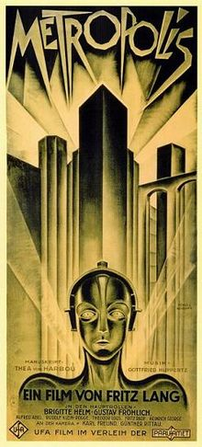
Cinema
It produced ‘cinematic masterpieces’ such as Metropolis, The Cabinet of DR Caligari, Nosferatu and The Blue Angel.
The film Metropolis, is acclaimed as the most technically advanced film of the decade.

Slide 20

Literature
This period encourages literature from both the left and the right in politics:
On the right, writers such as Arthur Moller were highly critical of German democracy and glorified the experiences of the first World War.
On the left writers such as Ludwig Renn were very anti war. Erich Remarque wrote a moving anti war novel called All Quiet on the Western front, which describes the horrors of the First World War.

Slide 21
Theatre
Provocative theatre and Cabaret flourished
Many works had a satirical edge
The playwright Erwin Piscator developed the Proletarian Theatre, which produced plays that challenged the values of the traditional middle class.
Another famous playwright of the time was a Marxist called Bertolt Brecht who voiced his communist opinions in his works

Slide 22
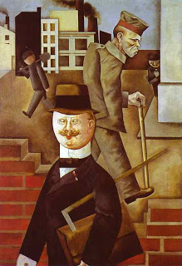
Task
What can you learn from this source about attitudes to the Weimar Republic?

Slide 23
A faceless worker
A maimed soldier.; he only has one arm and has been forgotten
A business man

Slide 24
Factory setting
The badge shows that he supports the monarchy rather than the Republic
The crumbling wall represents the crumbling Weimar

Slide 25
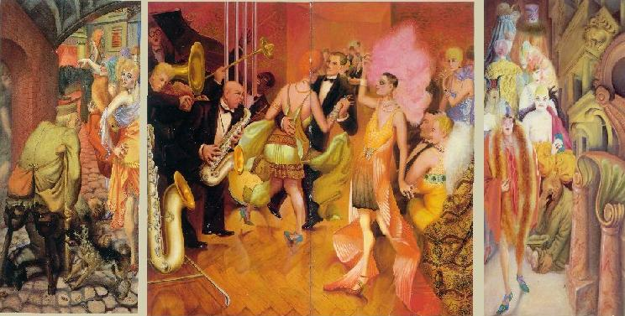

Slide 26
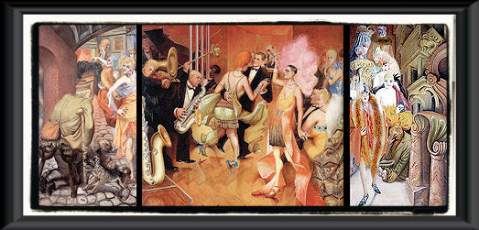
Dix shows us the differences in classes of the people in the Weimar Republic. He is showing us the pity he feels for both the prostitutes and cripples of Germany. By placing these three different classes right next to each other, Dix is showing the variation found in the quality of life between these groups.

Slide 27
In he centre Dix portrays the upper class of people in the Weimar Republic. In the foreground, we see a woman in a long, ornate dress. She is wearing a lot of jewellery, which makes it obvious that she is wealthy.
There is a band playing in the room and we can see a couple dancing. All of the figures in this section seem to be beautiful, carefree, and appear to be having a splendid time. By their actions, it is assumed that these people do not care at all about any other people than themselves. They are partying and seeming to have a good time while just outside, people are starving and resulting to prostitution to fill their basic human needs. .

Slide 28
On the left and right hand portions of, Dix has painted two scenes of crippled war veterans and prostitutes. In the right hand portion of the painting, Dix has painted high-class prostitutes. The material that their clothes are made of appears to be more expensive than the material used in the clothing of the prostitutes on the left hand side. The clothing of the women in the right hand panel displays female sexuality.
Even the soldier on the right hand part of the painting looks more well to do than the soldiers on the left. He is sitting up saluting the prostitutes as they walk by him.

Slide 29
Low class prostitutes occupy the left hand portion of the painting. The background that Dix has painted these women on is dark and dreary. The cobblestone that they are walking on appears worn and cheap. The women are also painted under a bridge. The dog in the foreground of this portion appears to be upset and ready to attack the cripple who is attempting to move around on cheap prosthetic legs. The look on the standing cripples face is of pure lust. The other veteran in this painting is lying on the ground appearing to look up the skirt of the prostitutes that is walking by. The women have disgusted looks on their faces and appear more worn down than the prostitutes on the right hand portion of the painting. Though the group of prostitutes on the left side of the painting appears to be worse off than the ones on the right, both of these groups of women are corrupt and none of the women in either of these groups are considered respected members of society

