Slide 1






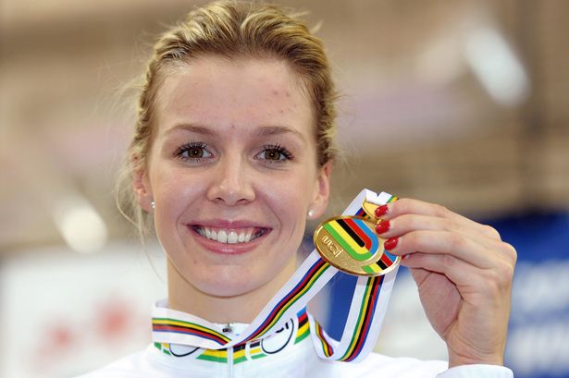
Draw a line to the matching picture. One is done as an example.
Rhedeg | Tennis | Pêl -droed | Golff | Nofio | Sglefrio | Syrffio | Merlota | Sgio | Tennis - bwrdd
/ 10
Becky James
Sion has written about his favourite Welsh sports star – the cyclist Becky James. Your task is to mark Sion’s work according to the success criteria (meini prawf llwyddiant). Add the score up and fill the box in red on the right.
Yn fy marn i dw i’n caru Becky James!
Mae hi’n chwaraewraig anhygoel.
Heb os nac oni bai Becky James ydy fy hoff bersonoliaeth chwaraeon.
Mae hi’n wych!
Sawl pwynt / How many points:
______
Meini Prawf Llwyddiant
Phrases – 5 points
Opinion – 4 points
Adjectives – 4 points
chwaraewraig / sportswoman
bersonoliaeth / personality

