Slide 1




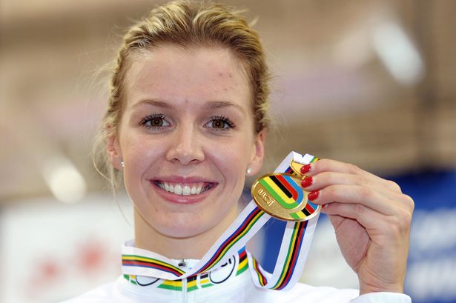
Draw a line to the matching picture. One is done as an example.
Becky James
Sion has written about his favourite Welsh sports star – the cyclist Becky James. Your task is to mark Sion’s work according to the success criteria (meini prawf llwyddiant). Add the score up at the end.
Yn fy marn i dw i’n caru Becky James!
Mae hi’n chwaraewraig anhygoel.
Heb os nac oni bai Becky James ydy fy hoff bersonoliaeth chwaraeon.
Mae hi’n wych!
Sawl pwynt / How many points:
______
Meini Prawf Llwyddiant
Phrases – 5 points
Opinion – 4 points
Adjectives – 4 points
1
chwaraewraig / sportswoman
bersonoliaeth / personality

