Slide 1
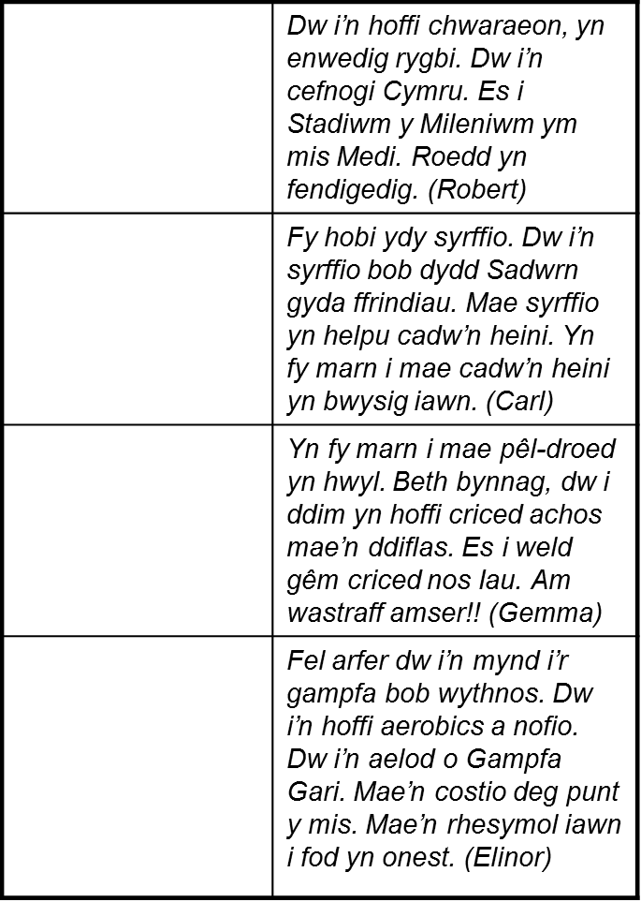
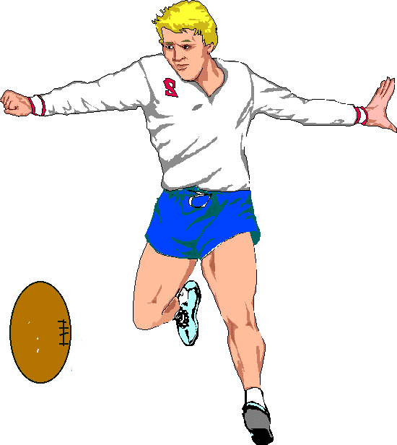
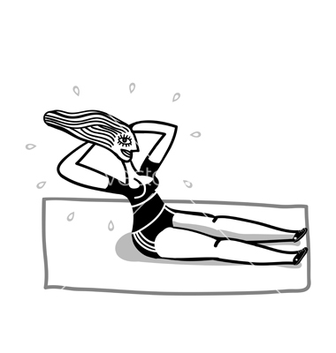
1. Trafodwch sylwadau’r bobl ifanc.
(Discuss the young people’s comments)
2. Pa chwaraeon ydych chi’n hoffi? Pam?
(What sports do you like? Why?)
3. Pa chwaraeon dydych chi ddim yn hoffi?
(What sports don’t you like?)
4. Siaradwch am gêm rydych chi wedi
gwylio neu chwarae yn ddiweddar.
(Talk about a game that you have watched or played recently)
1

Slide 2
Trafod Sylwadau’r bobl ifanc Discuss the young people’s comments
_______________________________________________
_______________________________________________
_______________________________________________
_______________________________________________
_______________________________________________
_______________________________________________
_______________________________________________
_______________________________________________
_______________________________________________
_______________________________________________
_______________________________________________
_______________________________________________
_______________________________________________
_______________________________________________
_______________________________________________
_______________________________________________
_______________________________________________
_______________________________________________
_______________________________________________
__________________________
__________________________
__________________________
__________________________
Mae Name yn dweud / Name says…
Es i / I went to
Chwaraeais i / I Played
Chwaraeodd Name / Name played
Hoffwn i chwarae / I would like to play…
Gwyliais i / I watched
2
If you need more paper please go to the back of your booklet – remember to include the title and date.

