Slide 1
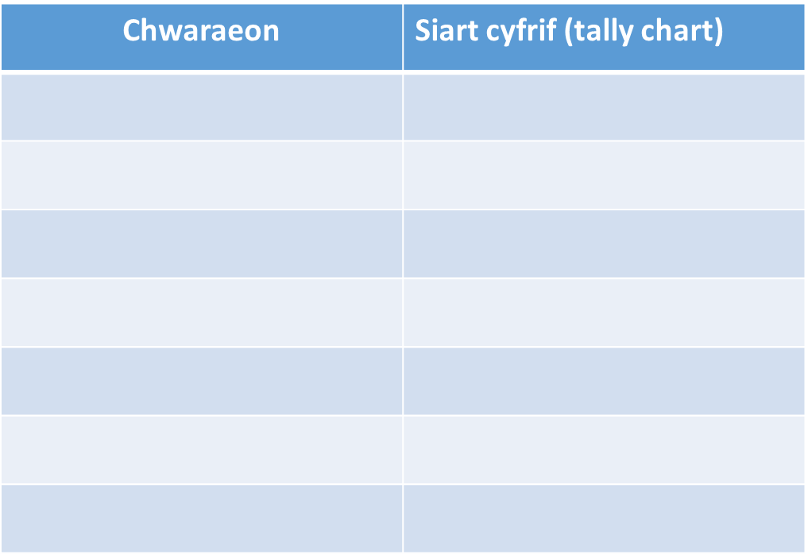
Ask other members of your class the following question; “P’un ydy dy hoff chwaraeon?” then make a tally chart based upon up to 7 different sports (chwaraeon). To respond you should say “fy hoff chwaraeon ydy_______”.
Now draw a bar chart to show your results.
1
chwaraeon / sports p’un / which fy hoff / my favourite

