Slide 1
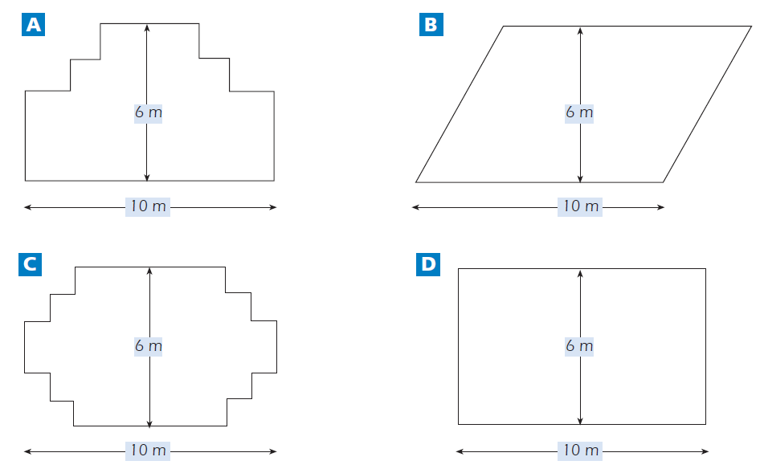
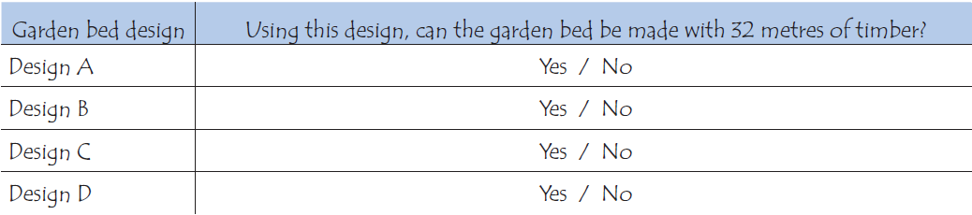
Mathematics Unit 10: Carpenter
QUESTION 10.1
A carpenter has 32 metres of timber and wants to make a border around a garden bed. He is considering the following designs for the garden bed.
Circle either “Yes” or “No” for each design to indicate whether the garden bed can be made with 32 metres of timber.
What do we want to find out?
What useful information do we know?
What other mathematical techniques do we need to apply?
What have we learned?

Slide 2
Mathematics Unit 10: Carpenter
QUESTION 10.1
A carpenter has 32 metres of timber and wants to make a border around a garden bed. He is considering the following designs for the garden bed.
Circle either “Yes” or “No” for each design to indicate whether the garden bed can be made with 32 metres of timber.
What do we want to find out?
What useful information do we know?
What other mathematical techniques do we need to apply?
What have we learned?
Back to start

Slide 3
Mathematics Unit 10: Carpenter
QUESTION 10.1
A carpenter has 32 metres of timber and wants to make a border around a garden bed. He is considering the following designs for the garden bed.
Circle either “Yes” or “No” for each design to indicate whether the garden bed can be made with 32 metres of timber.
What do we want to find out?
What useful information do we know?
What other mathematical techniques do we need to apply?
What have we learned?
Back to start

Slide 4
Mathematics Unit 10: Carpenter
QUESTION 10.1
A carpenter has 32 metres of timber and wants to make a border around a garden bed. He is considering the following designs for the garden bed.
Circle either “Yes” or “No” for each design to indicate whether the garden bed can be made with 32 metres of timber.
What do we want to find out?
What useful information do we know?
What other mathematical techniques do we need to apply?
What have we learned?
Back to start

Slide 5
Mathematics Unit 10: Carpenter
QUESTION 10.1
A carpenter has 32 metres of timber and wants to make a border around a garden bed. He is considering the following designs for the garden bed.
Circle either “Yes” or “No” for each design to indicate whether the garden bed can be made with 32 metres of timber.
What do we want to find out?
What useful information do we know?
What other mathematical techniques do we need to apply?
What have we learned?
Back to start

