Slide 1
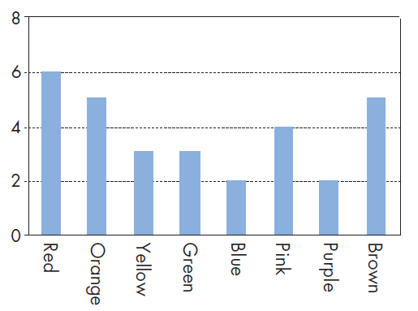
Mathematics Unit 4: Coloured Candies
QUESTION 14.1
Robert’s mother lets him pick one candy from a bag. He can’t see the candies. The number of candies of each colour in the bag is shown in the following graph.
What is the probability that Robert will pick a red candy?
10%
20%
25%
50%
What do we want to find out?
What useful information do we know?
What other mathematical techniques do we need to apply?
What have we learned?

Slide 2
Mathematics Unit 14: Coloured Candies
QUESTION 14.1
Robert’s mother lets him pick one candy from a bag. He can’t see the candies. The number of candies of each colour in the bag is shown in the following graph.
What is the probability that Robert will pick a red candy?
10%
20%
25%
50%
What do we want to find out?
What useful information do we know?
What other mathematical techniques do we need to apply?
What have we learned?
Back to start

Slide 3
Mathematics Unit 14: Coloured Candies
QUESTION 14.1
Robert’s mother lets him pick one candy from a bag. He can’t see the candies. The number of candies of each colour in the bag is shown in the following graph.
What is the probability that Robert will pick a red candy?
10%
20%
25%
50%
What do we want to find out?
What useful information do we know?
What other mathematical techniques do we need to apply?
What have we learned?
Back to start

Slide 4
Mathematics Unit 14: Coloured Candies
QUESTION 14.1
Robert’s mother lets him pick one candy from a bag. He can’t see the candies. The number of candies of each colour in the bag is shown in the following graph.
What is the probability that Robert will pick a red candy?
10%
20%
25%
50%
What do we want to find out?
What useful information do we know?
What other mathematical techniques do we need to apply?
What have we learned?
Back to start

Slide 5
Mathematics Unit 14: Coloured Candies
QUESTION 14.1
Robert’s mother lets him pick one candy from a bag. He can’t see the candies. The number of candies of each colour in the bag is shown in the following graph.
What is the probability that Robert will pick a red candy?
10%
20%
25%
50%
What do we want to find out?
What useful information do we know?
What other mathematical techniques do we need to apply?
What have we learned?
Back to start

