Slide 1
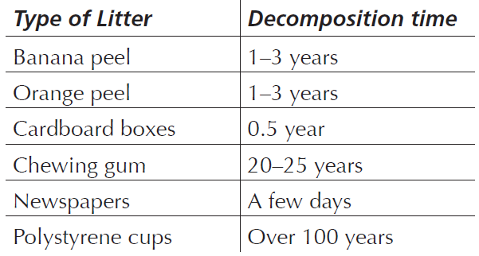
Mathematics Unit 17: Litter
QUESTION 17.1
For a homework assignment on the environment, students collected information on the decomposition time of several types of litter that people throw away:
A student thinks of displaying the results in a bar graph. Give one reason why a bar graph is unsuitable for displaying these data.
What do we want to find out?
What useful information do we know?
What other mathematical techniques do we need to apply?
What have we learned?

Slide 2
Mathematics Unit 17: Litter
QUESTION 17.1
For a homework assignment on the environment, students collected information on the decomposition time of several types of litter that people throw away:
A student thinks of displaying the results in a bar graph. Give one reason why a bar graph is unsuitable for displaying these data.
What do we want to find out?
What useful information do we know?
What other mathematical techniques do we need to apply?
What have we learned?
Back to start

Slide 3
Mathematics Unit 17: Litter
QUESTION 17.1
For a homework assignment on the environment, students collected information on the decomposition time of several types of litter that people throw away:
A student thinks of displaying the results in a bar graph. Give one reason why a bar graph is unsuitable for displaying these data.
What do we want to find out?
What useful information do we know?
What other mathematical techniques do we need to apply?
What have we learned?
Back to start

Slide 4
Mathematics Unit 17: Litter
QUESTION 17.1
For a homework assignment on the environment, students collected information on the decomposition time of several types of litter that people throw away:
A student thinks of displaying the results in a bar graph. Give one reason why a bar graph is unsuitable for displaying these data.
What do we want to find out?
What useful information do we know?
What other mathematical techniques do we need to apply?
What have we learned?
Back to start

Slide 5
Mathematics Unit 17: Litter
QUESTION 17.1
For a homework assignment on the environment, students collected information on the decomposition time of several types of litter that people throw away:
A student thinks of displaying the results in a bar graph. Give one reason why a bar graph is unsuitable for displaying these data.
What do we want to find out?
What useful information do we know?
What other mathematical techniques do we need to apply?
What have we learned?
Back to start

