Slide 1
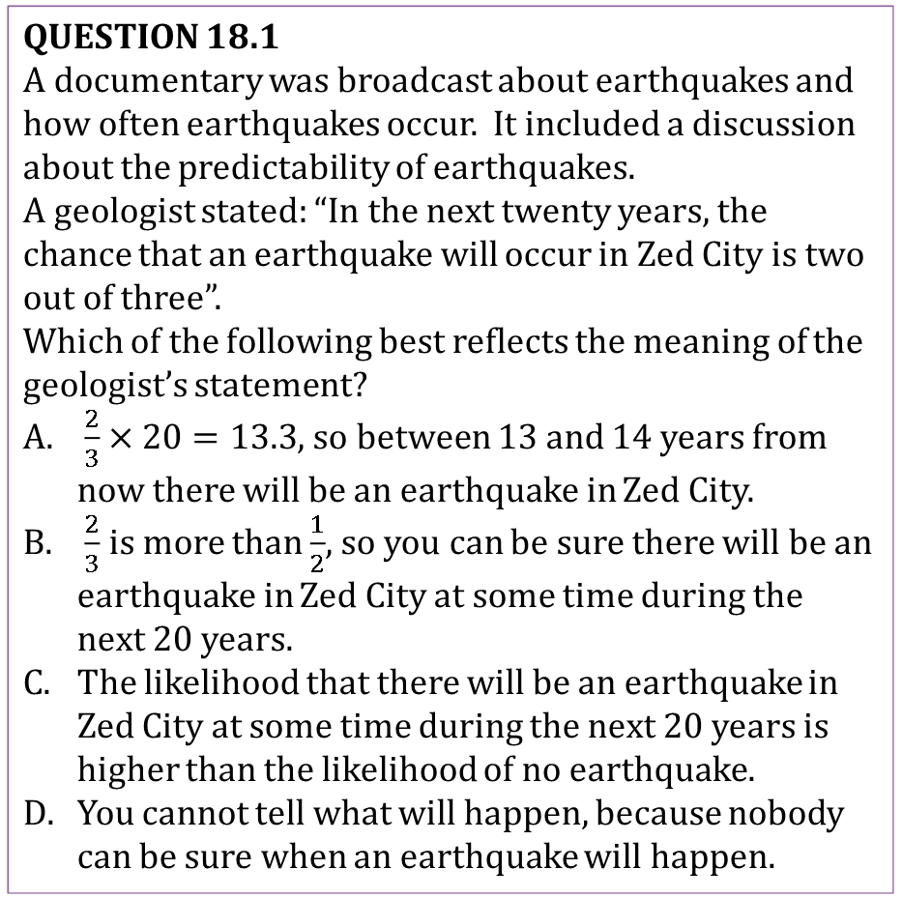
Mathematics Unit 18: Earthquake
QUESTION 18.1
A documentary was broadcast about earthquakes and how often earthquakes occur. It included a discussion about the predictability of earthquakes.
A geologist stated: “In the next twenty years, the chance that an earthquake will occur in Zed City is two out of three”.
Which of the following best reflects the meaning of the geologist’s statement?
$\frac{2}{3}×20=13.3$, so between 13 and 14 years from now there will be an earthquake in Zed City.
$\frac{2}{3}$ is more than $\frac{1}{2}$, so you can be sure there will be an earthquake in Zed City at some time during the next 20 years.
The likelihood that there will be an earthquake in Zed City at some time during the next 20 years is higher than the likelihood of no earthquake.
You cannot tell what will happen, because nobody can be sure when an earthquake will happen.
What do we want to find out?
What useful information do we know?
What other mathematical techniques do we need to apply?
What have we learned?

Slide 2
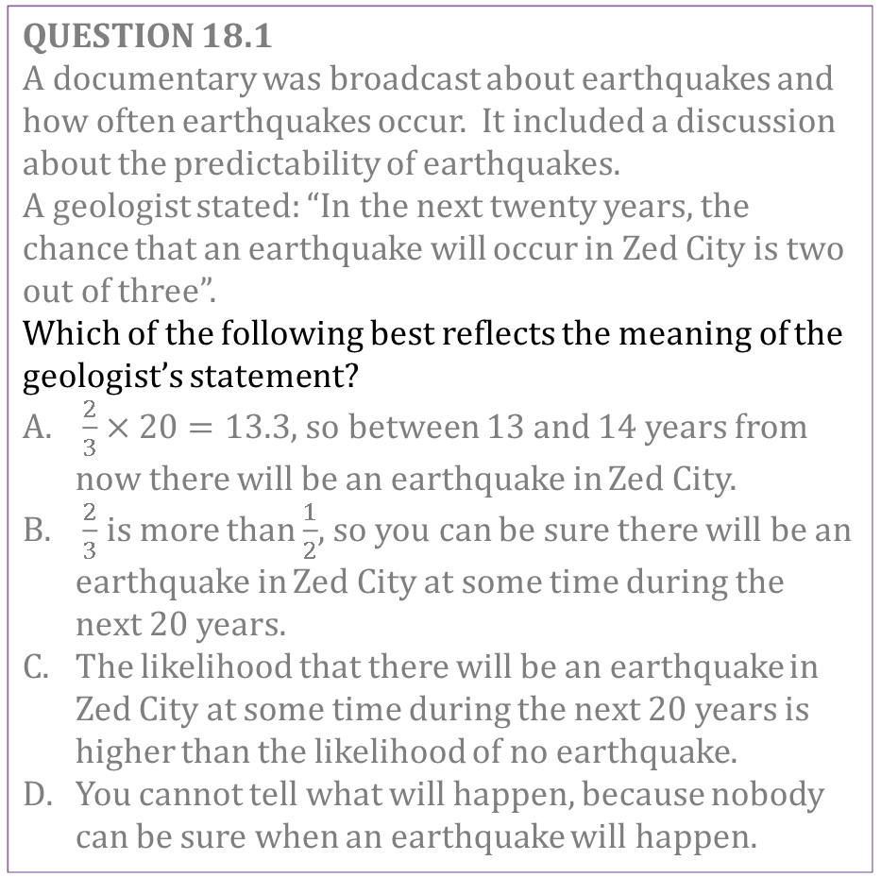
Mathematics Unit 18: Earthquake
QUESTION 18.1
A documentary was broadcast about earthquakes and how often earthquakes occur. It included a discussion about the predictability of earthquakes.
A geologist stated: “In the next twenty years, the chance that an earthquake will occur in Zed City is two out of three”.
Which of the following best reflects the meaning of the geologist’s statement?
$\frac{2}{3}×20=13.3$, so between 13 and 14 years from now there will be an earthquake in Zed City.
$\frac{2}{3}$ is more than $\frac{1}{2}$, so you can be sure there will be an earthquake in Zed City at some time during the next 20 years.
The likelihood that there will be an earthquake in Zed City at some time during the next 20 years is higher than the likelihood of no earthquake.
You cannot tell what will happen, because nobody can be sure when an earthquake will happen.
What do we want to find out?
What useful information do we know?
What other mathematical techniques do we need to apply?
What have we learned?
Back to start

Slide 3
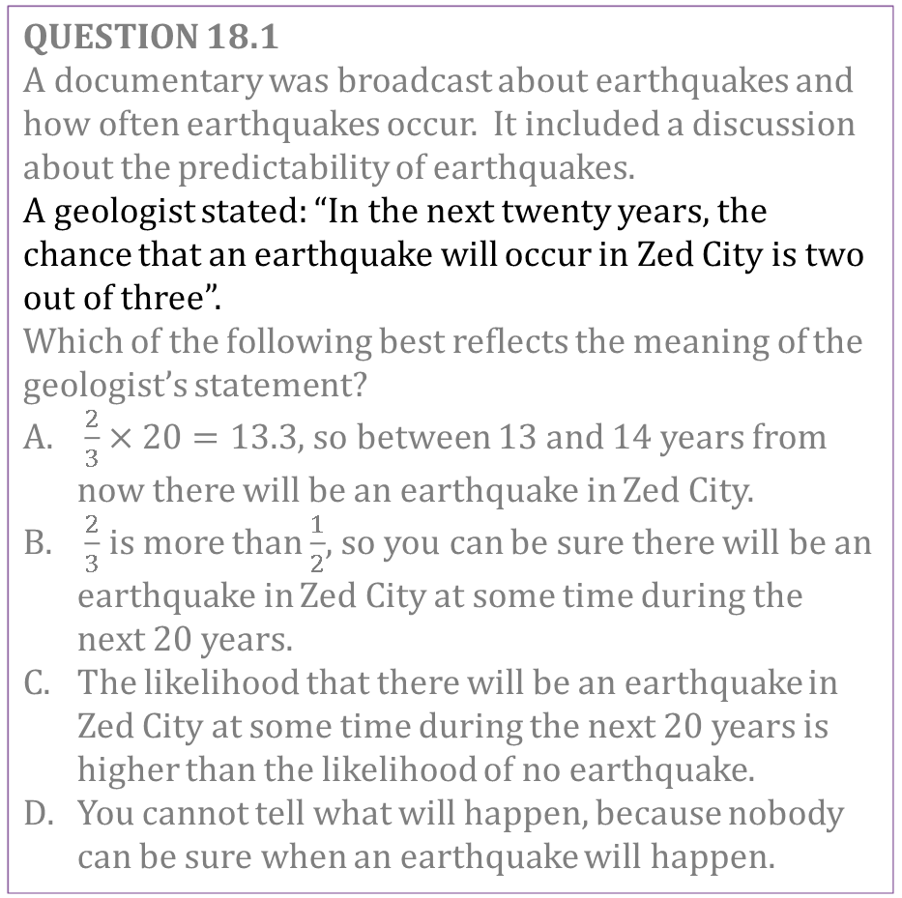
Mathematics Unit 18: Earthquake
QUESTION 18.1
A documentary was broadcast about earthquakes and how often earthquakes occur. It included a discussion about the predictability of earthquakes.
A geologist stated: “In the next twenty years, the chance that an earthquake will occur in Zed City is two out of three”.
Which of the following best reflects the meaning of the geologist’s statement?
$\frac{2}{3}×20=13.3$, so between 13 and 14 years from now there will be an earthquake in Zed City.
$\frac{2}{3}$ is more than $\frac{1}{2}$, so you can be sure there will be an earthquake in Zed City at some time during the next 20 years.
The likelihood that there will be an earthquake in Zed City at some time during the next 20 years is higher than the likelihood of no earthquake.
You cannot tell what will happen, because nobody can be sure when an earthquake will happen.
What do we want to find out?
What useful information do we know?
What other mathematical techniques do we need to apply?
What have we learned?
Back to start

Slide 4
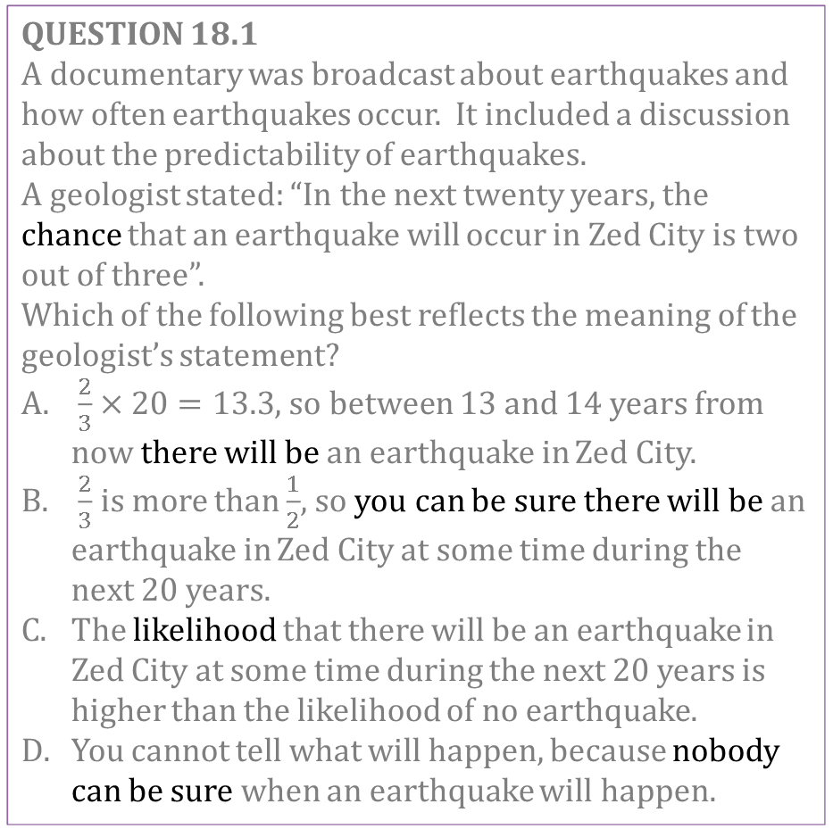
Mathematics Unit 18: Earthquake
QUESTION 18.1
A documentary was broadcast about earthquakes and how often earthquakes occur. It included a discussion about the predictability of earthquakes.
A geologist stated: “In the next twenty years, the chance that an earthquake will occur in Zed City is two out of three”.
Which of the following best reflects the meaning of the geologist’s statement?
$\frac{2}{3}×20=13.3$, so between 13 and 14 years from now there will be an earthquake in Zed City.
$\frac{2}{3}$ is more than $\frac{1}{2}$, so you can be sure there will be an earthquake in Zed City at some time during the next 20 years.
The likelihood that there will be an earthquake in Zed City at some time during the next 20 years is higher than the likelihood of no earthquake.
You cannot tell what will happen, because nobody can be sure when an earthquake will happen.
What do we want to find out?
What useful information do we know?
What other mathematical techniques do we need to apply?
What have we learned?
Back to start

Slide 5
Mathematics Unit 18: Earthquake
QUESTION 18.1
A documentary was broadcast about earthquakes and how often earthquakes occur. It included a discussion about the predictability of earthquakes.
A geologist stated: “In the next twenty years, the chance that an earthquake will occur in Zed City is two out of three”.
Which of the following best reflects the meaning of the geologist’s statement?
$\frac{2}{3}×20=13.3$, so between 13 and 14 years from now there will be an earthquake in Zed City.
$\frac{2}{3}$ is more than $\frac{1}{2}$, so you can be sure there will be an earthquake in Zed City at some time during the next 20 years.
The likelihood that there will be an earthquake in Zed City at some time during the next 20 years is higher than the likelihood of no earthquake.
You cannot tell what will happen, because nobody can be sure when an earthquake will happen.
What do we want to find out?
What useful information do we know?
What other mathematical techniques do we need to apply?
What have we learned?
Back to start

