Slide 1
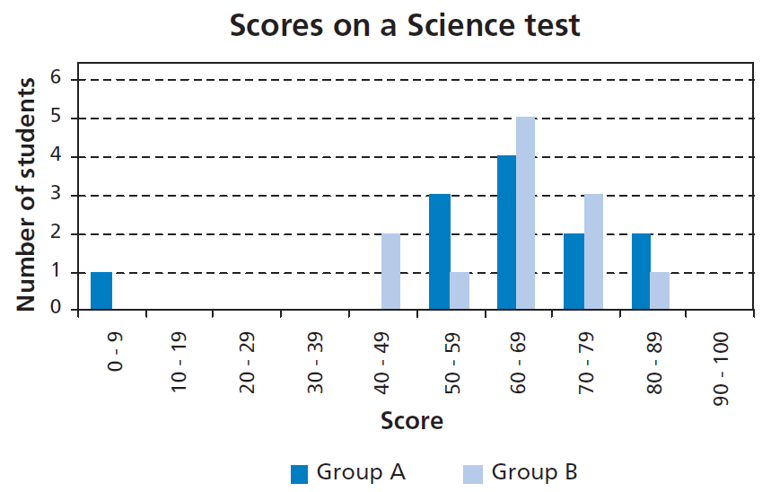
Mathematics Unit 20: Test Scores
QUESTION 20.1
The diagram below shows the results on a science test for two groups, labelled as Group A and Group B.
The mean score for Group A is 62.0 and the mean for Group B is 64.5. Students pass this test when their score is 50 or above.
Looking at the diagram, the teacher claims that Group B did better than Group A in this test.
The students in Group A don’t agree with their teacher. They try to convince the teacher that Group B may not necessarily have done better.
Give one mathematical argument, using the graph, that the students in Group A could use.
What do we want to find out?
What useful information do we know?
What other mathematical techniques do we need to apply?
What have we learned?

Slide 2
Mathematics Unit 20: Test Scores
QUESTION 20.1
The diagram below shows the results on a science test for two groups, labelled as Group A and Group B.
The mean score for Group A is 62.0 and the mean for Group B is 64.5. Students pass this test when their score is 50 or above.
Looking at the diagram, the teacher claims that Group B did better than Group A in this test.
The students in Group A don’t agree with their teacher. They try to convince the teacher that Group B may not necessarily have done better.
Give one mathematical argument, using the graph, that the students in Group A could use.
What do we want to find out?
What useful information do we know?
What other mathematical techniques do we need to apply?
What have we learned?
Back to start

Slide 3
Mathematics Unit 20: Test Scores
QUESTION 20.1
The diagram below shows the results on a science test for two groups, labelled as Group A and Group B.
The mean score for Group A is 62.0 and the mean for Group B is 64.5. Students pass this test when their score is 50 or above.
Looking at the diagram, the teacher claims that Group B did better than Group A in this test.
The students in Group A don’t agree with their teacher. They try to convince the teacher that Group B may not necessarily have done better.
Give one mathematical argument, using the graph, that the students in Group A could use.
What do we want to find out?
What useful information do we know?
What other mathematical techniques do we need to apply?
What have we learned?
Back to start

Slide 4
Mathematics Unit 20: Test Scores
QUESTION 20.1
The diagram below shows the results on a science test for two groups, labelled as Group A and Group B.
The mean score for Group A is 62.0 and the mean for Group B is 64.5. Students pass this test when their score is 50 or above.
Looking at the diagram, the teacher claims that Group B did better than Group A in this test.
The students in Group A don’t agree with their teacher. They try to convince the teacher that Group B may not necessarily have done better.
Give one mathematical argument, using the graph, that the students in Group A could use.
What do we want to find out?
What useful information do we know?
What other mathematical techniques do we need to apply?
What have we learned?
Back to start

Slide 5
Mathematics Unit 20: Test Scores
QUESTION 20.1
The diagram below shows the results on a science test for two groups, labelled as Group A and Group B.
The mean score for Group A is 62.0 and the mean for Group B is 64.5. Students pass this test when their score is 50 or above.
Looking at the diagram, the teacher claims that Group B did better than Group A in this test.
The students in Group A don’t agree with their teacher. They try to convince the teacher that Group B may not necessarily have done better.
Give one mathematical argument, using the graph, that the students in Group A could use.
What do we want to find out?
What useful information do we know?
What other mathematical techniques do we need to apply?
What have we learned?
Back to start

