Slide 1
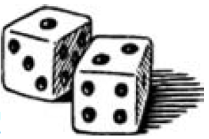
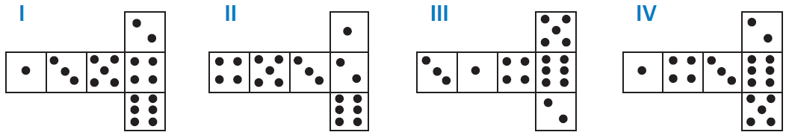
Mathematics Unit 23: Number Cubes
QUESTION 23.1
On the right, there is
a picture of two dice.
Dice are special number cubes for which the following rule applies: The total number of dots on two opposite faces is always seven.
You can make a simple number cube by cutting, folding and gluing cardboard. This can be done in many ways. In the figure below you can see four cuttings that can be used to make cubes, with dots on the sides.
Which of the following shapes can be folded together to form a cube that obeys the rule that the sum of opposite faces is 7?
What do we want to find out?
What useful information do we know?
What other mathematical techniques do we need to apply?
What have we learned?

Slide 2
Mathematics Unit 23: Number Cubes
QUESTION 23.1
On the right, there is
a picture of two dice.
Dice are special number cubes for which the following rule applies: The total number of dots on two opposite faces is always seven.
You can make a simple number cube by cutting, folding and gluing cardboard. This can be done in many ways. In the figure below you can see four cuttings that can be used to make cubes, with dots on the sides.
Which of the following shapes can be folded together to form a cube that obeys the rule that the sum of opposite faces is 7?
What do we want to find out?
What useful information do we know?
What other mathematical techniques do we need to apply?
What have we learned?
Back to start

Slide 3
Mathematics Unit 23: Number Cubes
QUESTION 23.1
On the right, there is
a picture of two dice.
Dice are special number cubes for which the following rule applies: The total number of dots on two opposite faces is always seven.
You can make a simple number cube by cutting, folding and gluing cardboard. This can be done in many ways. In the figure below you can see four cuttings that can be used to make cubes, with dots on the sides.
Which of the following shapes can be folded together to form a cube that obeys the rule that the sum of opposite faces is 7?
What do we want to find out?
What useful information do we know?
What other mathematical techniques do we need to apply?
What have we learned?
Back to start

Slide 4
Mathematics Unit 23: Number Cubes
QUESTION 23.1
On the right, there is
a picture of two dice.
Dice are special number cubes for which the following rule applies: The total number of dots on two opposite faces is always seven.
You can make a simple number cube by cutting, folding and gluing cardboard. This can be done in many ways. In the figure below you can see four cuttings that can be used to make cubes, with dots on the sides.
Which of the following shapes can be folded together to form a cube that obeys the rule that the sum of opposite faces is 7?
What do we want to find out?
What useful information do we know?
What other mathematical techniques do we need to apply?
What have we learned?
Back to start

Slide 5
Mathematics Unit 23: Number Cubes
QUESTION 23.1
On the right, there is
a picture of two dice.
Dice are special number cubes for which the following rule applies: The total number of dots on two opposite faces is always seven.
You can make a simple number cube by cutting, folding and gluing cardboard. This can be done in many ways. In the figure below you can see four cuttings that can be used to make cubes, with dots on the sides.
Which of the following shapes can be folded together to form a cube that obeys the rule that the sum of opposite faces is 7?
What do we want to find out?
What useful information do we know?
What other mathematical techniques do we need to apply?
What have we learned?
Back to start

