Slide 1
Mathematics Unit 31: Braking
The approximate distance to stop a moving vehicle is the sum of:
the distance covered during the time the driver takes to begin to apply the brakes (reaction-time distance)
the distance travelled while the brakes are applied (braking distance)
The ‘snail’ diagram on the following slides gives the theoretical stopping distance for a vehicle in good braking conditions (a particularly alert driver, brakes and tyres in perfect condition, a dry road with a good surface) and how much the stopping distance depends on speed.

Slide 2
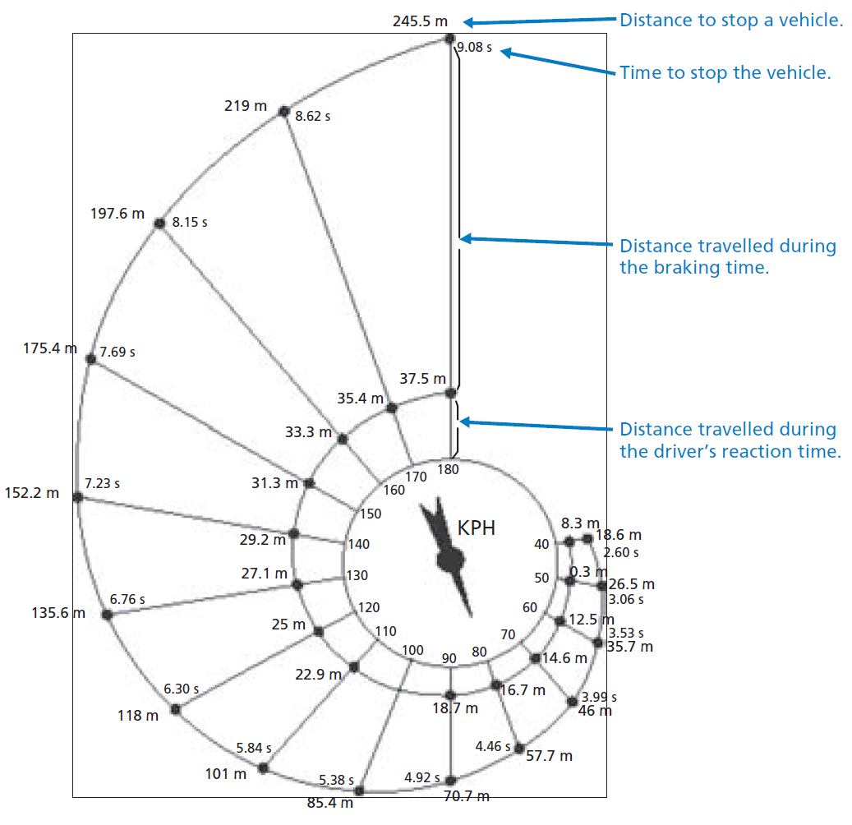
Mathematics Unit 31: Braking
QUESTION 31.1
If a vehicle is travelling at 110kph, what distance does the vehicle travel during the driver’s reaction time?
What do we want to find out?
What useful information do we know?
What other mathematical techniques do we need to apply?
What have we learned?

Slide 3
Mathematics Unit 31: Braking
QUESTION 31.1
If a vehicle is travelling at 110kph, what distance does the vehicle travel during the driver’s reaction time?
What do we want to find out?
What useful information do we know?
What other mathematical techniques do we need to apply?
What have we learned?
Back to start

Slide 4
Mathematics Unit 31: Braking
QUESTION 31.1
If a vehicle is travelling at 110kph, what distance does the vehicle travel during the driver’s reaction time?
What do we want to find out?
What useful information do we know?
What other mathematical techniques do we need to apply?
What have we learned?
Back to start

Slide 5
Mathematics Unit 31: Braking
QUESTION 31.1
If a vehicle is travelling at 110kph, what distance does the vehicle travel during the driver’s reaction time?
What do we want to find out?
What useful information do we know?
What other mathematical techniques do we need to apply?
What have we learned?
Back to start

Slide 6
Mathematics Unit 31: Braking
QUESTION 31.1
If a vehicle is travelling at 110kph, what distance does the vehicle travel during the driver’s reaction time?
What do we want to find out?
What useful information do we know?
What other mathematical techniques do we need to apply?
What have we learned?
Back to start

Slide 7
Mathematics Unit 31: Braking
QUESTION 31.2
If a vehicle is travelling at 110kph, what is the total distance travelled before the vehicle stops?
What do we want to find out?
What useful information do we know?
What other mathematical techniques do we need to apply?
What have we learned?

Slide 8
Mathematics Unit 31: Braking
QUESTION 31.2
If a vehicle is travelling at 110kph, what is the total distance travelled before the vehicle stops?
What do we want to find out?
What useful information do we know?
What other mathematical techniques do we need to apply?
What have we learned?
Back to start

Slide 9
Mathematics Unit 31: Braking
QUESTION 31.2
If a vehicle is travelling at 110kph, what is the total distance travelled before the vehicle stops?
What do we want to find out?
What useful information do we know?
What other mathematical techniques do we need to apply?
What have we learned?
Back to start

Slide 10
Mathematics Unit 31: Braking
QUESTION 31.2
If a vehicle is travelling at 110kph, what is the total distance travelled before the vehicle stops?
What do we want to find out?
What useful information do we know?
What other mathematical techniques do we need to apply?
What have we learned?
Back to start

Slide 11
Mathematics Unit 31: Braking
QUESTION 31.2
If a vehicle is travelling at 110kph, what is the total distance travelled before the vehicle stops?
What do we want to find out?
What useful information do we know?
What other mathematical techniques do we need to apply?
What have we learned?
Back to start

Slide 12
Mathematics Unit 31: Braking
QUESTION 31.3
If a vehicle is travelling at 110kph, how long does it take to stop the vehicle completely?
What do we want to find out?
What useful information do we know?
What other mathematical techniques do we need to apply?
What have we learned?

Slide 13
Mathematics Unit 31: Braking
QUESTION 31.3
If a vehicle is travelling at 110kph, how long does it take to stop the vehicle completely?
What do we want to find out?
What useful information do we know?
What other mathematical techniques do we need to apply?
What have we learned?
Back to start

Slide 14
Mathematics Unit 31: Braking
QUESTION 31.3
If a vehicle is travelling at 110kph, how long does it take to stop the vehicle completely?
What do we want to find out?
What useful information do we know?
What other mathematical techniques do we need to apply?
What have we learned?
Back to start

Slide 15
Mathematics Unit 31: Braking
QUESTION 31.3
If a vehicle is travelling at 110kph, how long does it take to stop the vehicle completely?
What do we want to find out?
What useful information do we know?
What other mathematical techniques do we need to apply?
What have we learned?
Back to start

Slide 16
Mathematics Unit 31: Braking
QUESTION 31.3
If a vehicle is travelling at 110kph, how long does it take to stop the vehicle completely?
What do we want to find out?
What useful information do we know?
What other mathematical techniques do we need to apply?
What have we learned?
Back to start

Slide 17
Mathematics Unit 31: Braking
QUESTION 31.4
If a vehicle is travelling at 110kph, what is the distance travelled while the brakes are being applied?
What do we want to find out?
What useful information do we know?
What other mathematical techniques do we need to apply?
What have we learned?

Slide 18
Mathematics Unit 31: Braking
QUESTION 31.4
If a vehicle is travelling at 110kph, what is the distance travelled while the brakes are being applied?
What do we want to find out?
What useful information do we know?
What other mathematical techniques do we need to apply?
What have we learned?
Back to start

Slide 19
Mathematics Unit 31: Braking
QUESTION 31.4
If a vehicle is travelling at 110kph, what is the distance travelled while the brakes are being applied?
What do we want to find out?
What useful information do we know?
What other mathematical techniques do we need to apply?
What have we learned?
Back to start

Slide 20
Mathematics Unit 31: Braking
QUESTION 31.4
If a vehicle is travelling at 110kph, what is the distance travelled while the brakes are being applied?
What do we want to find out?
What useful information do we know?
What other mathematical techniques do we need to apply?
What have we learned?
Back to start

Slide 21
Mathematics Unit 31: Braking
QUESTION 31.4
If a vehicle is travelling at 110kph, what is the distance travelled while the brakes are being applied?
What do we want to find out?
What useful information do we know?
What other mathematical techniques do we need to apply?
What have we learned?
Back to start

Slide 22
Mathematics Unit 31: Braking
QUESTION 31.5
A second driver, travelling in good conditions, stops her vehicle in a total distance of 70.7metres. At what speed was the vehicle travelling before the brakes were applied?
What do we want to find out?
What useful information do we know?
What other mathematical techniques do we need to apply?
What have we learned?

Slide 23
Mathematics Unit 31: Braking
QUESTION 31.5
A second driver, travelling in good conditions, stops her vehicle in a total distance of 70.7metres. At what speed was the vehicle travelling before the brakes were applied?
What do we want to find out?
What useful information do we know?
What other mathematical techniques do we need to apply?
What have we learned?
Back to start

Slide 24
Mathematics Unit 31: Braking
QUESTION 31.5
A second driver, travelling in good conditions, stops her vehicle in a total distance of 70.7metres. At what speed was the vehicle travelling before the brakes were applied?
What do we want to find out?
What useful information do we know?
What other mathematical techniques do we need to apply?
What have we learned?
Back to start

Slide 25
Mathematics Unit 31: Braking
QUESTION 31.5
A second driver, travelling in good conditions, stops her vehicle in a total distance of 70.7metres. At what speed was the vehicle travelling before the brakes were applied?
What do we want to find out?
What useful information do we know?
What other mathematical techniques do we need to apply?
What have we learned?
Back to start

Slide 26
Mathematics Unit 31: Braking
QUESTION 31.5
A second driver, travelling in good conditions, stops her vehicle in a total distance of 70.7metres. At what speed was the vehicle travelling before the brakes were applied?
What do we want to find out?
What useful information do we know?
What other mathematical techniques do we need to apply?
What have we learned?
Back to start

