Slide 1
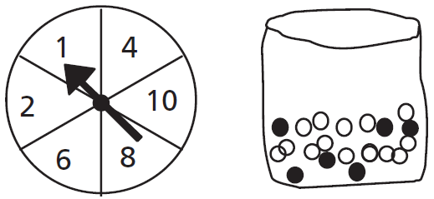
Mathematics Unit 37: Spring Fair
QUESTION 37.1
A game in a booth at a spring fair involves using a spinner first. Then, if the spinner stops on an even number, the player is allowed to pick a marble from a bag. The spinner and the marbles in the bag are represented in the diagram below.
Prizes are given when a black marble is picked. Sue plays the game once.
How likely is it that Sue will win a prize?
Impossible.
Not very likely.
About 50% likely.
Very likely.
Certain.
What do we want to find out?
What useful information do we know?
What other mathematical techniques do we need to apply?
What have we learned?

Slide 2
Mathematics Unit 37: Spring Fair
QUESTION 37.1
A game in a booth at a spring fair involves using a spinner first. Then, if the spinner stops on an even number, the player is allowed to pick a marble from a bag. The spinner and the marbles in the bag are represented in the diagram below.
Prizes are given when a black marble is picked. Sue plays the game once.
How likely is it that Sue will win a prize?
Impossible.
Not very likely.
About 50% likely.
Very likely.
Certain.
What do we want to find out?
What useful information do we know?
What other mathematical techniques do we need to apply?
What have we learned?
Back to start

Slide 3
Mathematics Unit 37: Spring Fair
QUESTION 37.1
A game in a booth at a spring fair involves using a spinner first. Then, if the spinner stops on an even number, the player is allowed to pick a marble from a bag. The spinner and the marbles in the bag are represented in the diagram below.
Prizes are given when a black marble is picked. Sue plays the game once.
How likely is it that Sue will win a prize?
Impossible.
Not very likely.
About 50% likely.
Very likely.
Certain.
What do we want to find out?
What useful information do we know?
What other mathematical techniques do we need to apply?
What have we learned?
Back to start

Slide 4
Mathematics Unit 37: Spring Fair
QUESTION 37.1
A game in a booth at a spring fair involves using a spinner first. Then, if the spinner stops on an even number, the player is allowed to pick a marble from a bag. The spinner and the marbles in the bag are represented in the diagram below.
Prizes are given when a black marble is picked. Sue plays the game once.
How likely is it that Sue will win a prize?
Impossible.
Not very likely.
About 50% likely.
Very likely.
Certain.
What do we want to find out?
What useful information do we know?
What other mathematical techniques do we need to apply?
What have we learned?
Back to start

Slide 5
Mathematics Unit 37: Spring Fair
QUESTION 37.1
A game in a booth at a spring fair involves using a spinner first. Then, if the spinner stops on an even number, the player is allowed to pick a marble from a bag. The spinner and the marbles in the bag are represented in the diagram below.
Prizes are given when a black marble is picked. Sue plays the game once.
How likely is it that Sue will win a prize?
Impossible.
Not very likely.
About 50% likely.
Very likely.
Certain.
What do we want to find out?
What useful information do we know?
What other mathematical techniques do we need to apply?
What have we learned?
Back to start

