Slide 1
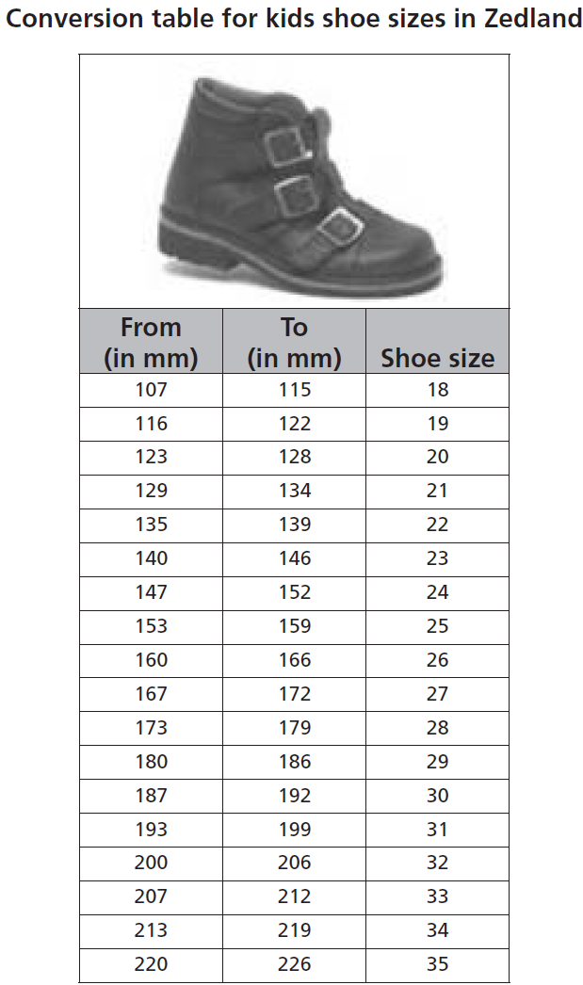
Mathematics Unit 41: Shoes for Kids
The following table
shows the
recommended
Zedland shoe sizes
corresponding to
various foot lengths.
QUESTION 41.1
Marina’s feet are
163 mm long.
Use the table to
determine which
Zedland shoe size
Marina should try on.
What do we want to find out?
What useful information do we know?
What other mathematical techniques do we need to apply?
What have we learned?

Slide 2
Mathematics Unit 41: Shoes for Kids
The following table
shows the
recommended
Zedland shoe sizes
corresponding to
various foot lengths.
QUESTION 41.1
Marina’s feet are
163 mm long.
Use the table to
determine which
Zedland shoe size
Marina should try on.
What do we want to find out?
What useful information do we know?
What other mathematical techniques do we need to apply?
What have we learned?
Back to start

Slide 3
Mathematics Unit 41: Shoes for Kids
The following table
shows the
recommended
Zedland shoe sizes
corresponding to
various foot lengths.
QUESTION 41.1
Marina’s feet are
163 mm long.
Use the table to
determine which
Zedland shoe size
Marina should try on.
What do we want to find out?
What useful information do we know?
What other mathematical techniques do we need to apply?
What have we learned?
Back to start

Slide 4
Mathematics Unit 41: Shoes for Kids
The following table
shows the
recommended
Zedland shoe sizes
corresponding to
various foot lengths.
QUESTION 41.1
Marina’s feet are
163 mm long.
Use the table to
determine which
Zedland shoe size
Marina should try on.
What do we want to find out?
What useful information do we know?
What other mathematical techniques do we need to apply?
What have we learned?
Back to start

Slide 5
Mathematics Unit 41: Shoes for Kids
The following table
shows the
recommended
Zedland shoe sizes
corresponding to
various foot lengths.
QUESTION 41.1
Marina’s feet are
163 mm long.
Use the table to
determine which
Zedland shoe size
Marina should try on.
What do we want to find out?
What useful information do we know?
What other mathematical techniques do we need to apply?
What have we learned?
Back to start

