Slide 1
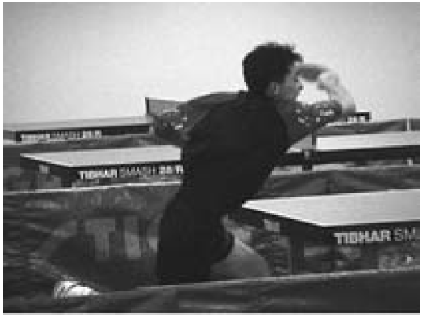
Mathematics Unit 42: Table Tennis Tournament
QUESTION 42.1
Teun, Riek, Bep and Dirk have formed a practice group in a table tennis club. Each player wishes to play against each other player once. They have reserved two practice tables for these matches.
Complete the following match schedule; by writing the names of the players in each match.
What do we want to find out?
What useful information do we know?
What other mathematical techniques do we need to apply?
What have we learned?

Slide 2
Mathematics Unit 42: Table Tennis Tournament
QUESTION 42.1
Teun, Riek, Bep and Dirk have formed a practice group in a table tennis club. Each player wishes to play against each other player once. They have reserved two practice tables for these matches.
Complete the following match schedule; by writing the names of the players in each match.
What do we want to find out?
What useful information do we know?
What other mathematical techniques do we need to apply?
What have we learned?
Back to start

Slide 3
Mathematics Unit 42: Table Tennis Tournament
QUESTION 42.1
Teun, Riek, Bep and Dirk have formed a practice group in a table tennis club. Each player wishes to play against each other player once. They have reserved two practice tables for these matches.
Complete the following match schedule; by writing the names of the players in each match.
What do we want to find out?
What useful information do we know?
What other mathematical techniques do we need to apply?
What have we learned?
Back to start

Slide 4
Mathematics Unit 42: Table Tennis Tournament
QUESTION 42.1
Teun, Riek, Bep and Dirk have formed a practice group in a table tennis club. Each player wishes to play against each other player once. They have reserved two practice tables for these matches.
Complete the following match schedule; by writing the names of the players in each match.
What do we want to find out?
What useful information do we know?
What other mathematical techniques do we need to apply?
What have we learned?
Back to start

Slide 5
Mathematics Unit 42: Table Tennis Tournament
QUESTION 42.1
Teun, Riek, Bep and Dirk have formed a practice group in a table tennis club. Each player wishes to play against each other player once. They have reserved two practice tables for these matches.
Complete the following match schedule; by writing the names of the players in each match.
What do we want to find out?
What useful information do we know?
What other mathematical techniques do we need to apply?
What have we learned?
Back to start

