Slide 1

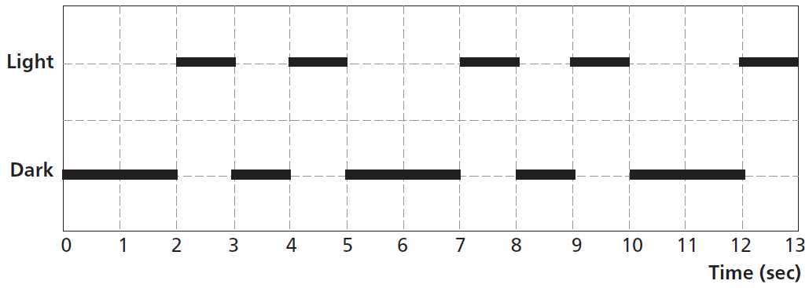
Mathematics Unit 43: Lighthouse
Lighthouses are towers with a light beacon on
top. Lighthouses assist sea ships in finding
their way at night when they are sailing close
to the shore.
A lighthouse beacon sends out light flashes with a regular fixed pattern. Every lighthouse has its own pattern.
In the diagram below you see the pattern of a certain lighthouse. The light flashes alternate with dark periods.
It is a regular pattern. After some time the pattern repeats itself. The time taken by one complete cycle of a pattern, before it starts to repeat, is called the period. When you find the period of a pattern, it is easy to extend the diagram for the next seconds or minutes or even hours.

Slide 2
Mathematics Unit 43: Lighthouse
In the diagram below you see the pattern of a certain lighthouse. The light flashes alternate with dark periods.
It is a regular pattern. After some time the pattern repeats itself. The time taken by one complete cycle of a pattern, before it starts to repeat, is called the period.
QUESTION 43.1
Which of the following could be the period of the pattern of this lighthouse?
2 seconds.
3 seconds.
5 seconds.
12 seconds.
What do we want to find out?
What useful information do we know?
What other mathematical techniques do we need to apply?
What have we learned?

Slide 3
Mathematics Unit 43: Lighthouse
In the diagram below you see the pattern of a certain lighthouse. The light flashes alternate with dark periods.
It is a regular pattern. After some time the pattern repeats itself. The time taken by one complete cycle of a pattern, before it starts to repeat, is called the period.
QUESTION 43.1
Which of the following could be the period of the pattern of this lighthouse?
2 seconds.
3 seconds.
5 seconds.
12 seconds.
What do we want to find out?
What useful information do we know?
What other mathematical techniques do we need to apply?
What have we learned?
Back to start

Slide 4
Mathematics Unit 43: Lighthouse
In the diagram below you see the pattern of a certain lighthouse. The light flashes alternate with dark periods.
It is a regular pattern. After some time the pattern repeats itself. The time taken by one complete cycle of a pattern, before it starts to repeat, is called the period.
QUESTION 43.1
Which of the following could be the period of the pattern of this lighthouse?
2 seconds.
3 seconds.
5 seconds.
12 seconds.
What do we want to find out?
What useful information do we know?
What other mathematical techniques do we need to apply?
What have we learned?
Back to start

Slide 5
Mathematics Unit 43: Lighthouse
In the diagram below you see the pattern of a certain lighthouse. The light flashes alternate with dark periods.
It is a regular pattern. After some time the pattern repeats itself. The time taken by one complete cycle of a pattern, before it starts to repeat, is called the period.
QUESTION 43.1
Which of the following could be the period of the pattern of this lighthouse?
2 seconds.
3 seconds.
5 seconds.
12 seconds.
What do we want to find out?
What useful information do we know?
What other mathematical techniques do we need to apply?
What have we learned?
Back to start

Slide 6
Mathematics Unit 43: Lighthouse
In the diagram below you see the pattern of a certain lighthouse. The light flashes alternate with dark periods.
It is a regular pattern. After some time the pattern repeats itself. The time taken by one complete cycle of a pattern, before it starts to repeat, is called the period.
QUESTION 43.1
Which of the following could be the period of the pattern of this lighthouse?
2 seconds.
3 seconds.
5 seconds.
12 seconds.
What do we want to find out?
What useful information do we know?
What other mathematical techniques do we need to apply?
What have we learned?
Back to start

Slide 7
Mathematics Unit 43: Lighthouse
In the diagram below you see the pattern of a certain lighthouse. The light flashes alternate with dark periods.
It is a regular pattern. After some time the pattern repeats itself. The time taken by one complete cycle of a pattern, before it starts to repeat, is called the period.
QUESTION 43.2
For how many seconds does the lighthouse send out light flashes in 1 minute?
4
12
20
24
What do we want to find out?
What useful information do we know?
What other mathematical techniques do we need to apply?
What have we learned?

Slide 8
Mathematics Unit 43: Lighthouse
In the diagram below you see the pattern of a certain lighthouse. The light flashes alternate with dark periods.
It is a regular pattern. After some time the pattern repeats itself. The time taken by one complete cycle of a pattern, before it starts to repeat, is called the period.
QUESTION 43.2
For how many seconds does the lighthouse send out light flashes in 1 minute?
4
12
20
24
What do we want to find out?
What useful information do we know?
What other mathematical techniques do we need to apply?
What have we learned?
Back to start

Slide 9
Mathematics Unit 43: Lighthouse
In the diagram below you see the pattern of a certain lighthouse. The light flashes alternate with dark periods.
It is a regular pattern. After some time the pattern repeats itself. The time taken by one complete cycle of a pattern, before it starts to repeat, is called the period.
QUESTION 43.2
For how many seconds does the lighthouse send out light flashes in 1 minute?
4
12
20
24
What do we want to find out?
What useful information do we know?
What other mathematical techniques do we need to apply?
What have we learned?
Back to start

Slide 10
Mathematics Unit 43: Lighthouse
In the diagram below you see the pattern of a certain lighthouse. The light flashes alternate with dark periods.
It is a regular pattern. After some time the pattern repeats itself. The time taken by one complete cycle of a pattern, before it starts to repeat, is called the period.
QUESTION 43.2
For how many seconds does the lighthouse send out light flashes in 1 minute?
4
12
20
24
What do we want to find out?
What useful information do we know?
What other mathematical techniques do we need to apply?
What have we learned?
Back to start

Slide 11
Mathematics Unit 43: Lighthouse
In the diagram below you see the pattern of a certain lighthouse. The light flashes alternate with dark periods.
It is a regular pattern. After some time the pattern repeats itself. The time taken by one complete cycle of a pattern, before it starts to repeat, is called the period.
QUESTION 43.2
For how many seconds does the lighthouse send out light flashes in 1 minute?
4
12
20
24
What do we want to find out?
What useful information do we know?
What other mathematical techniques do we need to apply?
What have we learned?
Back to start

Slide 12
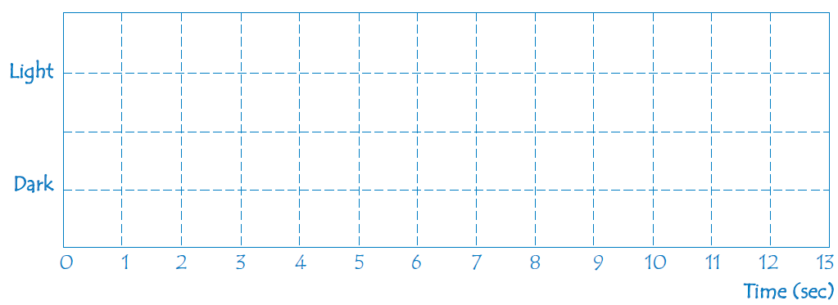
Mathematics Unit 43: Lighthouse
In the diagram below you see the pattern of a certain lighthouse. The light flashes alternate with dark periods.
QUESTION 43.3
In the diagram below, make a graph of a possible pattern of light flashes of a lighthouse that sends out light flashes for 30 seconds per minute. The period of this pattern must be equal to 6 seconds.
What do we want to find out?
What useful information do we know?
What other mathematical techniques do we need to apply?
What have we learned?

Slide 13
Mathematics Unit 43: Lighthouse
In the diagram below you see the pattern of a certain lighthouse. The light flashes alternate with dark periods.
QUESTION 43.3
In the diagram below, make a graph of a possible pattern of light flashes of a lighthouse that sends out light flashes for 30 seconds per minute. The period of this pattern must be equal to 6 seconds.
What do we want to find out?
What useful information do we know?
What other mathematical techniques do we need to apply?
What have we learned?
Back to start

Slide 14
Mathematics Unit 43: Lighthouse
In the diagram below you see the pattern of a certain lighthouse. The light flashes alternate with dark periods.
QUESTION 43.3
In the diagram below, make a graph of a possible pattern of light flashes of a lighthouse that sends out light flashes for 30 seconds per minute. The period of this pattern must be equal to 6 seconds.
What do we want to find out?
What useful information do we know?
What other mathematical techniques do we need to apply?
What have we learned?
Back to start

Slide 15
Mathematics Unit 43: Lighthouse
In the diagram below you see the pattern of a certain lighthouse. The light flashes alternate with dark periods.
QUESTION 43.3
In the diagram below, make a graph of a possible pattern of light flashes of a lighthouse that sends out light flashes for 30 seconds per minute. The period of this pattern must be equal to 6 seconds.
What do we want to find out?
What useful information do we know?
What other mathematical techniques do we need to apply?
What have we learned?
Back to start

Slide 16
Mathematics Unit 43: Lighthouse
In the diagram below you see the pattern of a certain lighthouse. The light flashes alternate with dark periods.
QUESTION 43.3
In the diagram below, make a graph of a possible pattern of light flashes of a lighthouse that sends out light flashes for 30 seconds per minute. The period of this pattern must be equal to 6 seconds.
What do we want to find out?
What useful information do we know?
What other mathematical techniques do we need to apply?
What have we learned?
Back to start

