Slide 1
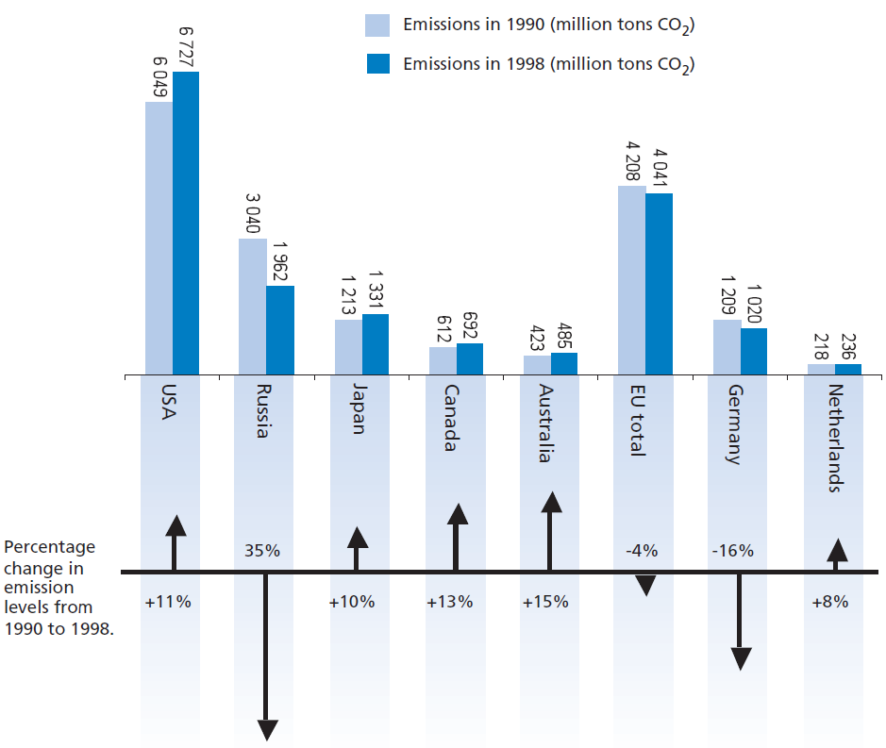
Mathematics Unit 44: Decreasing CO₂ levels
Many scientists fear that the increasing level of CO₂ gas in our atmosphere is causing climate change.
The diagram below shows the CO₂ emission levels in 1990 (the light bars) for several countries (or regions), the emission levels in 1998 (the dark bars), and the percentage change in emission levels between 1990 and 1998 (the arrows with percentages).
What do we want to find out?
What useful information do we know?
What other mathematical techniques do we need to apply?
What have we learned?

Slide 2
Mathematics Unit 44: Decreasing CO₂ levels
QUESTION 44.1
In the diagram you can read that in the USA, the increase in CO₂ emission level from 1990 to 1998 was 11%. Show the calculation to demonstrate how the 11% is obtained.
What do we want to find out?
What useful information do we know?
What other mathematical techniques do we need to apply?
What have we learned?

Slide 3
Mathematics Unit 44: Decreasing CO₂ levels
QUESTION 44.1
In the diagram you can read that in the USA, the increase in CO₂ emission level from 1990 to 1998 was 11%. Show the calculation to demonstrate how the 11% is obtained.
What do we want to find out?
What useful information do we know?
What other mathematical techniques do we need to apply?
What have we learned?
Back to start

Slide 4
Mathematics Unit 44: Decreasing CO₂ levels
QUESTION 44.1
In the diagram you can read that in the USA, the increase in CO₂ emission level from 1990 to 1998 was 11%. Show the calculation to demonstrate how the 11% is obtained.
What do we want to find out?
What useful information do we know?
What other mathematical techniques do we need to apply?
What have we learned?
Back to start

Slide 5
Mathematics Unit 44: Decreasing CO₂ levels
QUESTION 44.1
In the diagram you can read that in the USA, the increase in CO₂ emission level from 1990 to 1998 was 11%. Show the calculation to demonstrate how the 11% is obtained.
What do we want to find out?
What useful information do we know?
What other mathematical techniques do we need to apply?
What have we learned?
Back to start

Slide 6
Mathematics Unit 44: Decreasing CO₂ levels
QUESTION 44.1
In the diagram you can read that in the USA, the increase in CO₂ emission level from 1990 to 1998 was 11%. Show the calculation to demonstrate how the 11% is obtained.
What do we want to find out?
What useful information do we know?
What other mathematical techniques do we need to apply?
What have we learned?
Back to start

Slide 7
Mathematics Unit 44: Decreasing CO₂ levels
QUESTION 44.2
Mandy analysed the diagram and claimed she discovered a mistake in the percentage change in emission levels: “The percentage decrease in Germany (16%) is bigger than the percentage decrease in the whole European Union (EU total, 4%). This is not possible, since Germany is part of the EU.”
Do you agree with Mandy when she says this is not possible? Give an explanation to support your answer.
What do we want to find out?
What useful information do we know?
What other mathematical techniques do we need to apply?
What have we learned?

Slide 8
Mathematics Unit 44: Decreasing CO₂ levels
QUESTION 44.2
Mandy analysed the diagram and claimed she discovered a mistake in the percentage change in emission levels: “The percentage decrease in Germany (16%) is bigger than the percentage decrease in the whole European Union (EU total, 4%). This is not possible, since Germany is part of the EU.”
Do you agree with Mandy when she says this is not possible? Give an explanation to support your answer.
What do we want to find out?
What useful information do we know?
What other mathematical techniques do we need to apply?
What have we learned?
Back to start

Slide 9
Mathematics Unit 44: Decreasing CO₂ levels
QUESTION 44.2
Mandy analysed the diagram and claimed she discovered a mistake in the percentage change in emission levels: “The percentage decrease in Germany (16%) is bigger than the percentage decrease in the whole European Union (EU total, 4%). This is not possible, since Germany is part of the EU.”
Do you agree with Mandy when she says this is not possible? Give an explanation to support your answer.
What do we want to find out?
What useful information do we know?
What other mathematical techniques do we need to apply?
What have we learned?
Back to start

Slide 10
Mathematics Unit 44: Decreasing CO₂ levels
QUESTION 44.2
Mandy analysed the diagram and claimed she discovered a mistake in the percentage change in emission levels: “The percentage decrease in Germany (16%) is bigger than the percentage decrease in the whole European Union (EU total, 4%). This is not possible, since Germany is part of the EU.”
Do you agree with Mandy when she says this is not possible? Give an explanation to support your answer.
What do we want to find out?
What useful information do we know?
What other mathematical techniques do we need to apply?
What have we learned?
Back to start

Slide 11
Mathematics Unit 44: Decreasing CO₂ levels
QUESTION 44.2
Mandy analysed the diagram and claimed she discovered a mistake in the percentage change in emission levels: “The percentage decrease in Germany (16%) is bigger than the percentage decrease in the whole European Union (EU total, 4%). This is not possible, since Germany is part of the EU.”
Do you agree with Mandy when she says this is not possible? Give an explanation to support your answer.
What do we want to find out?
What useful information do we know?
What other mathematical techniques do we need to apply?
What have we learned?
Back to start

Slide 12
Mathematics Unit 44: Decreasing CO₂ levels
QUESTION 44.2
Mandy and Niels discussed which country (or region) had the largest increase of CO₂ emissions. Each came up with a different conclusion based on the diagram.
Give two possible ‘correct’ answers to this question, and explain how you can obtain each of these answers.
What do we want to find out?
What useful information do we know?
What other mathematical techniques do we need to apply?
What have we learned?

Slide 13
Mathematics Unit 44: Decreasing CO₂ levels
QUESTION 44.2
Mandy and Niels discussed which country (or region) had the largest increase of CO₂ emissions. Each came up with a different conclusion based on the diagram.
Give two possible ‘correct’ answers to this question, and explain how you can obtain each of these answers.
What do we want to find out?
What useful information do we know?
What other mathematical techniques do we need to apply?
What have we learned?
Back to start

Slide 14
Mathematics Unit 44: Decreasing CO₂ levels
QUESTION 44.2
Mandy and Niels discussed which country (or region) had the largest increase of CO₂ emissions. Each came up with a different conclusion based on the diagram.
Give two possible ‘correct’ answers to this question, and explain how you can obtain each of these answers.
What do we want to find out?
What useful information do we know?
What other mathematical techniques do we need to apply?
What have we learned?
Back to start

Slide 15
Mathematics Unit 44: Decreasing CO₂ levels
QUESTION 44.2
Mandy and Niels discussed which country (or region) had the largest increase of CO₂ emissions. Each came up with a different conclusion based on the diagram.
Give two possible ‘correct’ answers to this question, and explain how you can obtain each of these answers.
What do we want to find out?
What useful information do we know?
What other mathematical techniques do we need to apply?
What have we learned?
Back to start

Slide 16
Mathematics Unit 44: Decreasing CO₂ levels
QUESTION 44.2
Mandy and Niels discussed which country (or region) had the largest increase of CO₂ emissions. Each came up with a different conclusion based on the diagram.
Give two possible ‘correct’ answers to this question, and explain how you can obtain each of these answers.
What do we want to find out?
What useful information do we know?
What other mathematical techniques do we need to apply?
What have we learned?
Back to start

