Slide 1
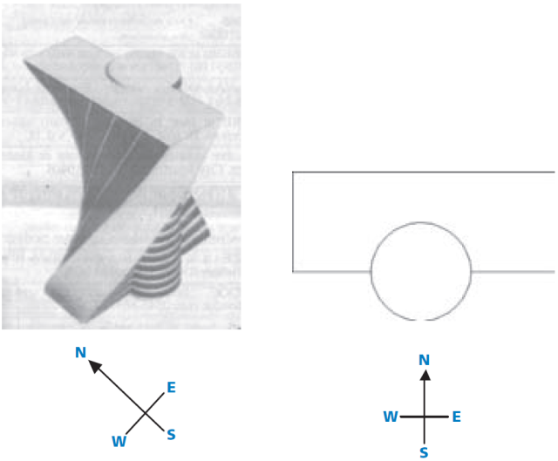
Mathematics Unit 45: Twisted Building
In modern architecture,
buildings often have
unusual shapes. The
picture here shows a
computer model of a
‘twisted building’ and a
plan of the ground floor.
The compass points show
the orientation of the building.
The ground floor of the building contains the main entrance and has room for shops. Above the ground floor there are 20 storeys containing apartments.
The plan of each storey is similar to the plan of the ground floor, but each has a slightly different orientation from the storey below. The cylinder contains the elevator shaft and a landing on each floor.
QUESTION 45.1
Estimate the total height of the building, in metres. Explain how you found your answer.
What do we want to find out?
What useful information do we know?
What other mathematical techniques do we need to apply?
What have we learned?

Slide 2
Mathematics Unit 45: Twisted Building
In modern architecture,
buildings often have
unusual shapes. The
picture here shows a
computer model of a
‘twisted building’ and a
plan of the ground floor.
The compass points show
the orientation of the building.
The ground floor of the building contains the main entrance and has room for shops. Above the ground floor there are 20 storeys containing apartments.
The plan of each storey is similar to the plan of the ground floor, but each has a slightly different orientation from the storey below. The cylinder contains the elevator shaft and a landing on each floor.
QUESTION 45.1
Estimate the total height of the building, in metres. Explain how you found your answer.
What do we want to find out?
What useful information do we know?
What other mathematical techniques do we need to apply?
What have we learned?
Back to start

Slide 3
Mathematics Unit 45: Twisted Building
In modern architecture,
buildings often have
unusual shapes. The
picture here shows a
computer model of a
‘twisted building’ and a
plan of the ground floor.
The compass points show
the orientation of the building.
The ground floor of the building contains the main entrance and has room for shops. Above the ground floor there are 20 storeys containing apartments.
The plan of each storey is similar to the plan of the ground floor, but each has a slightly different orientation from the storey below. The cylinder contains the elevator shaft and a landing on each floor.
QUESTION 45.1
Estimate the total height of the building, in metres. Explain how you found your answer.
What do we want to find out?
What useful information do we know?
What other mathematical techniques do we need to apply?
What have we learned?
Back to start

Slide 4
Mathematics Unit 45: Twisted Building
In modern architecture,
buildings often have
unusual shapes. The
picture here shows a
computer model of a
‘twisted building’ and a
plan of the ground floor.
The compass points show
the orientation of the building.
The ground floor of the building contains the main entrance and has room for shops. Above the ground floor there are 20 storeys containing apartments.
The plan of each storey is similar to the plan of the ground floor, but each has a slightly different orientation from the storey below. The cylinder contains the elevator shaft and a landing on each floor.
QUESTION 45.1
Estimate the total height of the building, in metres. Explain how you found your answer.
What do we want to find out?
What useful information do we know?
What other mathematical techniques do we need to apply?
What have we learned?
Back to start

Slide 5
Mathematics Unit 45: Twisted Building
In modern architecture,
buildings often have
unusual shapes. The
picture here shows a
computer model of a
‘twisted building’ and a
plan of the ground floor.
The compass points show
the orientation of the building.
The ground floor of the building contains the main entrance and has room for shops. Above the ground floor there are 20 storeys containing apartments.
The plan of each storey is similar to the plan of the ground floor, but each has a slightly different orientation from the storey below. The cylinder contains the elevator shaft and a landing on each floor.
QUESTION 45.1
Estimate the total height of the building, in metres. Explain how you found your answer.
What do we want to find out?
What useful information do we know?
What other mathematical techniques do we need to apply?
What have we learned?
Back to start

Slide 6
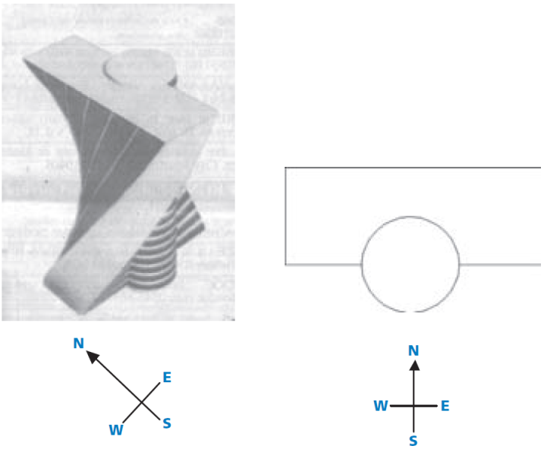
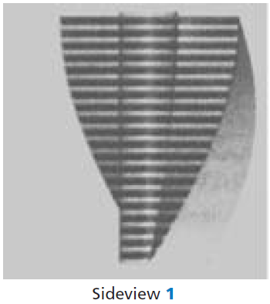
Mathematics Unit 45: Twisted Building
The following pictures include a sideview of the twisted building.
QUESTION 45.2
From which direction has Sideview 1 been drawn?
From the North.
From the West.
From the East.
From the South.
What do we want to find out?
What useful information do we know?
What other mathematical techniques do we need to apply?
What have we learned?

Slide 7
Mathematics Unit 45: Twisted Building
The following pictures include a sideview of the twisted building.
QUESTION 45.2
From which direction has Sideview 1 been drawn?
From the North.
From the West.
From the East.
From the South.
What do we want to find out?
What useful information do we know?
What other mathematical techniques do we need to apply?
What have we learned?
Back to start

Slide 8
Mathematics Unit 45: Twisted Building
The following pictures include a sideview of the twisted building.
QUESTION 45.2
From which direction has Sideview 1 been drawn?
From the North.
From the West.
From the East.
From the South.
What do we want to find out?
What useful information do we know?
What other mathematical techniques do we need to apply?
What have we learned?
Back to start

Slide 9
Mathematics Unit 45: Twisted Building
The following pictures include a sideview of the twisted building.
QUESTION 45.2
From which direction has Sideview 1 been drawn?
From the North.
From the West.
From the East.
From the South.
What do we want to find out?
What useful information do we know?
What other mathematical techniques do we need to apply?
What have we learned?
Back to start

Slide 10
Mathematics Unit 45: Twisted Building
The following pictures include a sideview of the twisted building.
QUESTION 45.2
From which direction has Sideview 1 been drawn?
From the North.
From the West.
From the East.
From the South.
What do we want to find out?
What useful information do we know?
What other mathematical techniques do we need to apply?
What have we learned?
Back to start

Slide 11
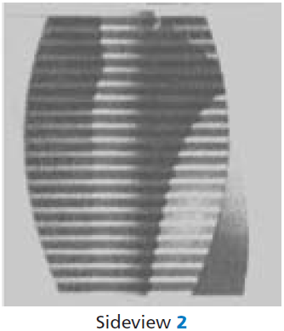
Mathematics Unit 45: Twisted Building
The following pictures include another sideview of the twisted building.
QUESTION 45.3
From which direction has Sideview 2 been drawn?
From the North West.
From the North East.
From the South West.
From the South East.
What do we want to find out?
What useful information do we know?
What other mathematical techniques do we need to apply?
What have we learned?

Slide 12
Mathematics Unit 45: Twisted Building
The following pictures include another sideview of the twisted building.
QUESTION 45.3
From which direction has Sideview 2 been drawn?
From the North West.
From the North East.
From the South West.
From the South East.
What do we want to find out?
What useful information do we know?
What other mathematical techniques do we need to apply?
What have we learned?
Back to start

Slide 13
Mathematics Unit 45: Twisted Building
The following pictures include another sideview of the twisted building.
QUESTION 45.3
From which direction has Sideview 2 been drawn?
From the North West.
From the North East.
From the South West.
From the South East.
What do we want to find out?
What useful information do we know?
What other mathematical techniques do we need to apply?
What have we learned?
Back to start

Slide 14
Mathematics Unit 45: Twisted Building
The following pictures include another sideview of the twisted building.
QUESTION 45.3
From which direction has Sideview 2 been drawn?
From the North West.
From the North East.
From the South West.
From the South East.
What do we want to find out?
What useful information do we know?
What other mathematical techniques do we need to apply?
What have we learned?
Back to start

Slide 15
Mathematics Unit 45: Twisted Building
The following pictures include another sideview of the twisted building.
QUESTION 45.3
From which direction has Sideview 2 been drawn?
From the North West.
From the North East.
From the South West.
From the South East.
What do we want to find out?
What useful information do we know?
What other mathematical techniques do we need to apply?
What have we learned?
Back to start

Slide 16
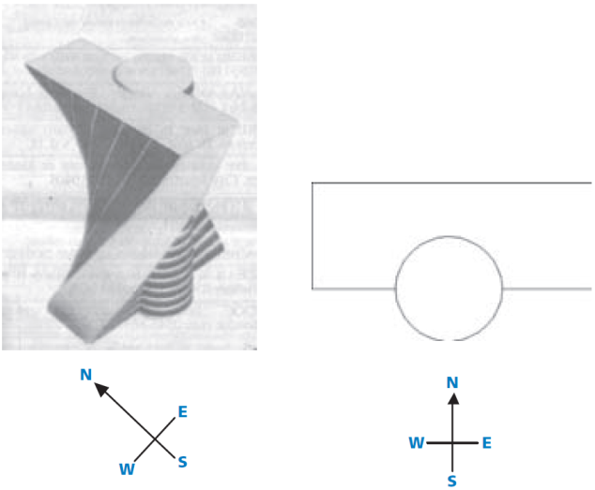
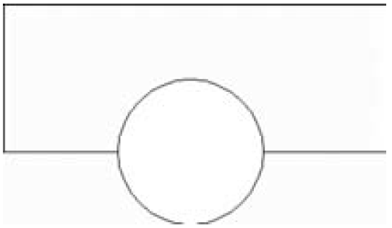
Mathematics Unit 45: Twisted Building
QUESTION 45.4
Each storey containing
apartments has a certain
‘twist’ compared to the
ground floor. The top floor
(the 20th floor above the
ground floor) is at right
angles to the ground floor.
The drawing below represents the ground floor.
Draw in this diagram the plan of the 10th floor above the ground floor, showing how this floor is situated compared to the ground floor.
What do we want to find out?
What useful information do we know?
What other mathematical techniques do we need to apply?
What have we learned?

Slide 17
Mathematics Unit 45: Twisted Building
QUESTION 45.4
Each storey containing
apartments has a certain
‘twist’ compared to the
ground floor. The top floor
(the 20th floor above the
ground floor) is at right
angles to the ground floor.
The drawing below represents the ground floor.
Draw in this diagram the plan of the 10th floor above the ground floor, showing how this floor is situated compared to the ground floor.
What do we want to find out?
What useful information do we know?
What other mathematical techniques do we need to apply?
What have we learned?
Back to start

Slide 18
Mathematics Unit 45: Twisted Building
QUESTION 45.4
Each storey containing
apartments has a certain
‘twist’ compared to the
ground floor. The top floor
(the 20th floor above the
ground floor) is at right
angles to the ground floor.
The drawing below represents the ground floor.
Draw in this diagram the plan of the 10th floor above the ground floor, showing how this floor is situated compared to the ground floor.
What do we want to find out?
What useful information do we know?
What other mathematical techniques do we need to apply?
What have we learned?
Back to start

Slide 19
Mathematics Unit 45: Twisted Building
QUESTION 45.4
Each storey containing
apartments has a certain
‘twist’ compared to the
ground floor. The top floor
(the 20th floor above the
ground floor) is at right
angles to the ground floor.
The drawing below represents the ground floor.
Draw in this diagram the plan of the 10th floor above the ground floor, showing how this floor is situated compared to the ground floor.
What do we want to find out?
What useful information do we know?
What other mathematical techniques do we need to apply?
What have we learned?
Back to start

Slide 20
Mathematics Unit 45: Twisted Building
QUESTION 45.4
Each storey containing
apartments has a certain
‘twist’ compared to the
ground floor. The top floor
(the 20th floor above the
ground floor) is at right
angles to the ground floor.
The drawing below represents the ground floor.
Draw in this diagram the plan of the 10th floor above the ground floor, showing how this floor is situated compared to the ground floor.
What do we want to find out?
What useful information do we know?
What other mathematical techniques do we need to apply?
What have we learned?
Back to start

