Slide 1
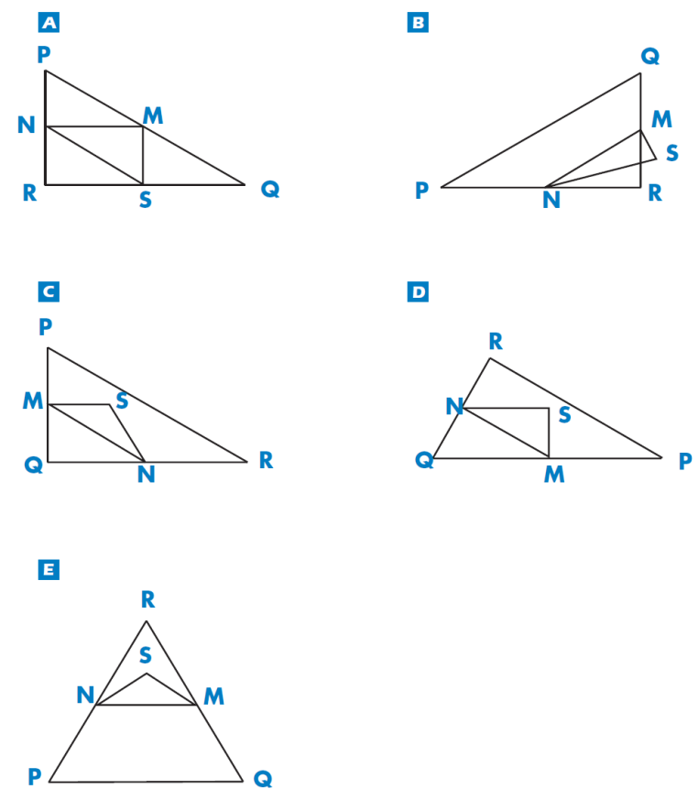
Mathematics Unit 8: Triangles
QUESTION 8.1
Circle the one figure below that fits the following description. Triangle PQR is a right angle with right angle at R. The line RQ is less than the line PR. M is the midpoint of the line PQ and N is the midpoint of the line QR. S is a point inside the triangle. The line MN is greater than the line MS.
What do we want to find out?
What useful information do we know?
What other mathematical techniques do we need to apply?
What have we learned?

Slide 2
Mathematics Unit 8: Triangles
QUESTION 8.1
Circle the one figure below that fits the following description. Triangle PQR is a right angle with right angle at R. The line RQ is less than the line PR. M is the midpoint of the line PQ and N is the midpoint of the line QR. S is a point inside the triangle. The line MN is greater than the line MS.
What do we want to find out?
What useful information do we know?
What other mathematical techniques do we need to apply?
What have we learned?
Back to start

Slide 3
Mathematics Unit 8: Triangles
QUESTION 8.1
Circle the one figure below that fits the following description. Triangle PQR is a right angle with right angle at R. The line RQ is less than the line PR. M is the midpoint of the line PQ and N is the midpoint of the line QR. S is a point inside the triangle. The line MN is greater than the line MS.
What do we want to find out?
What useful information do we know?
What other mathematical techniques do we need to apply?
What have we learned?
Back to start

Slide 4
Mathematics Unit 8: Triangles
QUESTION 8.1
Circle the one figure below that fits the following description. Triangle PQR is a right angle with right angle at R. The line RQ is less than the line PR. M is the midpoint of the line PQ and N is the midpoint of the line QR. S is a point inside the triangle. The line MN is greater than the line MS.
What do we want to find out?
What useful information do we know?
What other mathematical techniques do we need to apply?
What have we learned?
Back to start

Slide 5
Mathematics Unit 8: Triangles
QUESTION 8.1
Circle the one figure below that fits the following description. Triangle PQR is a right angle with right angle at R. The line RQ is less than the line PR. M is the midpoint of the line PQ and N is the midpoint of the line QR. S is a point inside the triangle. The line MN is greater than the line MS.
What do we want to find out?
What useful information do we know?
What other mathematical techniques do we need to apply?
What have we learned?
Back to start

