Slide 1
The New History GCSE

Slide 2
Changes at a Glance
There is no longer a Route A or B
There are still 4 units, 3 examinations and one Non Examination Unit (NEU)
Some units have remained
Some units have gone
Some NEW units
Every question on each exam paper to be answered. Currently students can choose for unit 3 and so teacher can also choose not to cover the whole course.
Maximum points awarded now 300. Different units now awarded different marks, they are no longer all uniform.
No longer possible to predict questions!!!

Slide 3
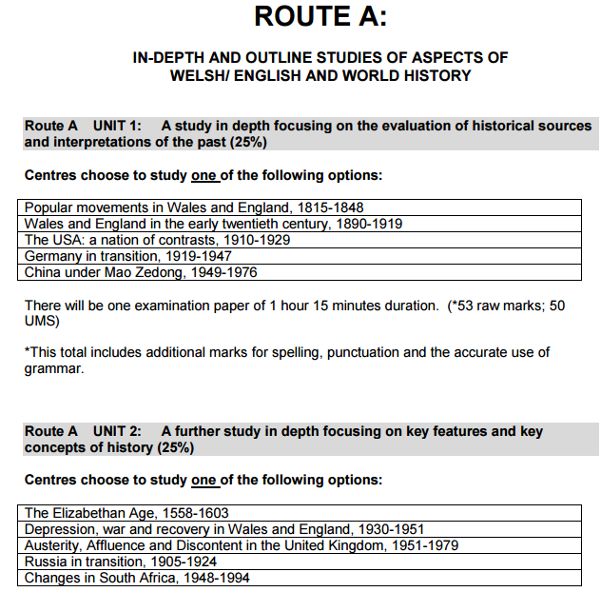
The Legacy Route A

Slide 4
Route A Unit 1: A study in depth focusing on the evaluation of historical sources and interpretations of the past
Popular movements in Wales and England, 1815 -1848
Wales and England in the early twentieth century, 1890-1919
The USA: a nation of contrasts, 1910-1929
Germany in transition, 1919-47
China under Mao Zedong, 1949-1976
Legacy Specification
Radicalism and Protest,1810-1848 – Unit 1B
Gone
The USA: a nation of contrasts, 1910-1929 – Unit 2B
Germany in transition, 1919-47 - Unit 2C
Gone
New
Specification

Slide 5
Route A Unit 2: A further study in depth
The Elizabethan Age 1558-1603
Depression, war and recovery in Wales and England 1930-51
Austerity, Affluence and Discontent in the United Kingdom, 1951-1979
Russia in transition, 1905-1924
Changes in South Africa, 1948-1994
Legacy
Spec
The Elizabethan Age 1558-1603 - Unit 1A
Depression, war and recovery in Wales and England 1930-51 – Unit 1C
Austerity, Affluence and Discontent in the United Kingdom, 1951-1979 – Unit 1D
Russia in transition, 1905-1924 – Unit 2A
Changes in South Africa, 1948-1994 - Unit 2D
New
Spec

Slide 6
Route A UNIT 3: An outline study focusing on change and continuity in the twentieth century (25%)
The development of Germany, 1919-1991
Developing relations in Palestine, Israel and the Middle East, 1919-2000
The development of the USA, 1930-2000
The development of Wales, 1900-2000
Legacy
Spec
Gone
Gone
Gone
Gone
New
Spec

Slide 7
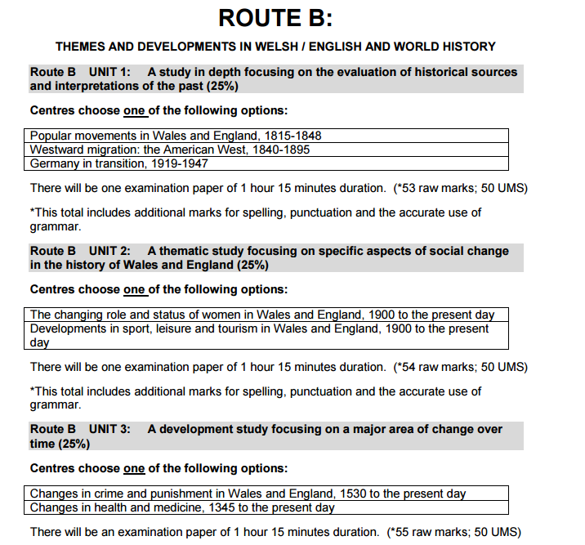
The Legacy Route B

Slide 8
Route B UNIT 1: A study in depth focusing on the evaluation of historical sources and interpretations of the past (25%)
Popular movements in Wales and England, 1815-1848
Westward migration: the American West, 1840-1895
Germany in transition, 1919-1947
Legacy Spec
Radicalism and Protest,1810-1848 – Unit 1B
Gone
Germany in transition, 1919-47 Unit 2C
New
Spec

Slide 9
Route B UNIT 2: A thematic study focusing on specific aspects of social change in the history of Wales and England (25%)
The changing role and status of women in Wales and England, 1900 to the present day
Developments in sport, leisure and tourism in Wales and England, 1900 to the present day
Legacy
Spec
Gone
Gone
New
Spec

Slide 10
Route B UNIT 3: A development study focusing on a major area of change over time (25%)
Changes in crime and punishment in Wales and England, 1530 to the present day
Changes in health and medicine, 1345 to the present day
Legacy
Spec
Changes in Crime and Punishment, c.1500 to the present day - Unit 3a
Changes in Health and Medicine, c.1340 to the present day - Unit 3b
New
Spec

Slide 11
Summary of Assessment

Slide 13
Assessment

Slide 14
Grading

Slide 15
Unit 2 - 1 hour – Can be sat in 2018

Slide 17
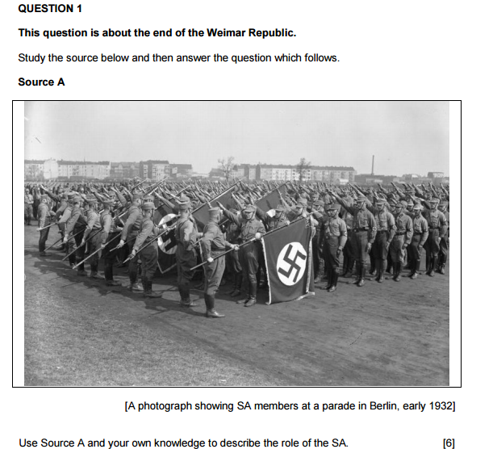

Slide 18
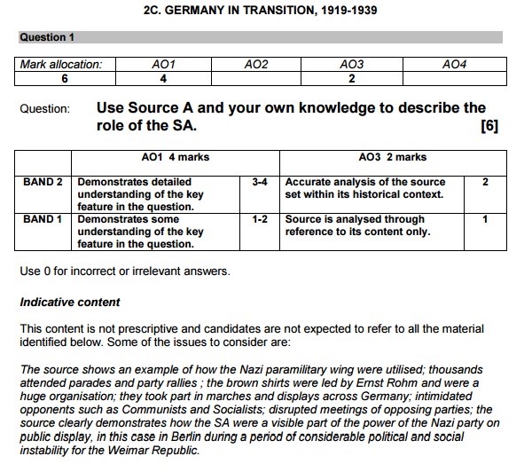

Slide 21
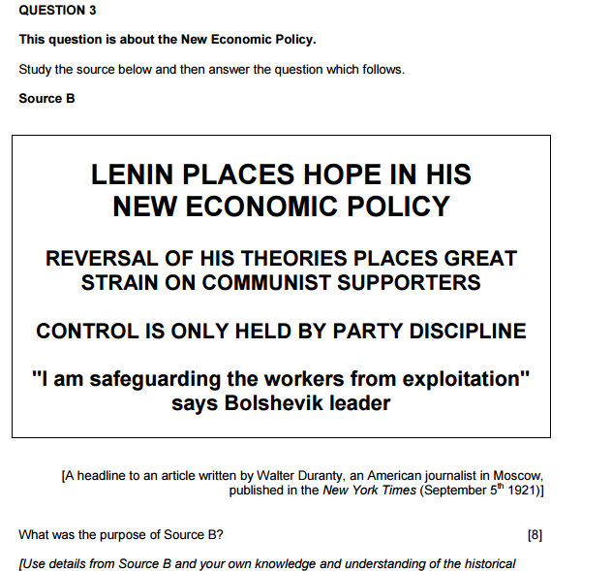

Slide 23
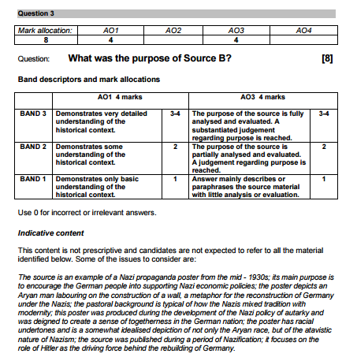

Slide 24
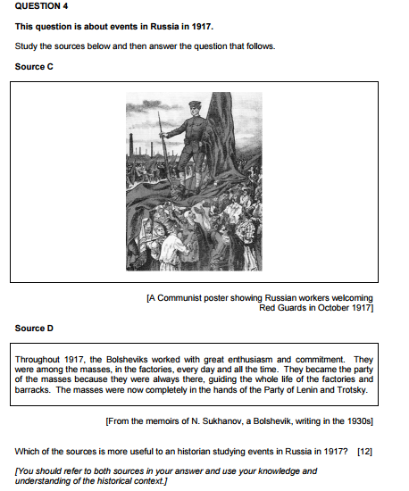

Slide 25
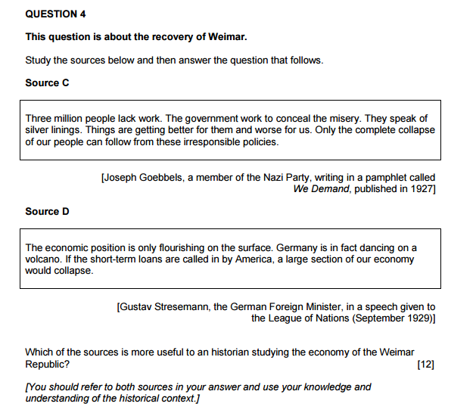

Slide 26
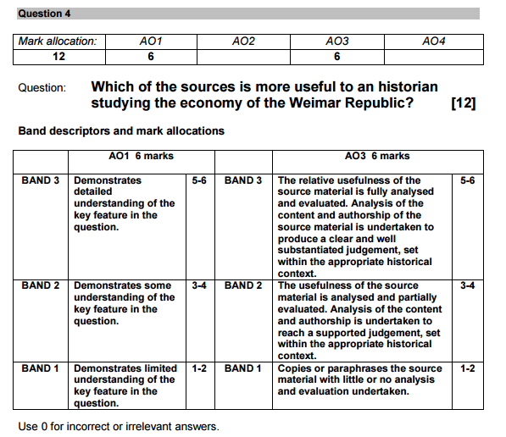

Slide 27
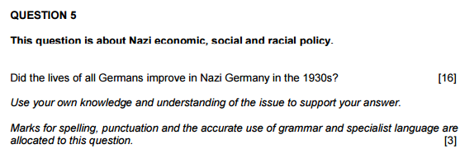

Slide 28
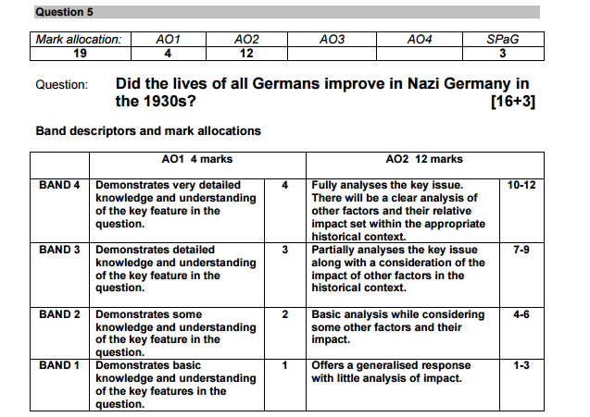

Slide 29
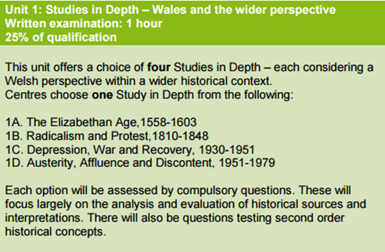
These ‘second order’ concepts include continuity and change, cause and effect, chronology, empathic understanding and the use of evidence.

Slide 30
Assessment
Unit 1 – 1 hour

Slide 31
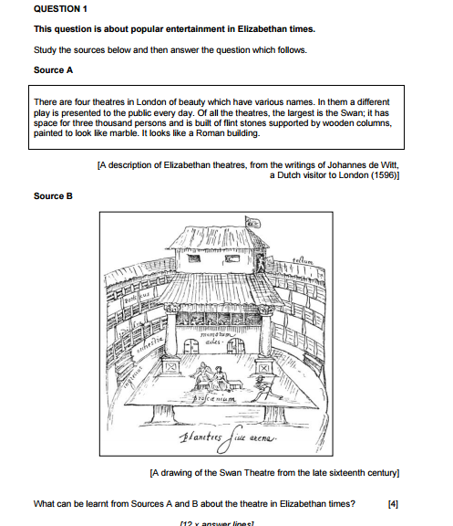

Slide 32
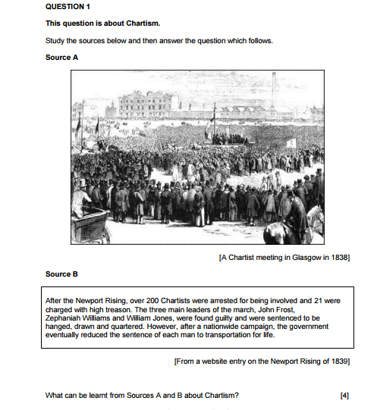

Slide 33
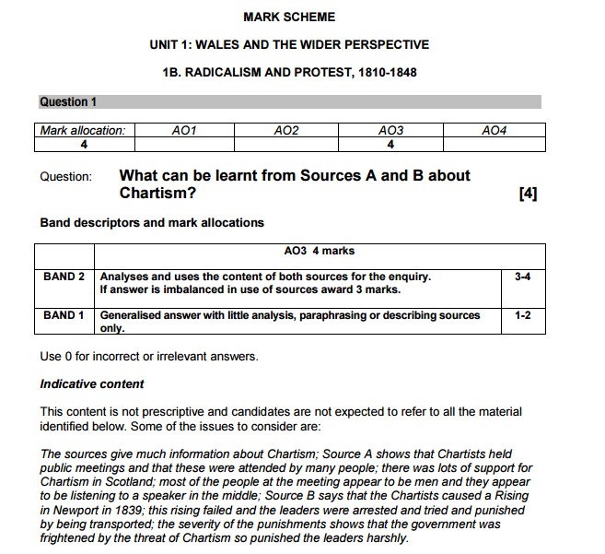

Slide 34
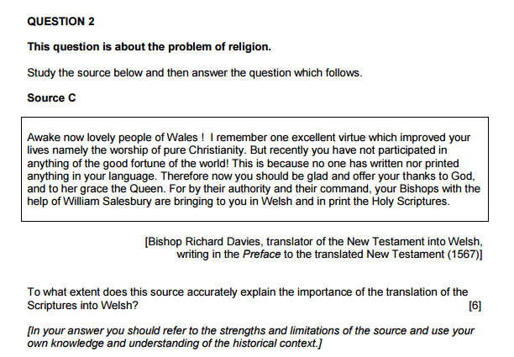

Slide 35
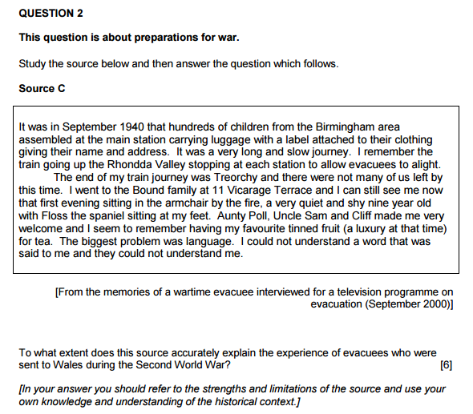

Slide 36
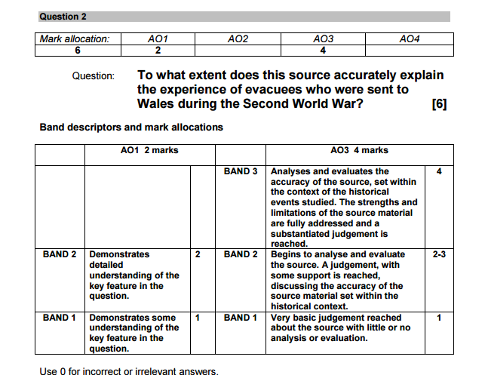

Slide 38
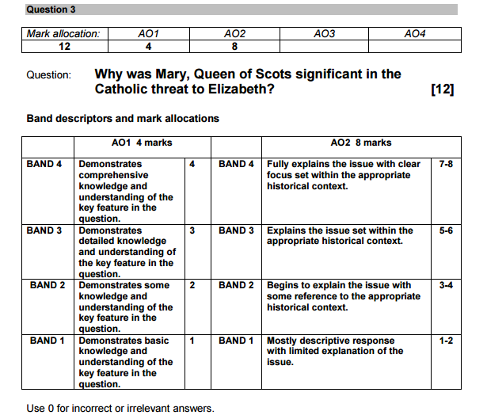

Slide 39
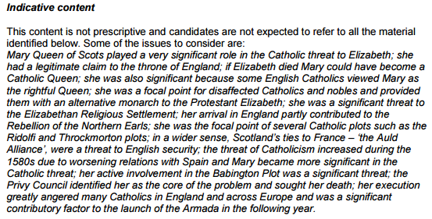

Slide 40
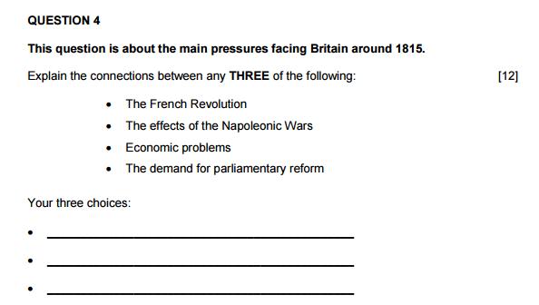

Slide 41
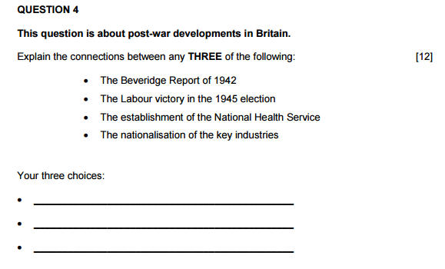

Slide 42
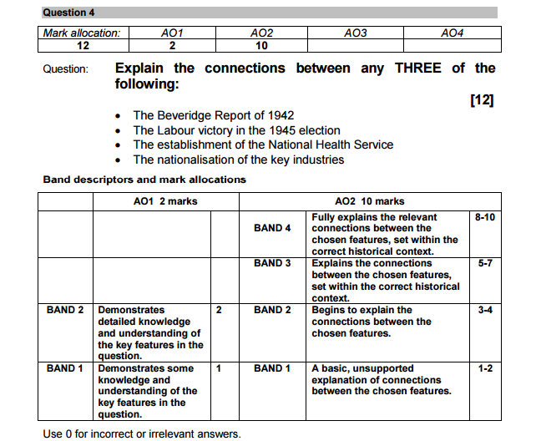

Slide 44
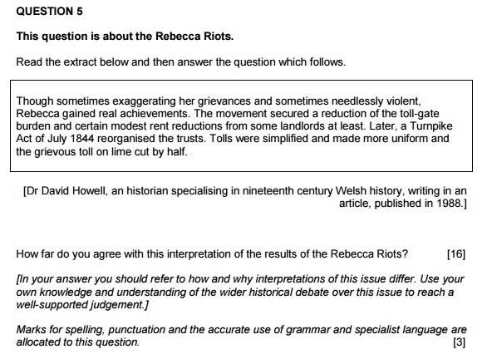

Slide 45
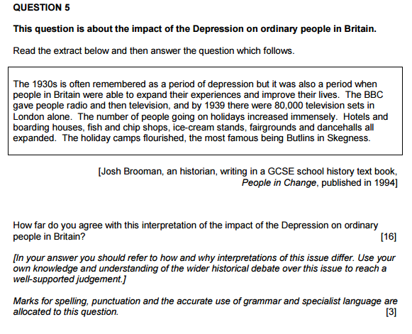

Slide 46
