Slide 1
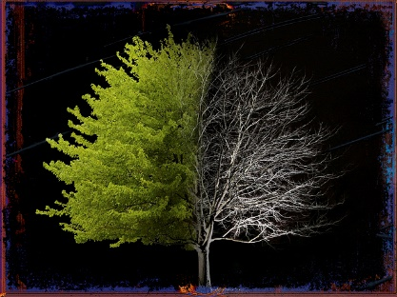
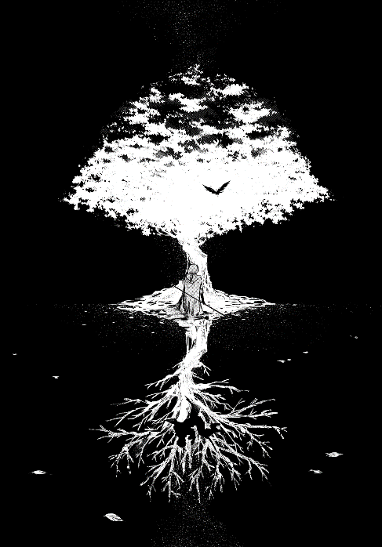
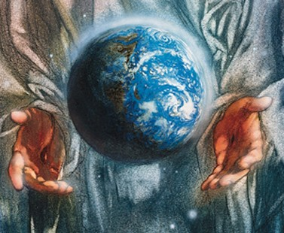
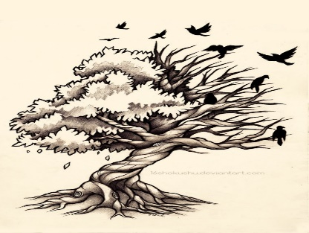
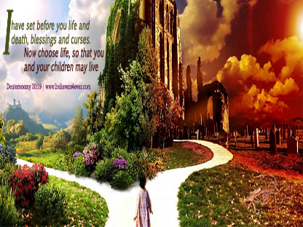
Theme 1:
Matters of Life and Death
Study Field:
The World

Slide 2
Content from Jewish and non-religious perspectives
Fields of study | Contents
THE WORLD | Orthodox and Reform Jewish beliefs, teachings and attitudes about the accounts of the origin of the universe: Genesis 1 and 2 The relationship between Jewish views and non-religious views of creation and the extent to which they conflict Jewish beliefs, teachings and attitudes about dominion, tikkun olam and bal tashchit, gemilut hasadim, stewardship, environmental responsibility, sustainability, and global citizenship: Honi from the Talmud (Avot d'Rebbe/Rabbi Natan 31b) and teachings of Maimonides' 13 Principles (number 10) TuB'shevat: an ecological awareness day commemorated by planting trees Non-religious views on: the creation of the universe: 'Big-Bang theory' (Stephen Hawking), 'Blind' Evolution versus 'Planned' Evolution (Charles Darwin and Richard Dawkins) stewardship, social and community responsibility, sustainability; 'Humanists for a Better World'

Slide 3
Jewish beliefs about creation of the world: Diamond 9
The template for the Diamond 9 activity is on the next slide. There is no need to include the reference! It makes the task even harder!
‘In the beginning God created the Heavens and the earth’. (Genesis 1:1)
‘And the earth was without form and void…..’ (Genesis 1:2)
‘So God created man in his own image, in the image of God created he him; male and female created he them.’ (Genesis 1:27)
‘And God saw everything that he had made …was very good’. (Genesis 1:31)
‘And on the seventh day God ended his work which he had made; and he rested on the seventh day from all his work which he had made.’ (Genesis 2:2)
‘And the Lord God planted a garden eastward in Eden; and there he put the man whom he had formed.’ (Genesis 2:8)
“Of every tree of the garden thou mayest freely eat: but of the tree of the knowledge of good and evil, thou shall not eat of it: for in the day that thou eatest thereof thou shalt surely die”’ (Genesis 2: 16-17)
‘And the LORD God said, It is not good that man should be alone; I will make him an help meet for him.’ (Genesis 2:18)
‘Therefore man shall leave his father and his mother, and shall cleave unto his wife.’ (Genesis 2:24)
Try and put these cards in order to discover the order of the creation story in the Bible. Then, write a short paragraph in your books showing how the world was created from a Jewish viewpoint.

Slide 4
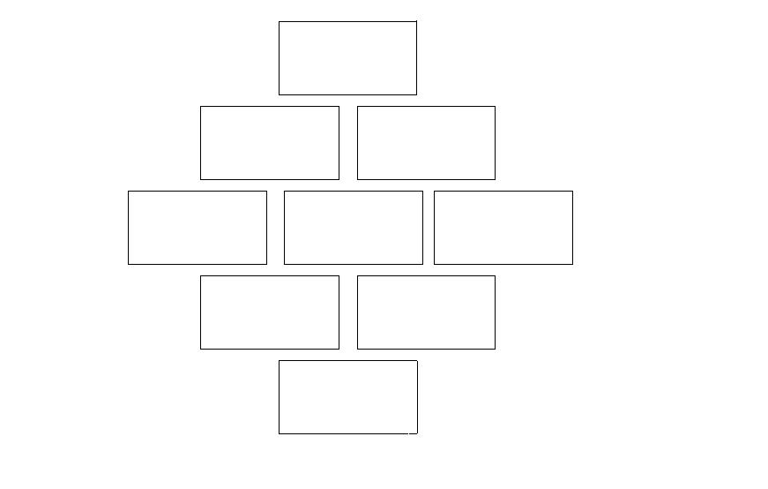
Diamond 9 = Creation of the World
Remember to write a paragraph in your books about the Jewish teaching about the creation of the world in the book of Genesis.

Slide 5
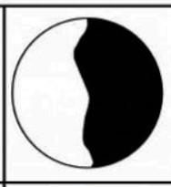
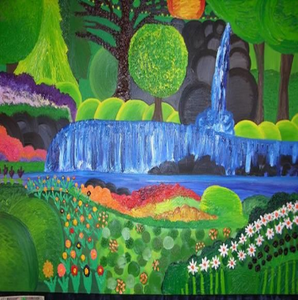
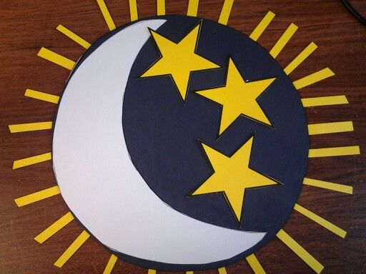
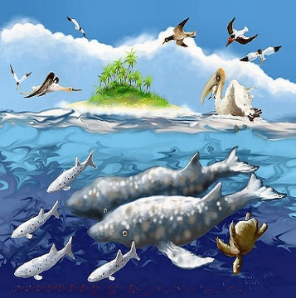
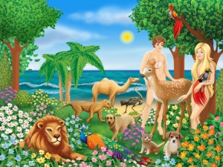
What happens every day?
Connect each picture with the correct facts.
The facts on the next slide!

Slide 6
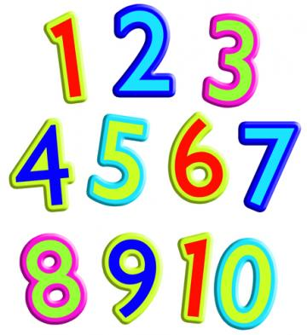
Here are facts about what happens every day in the order of creation. Connect these sentences with the correct pictures on the previous slide. You may do so by numbering the picture with the correct sentence or by cutting them out and stick them with the matching sentence in your books. It is your choice!
God created light and called it ‘a day’. He called darkness ‘night’.
God filled the waters with moving creatures and the air with birds.
God created a firmament to divide the waters that were under and above the firmament.
God blessed the land and a variety of moving creatures were made, tame, wild and crawling. Then God created a man and a woman in his own image.
God gathered the waters together and let dry land appear and it was called ‘the earth’. Then God blessed the land and it produced vegetation.
God blessed the day and made it sacred, and then he rested.
It is important for you to know what happens every day. Therefore,
number every picture!
And God made two great lights – the sun to rule the day and the moon to rule the night. He also made the stars.
STUDY THE 5W. WHO? WHY? WHERE? WHEN? WHAT? THINK HARD!

Slide 7
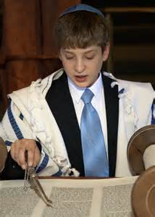
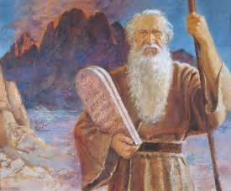
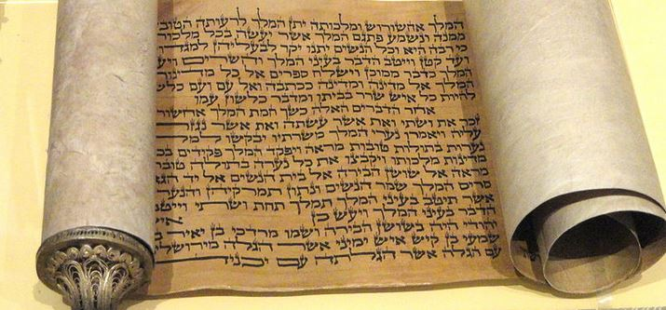
How should we explain this?
An omnipotent God and sustainer of the world
Maimonides principle number 10
I believe in ONE God who created the world. We have two stories about creation in Genesis, the first book of the Torah. The Torah, of course, is the most important book of the Tenakh, the Jewish Scriptures. In this book we have the story of how God created the world in six days and then rested on the seventh day. In the second story, Genesis 2:4-25, we have another story about how God created the world, with Adam and Eve being placed in the
Garden of Eden.
Orthodox
Jews
Reformed
Jews
v
TENAKH = ALL WORDS TRUE?
MOSES =
LITERAL

Slide 8
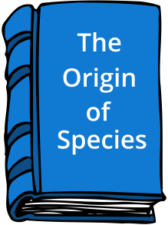
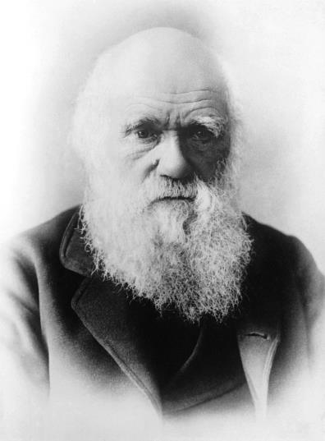
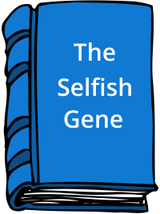
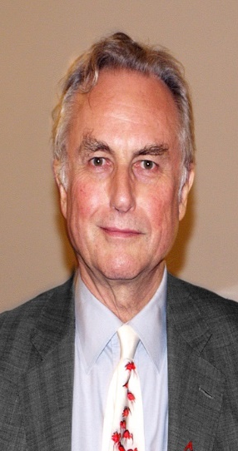
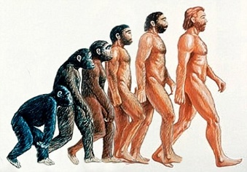
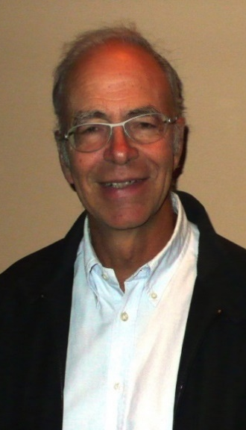
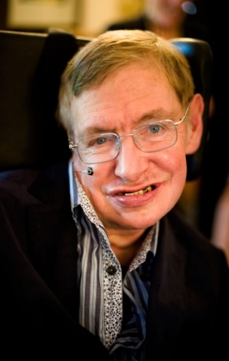
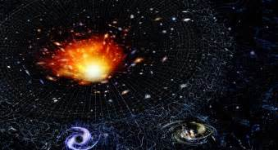
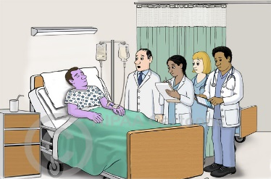
What do Scientists have to say?
“Wow! What is even more marvellous than how a man’s hand was formed in order to grab hold of something, the paws of a mole for digging, the leg of a horse, a paddle porpoise, and bat wings all created with the same pattern? That is why I support evolution.”
He thought about the theory of evolution
“Some truths force me to smile a lot. We are survival machines
- Robot motors blind programmed to keep the selfish molecules that are referred to as genes. We do what we have to do.”
He develops the theory of
evolution even further
in order to fully understand
the meaning of genes.
DEVELOPED AND EVOLVED FROM APES– HAVE NOT BEEN CREATED
1859
1976
A MIXTURE OF GENES –
NO MORE, NO LESS
1859 – AN IMPORTANT YEAR
GOD CREATING THE WORLD – NOT AT ALL!
EXPLAINING EVOLUTION IN A DETAILED AND LOGICAL WAY
THE BLIND WATCHMAKER
Charles Darwin
Richard Dawkins
Analysing the Big Bang
Theory is his main field
– Time could not even exist
before this!
He wrote about the
importance of human life and animals–
speciesism– prejudice against animals that are equal to man!
“The idea that human life is sacred because it deals with human life is a very old fashioned idea, if not middle aged...the traditional idea of the sanctity of life will bend under the pressure of scientific, technological and demographic developments! That does not make any sense at all”
“This planet is a very ordinary star. We are species of developed monkeys living on a small planet. But we have the ability to understand the Universe. This make us very special people.”
TIME DID NOT EVEN EXIST BEFORE BIG BANG!
1979
1988
IT IS NOT THE SANCTITY OF LIFE THAT IS IMPORANT BUT ITS QUALITY!
GOD, A SUPERNATURAL
BEING DID NOT CREATE THE UNIVERS! IT WAS THE LAWS OF PHYSICS.
ETHICAL PROBLEMS
FROM
NON-RELIGIOUS VIEWPOINT
Stephen Hawking
Peter Singer

Slide 9
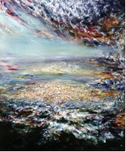
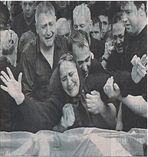
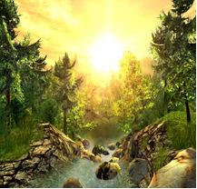
Proving the existence of God!
Here are three important words you will have to learn in this unit:
BELIEVER/THEIST : SOMEONE WHO BELIEVES IN THE EXISTENCE OF GOD
AGNOSTIC: SOMEONE WHO BELIEVES IT IS IMPOSSIBLE TO PROVE OR DISPROVE THE EXISTENCE OF GOD
ATHEIST: SOMEONE WHO DOES NOT BELIEVE IN THE EXISTENCE OF GOD
Look at the different descriptions or a few opinions about God on page in Exploring Matters in Religious Education 1 and then fill in the table below by placing a tick in the correct box:
STATEMENT | THEIST | ATHEIST | AGNOSTIC
1
2
3
4
5
6
7
8
9
10
11
12
HUMANISTS: We can understand the world through Science and that religious explanations of the world are unreliable. They say that there are no good reasons for believing in the existence of God and there is plenty of evidence to suggest that the world formed by itself, through slow gradual processes over billions of years. Evolution can help us to understand the way species are related to each other today, rather than relying on the religious belief that the creation of life is a ‘mystery’.

Slide 10
Essential Information! Defining terms!
(These may be cut like cards – ‘mix & match’)
 | This is a process whereby scientists/some religious believers believe that different creatures have developed from early and natural other species in the history of the earth e.g. Darwin believed that people had evolved from apes. This ids done by means of natural selection, animals or birds that adapt to the environment that they live in. Orthodox Jews believe that this idea contradicts their beliefs and their teaching in the Torah.
 | A scientific theory that states the earth and time have begun about 15 billion years ago. According to this theory life has started from singularity i.e. from a very small dot. This dot was hot and thick. It expands by means of genes that develop into atoms. They have given birth to stars and planets. Some physicists believe that the earth is continuing to expand even today. This is the theory that Stephen Hawkins believes in. Some Reformed Jews might support this theory with God being the designer behind the big bang.
 | Earth was created by accident without any form of an intelligent design. The earth as it is seen today was the result of different natural processes. According to Richard Dawkins the development of the genes of different creatures has been responsible for the condition of the world as we see it today. Peter Singer seems to agree with him to some extent. Animals should be considered equal to man – ,man is no way special, and therefore does not have a soul. Orthodox Jews would totally disagree with this idea – there must be an intelligent designer behind it all.
 | For those who believe in a planned evolution there must be some sort of design lying behind the creation of the world .An American scientist called Michael Behe strongly believes in this idea. For him this idea can be compared to a mousetrap. No part will work at all if any other part is broken! Some Reformed Jews might also agree with him.
EVOLUTION
THE BIG BANG
BLIND EVOLUTION
PLANNED EVOLUTION

Slide 11
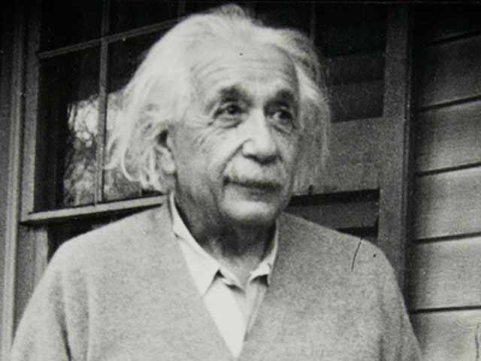
Religion v Science!
This is the result of a survey made in Britain during 2008. 2060 people responded to this survey. They were asked if this statement was true or not.
This is the statement: “The idea of a non-religious evolution seems to make a belief in God unnecessary and absurd.” Do you agree?
You may see the results in the table below:
P
R
O
B
L
E
M
Analyse the results by explaining what the results tell us about modern ideas of creation.
Why might some people find these results surprising?
 | %
Definitely true | 13
Probably true | 21
Probably untrue | 27
Definitely untrue | 30
Don’t know | 9
The more I study Science the more I believe in the existence of God.
EXPLAINING CREATION
CONCLUSION: Only 42% of British people accept the idea of atheistic evolution.
SCIENCE = HOW
RELIGION = WHY
EINSTEIN

Slide 12
LOOK AT THE NEXT SLIDE!
What does the Tenakh say?
God blessed them and said, “Be fruitful and multiply, fill the
Earth and submit to it;
rule over the fish of the sea,
the birds of the air and
everything living that moves
on the earth.” GENESIS 1:28
Read
Genesis 1:28 and the Psalms 8:6!
“You made them rulers over
the works of your hands; you
put everything under their
feet.”
PSALMS 8:6
What do these verses say about the authority of man and his environmental responsibility over the earth? Oral discussion/
written explanation!

Slide 13
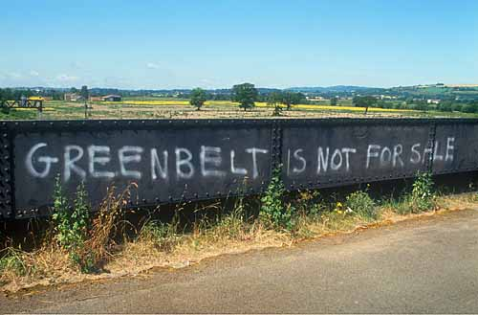
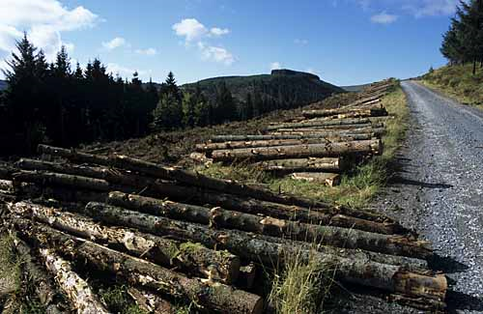
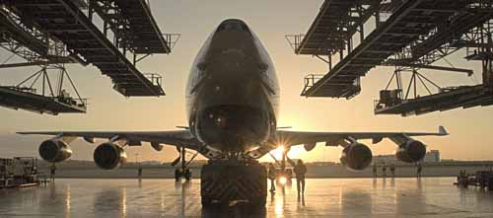
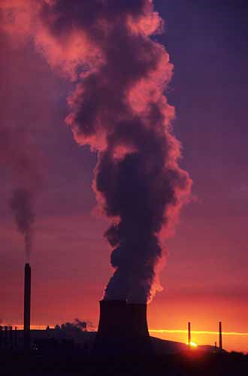
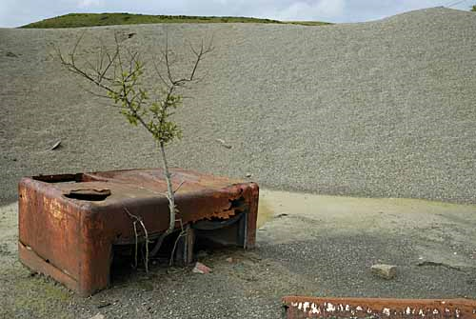
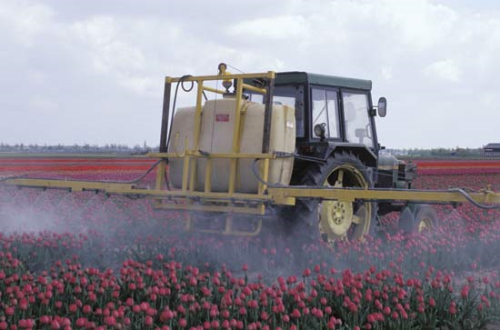
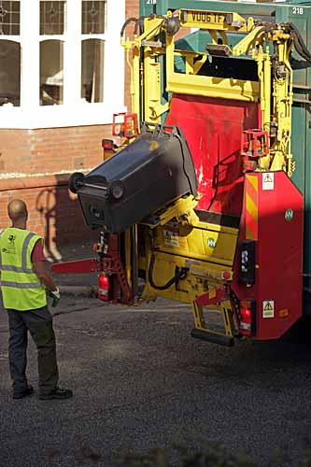
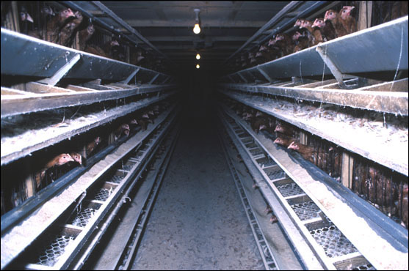
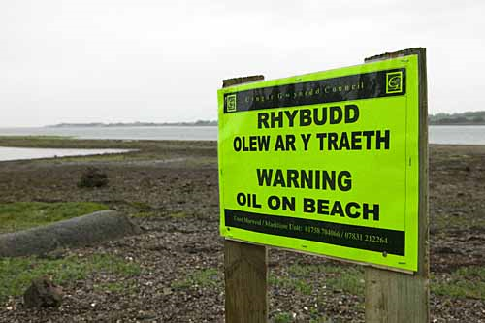
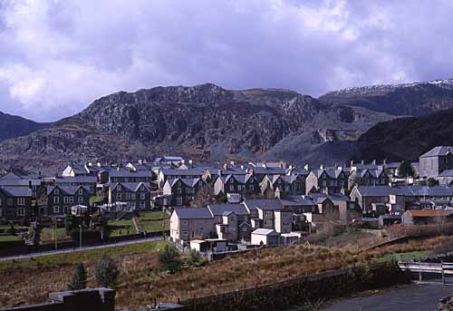
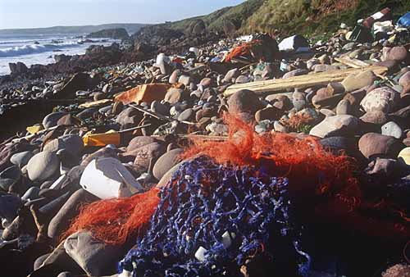
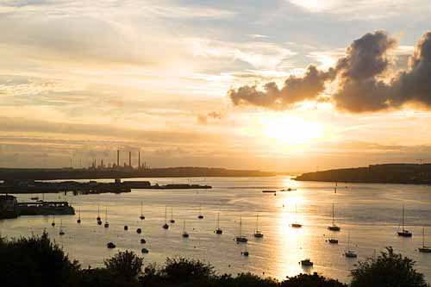
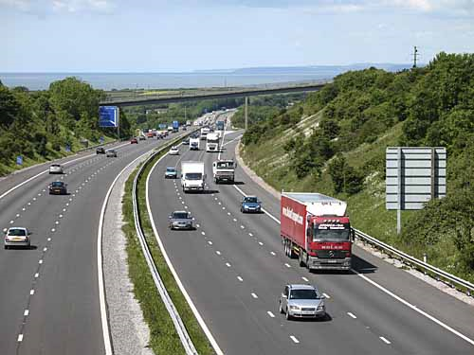
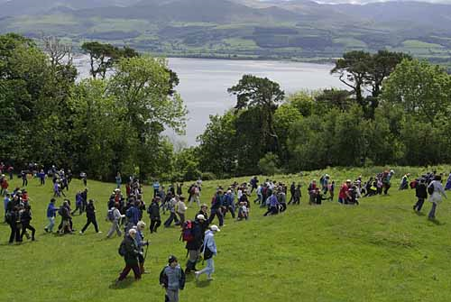
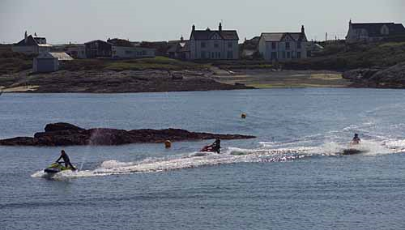
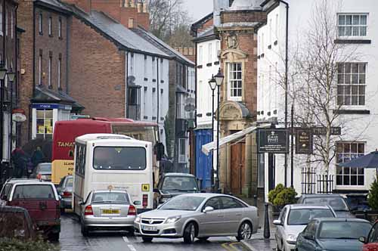
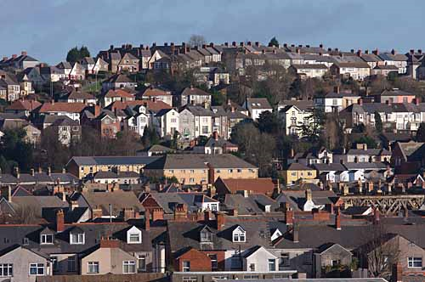
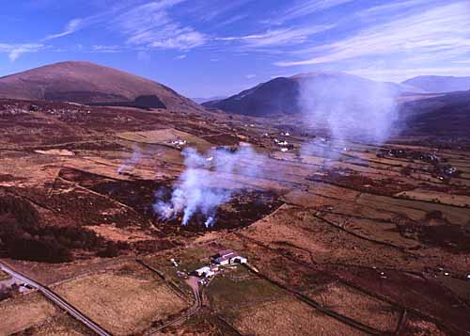

Slide 14
Spider Chart!
Look back at the last slide in order to see how man can ruin the world. Then answer the question on how we should use our natural resources in order to maintain the world in the correct way. Do this in the form of a spider chart!
T
H
E
5
W
How should we use the natural resources of our world?
You may use non-religious ideas here as well!
Think and discuss before you start!

Slide 15
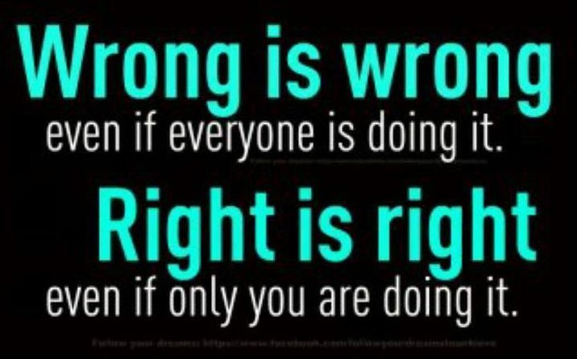
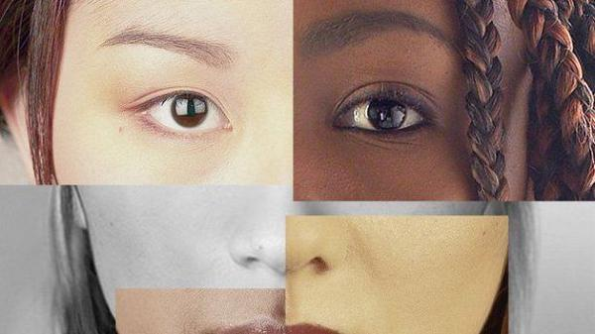
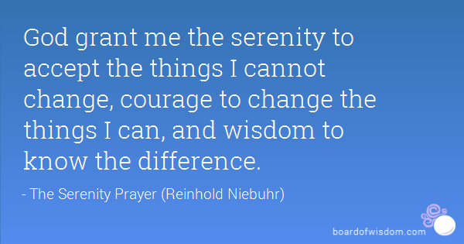
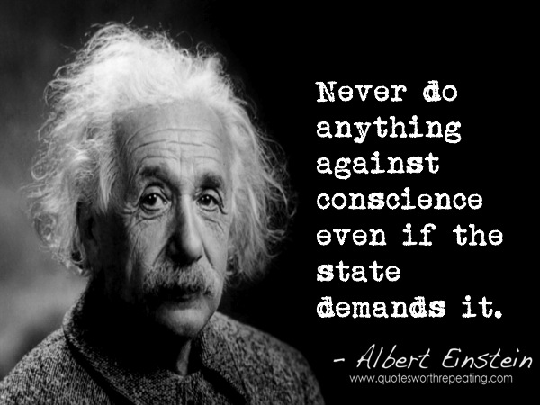
NEED TO
THINK!
PREJUDICE
WORLDWIDE
CITIZENSHIP=
WHAT ROLE
DOES A /
JEW/
HUMANIST
HAVE TO PLAY
IN IT?
POVERTY/WEALTH
EQUALITY
CHARITIES
RIGHT & WRONG
GOVERNMENT
PERSONAL CONVICTION
COMMITMENT
CONSCIENCE
WORLD
WISDOM
CONTINENT
JUSTICE
COUNTRY
HUMAN RIGHTS
COUNTY
SEGREGATION
TOWN
VILLAGE
GOLDEN RULE = DO TO OTHERS AS YOU WOULD LIKE
OTHERS DO TO YOU = THE WORDS OF THE TORAH!

Slide 16
JEWISH TERMS
and their connection with stewardship and looking after the world
Deuteronomy 20:19
“When you lay siege to a city…do not destroy its trees by putting an axe to them”
BAL TASHCHIT =
“do not destroy”.
Use resources wisely and do not waste or exploit any.
TIKKUN OLAM =
“Trwsio/cadw’r ddaear”
That is why the Jews work hard to look after the earth by making a reasonable use of its resources and emphasise
a great deal on recycling.
GEMILUT HASADIM = MITZVAH
= duty for every Jew =
“To be kind/do a favour”
It is important to take care of
others and the world created by
God. Caring for the environment might mean going out of your way not to be wasteful or being prepared to pay more for ethical products e.g. when you buy food for the family.
What type of things could Jews do in order to keep the above commandments?

Slide 17
Humanists for a better world!
"Arguments for preservation based on the beauty of wilderness are sometimes treated as if they were of little weight because they are 'merely aesthetic'. That is a mistake. We go to great lengths to preserve the artistic treasures of earlier human civilisations. It is difficult to imagine any economic gain that we would be prepared to accept as adequate compensation for, for instance, the destruction of the paintings in the Louvre. How should we compare the aesthetic value of wilderness with that of the paintings in the Louvre? Here, perhaps, judgment does become inescapably subjective; so I shall report my own experiences. I have looked at the paintings in the Louvre, and in many of the other great galleries of Europe and the United States. I think I have a reasonable sense of appreciation of the fine arts; yet I have not had, in any museum, experiences that have filled my aesthetic senses in the way that they are filled when I walk in a natural setting and pause to survey the view from a rocky peak overlooking a forested valley, or by a stream tumbling over moss-covered boulders set amongst tall tree-ferns, growing in the shade of the forest canopy, I do not think I am alone in this; for many people, wilderness is the source of the greatest feelings of aesthetic appreciation, rising to an almost mystical intensity.“
Geiriau gan Peter Singer (sydd gyda barn gref am rywogaethiaeth!)
http://www.humanistlife.org.uk/tag/environment/ http://www.humanismforschools.org.uk/pdfs/environmental%20issues.pdf http://www.shapworkingparty.org.uk/journals/articles_0809/copson.pdf
What does Peter Singer
have to say about looking
after the world? Look at the different websites to discover the humanist approach towards the subject.
Look at the above websites in order to have a more detailed answer. That is important!

Slide 18
Honi from the Talmud
HONI’S GRAVESTONE
PLANTING TREES AS A
MEANS OF RESPECT
THE CIRCLE OF RAIN DROPS
Browse the website www.g-dcast.com/tu-bshvat (also seen on youtube) and www.jewishmag.com/127mag/choni_hamaagal/choni_hamaagal.htm
In order to discover what is the contribution of Honi to the Jewish teaching on preserving the earth. Prepare a poster to convey his ideas – their purpose, their importance and significance.
Avot d’Rebbe/Rabbi Natan 31b = an explanation on parts of the Talmud dealing with the Jewish teaching on stewardship, environmental responsibility and sustainability.

Slide 19
The example of a loving creator God should lead human beings to act lovingly towards animals
Inflicting pain on any living creature is incompatible with living in a Christ-like way
To love those who cannot love you in the same way is a way of showing agape (Christian love)
God made animals to SERVE man, as his companion and as his food. Man NAMES the animals which shows he has power over them (Gensis 2:18-20)
Maimonides
He lived in the twelfth century.
He taught that animals must be respected for themselves; they were not created by God just for the benefit of humans.
The Torah teaches that, although humans have been given dominion over animals, this does not give us the right to exploit and harm them.
And God said, Let us make man in our image, after our likeness: and let them have dominion over the fish of the sea, and over the fowl of the air, and over the cattle, and over all the earth, and over every creeping thing that creepeth upon the earth”
God gave man POWER over animals Genesis 1:26
In God's ideal world human beings live in harmony with animals
The Garden of Eden, in which human beings lived in peace and harmony with animals, demonstrates God's ideal world, and the state of affairs that human beings should work towards
The prophet Isaiah describes the Kingdom of Heaven as a place where animals and human beings live together in peace
Humans,
Animals,
and religion
ORTHODOX JEWS
Animals were created to be used by human beings
Animals do not have the ability to reason, and are therefore inferior to human beings
The status of animals is shown by the fact that the punishment for killing someone else's animal is a punishment for misusing that person's property, not for killing the animal
Maimonides told human beings to be kind to the weak and helpless
In comparison to human beings, animals are often weak and helpless
Christians should therefore show compassion to animals
A quote by C.S Lewis
“[If animals have no soul then] they have no moral responsibilities and are not immortal. But the absence of 'soul' in that sense makes the infliction of pain upon them not easier but harder to justify, for it means that animals cannot deserve pain, nor profit morally by the discipline of pain, nor be recompensed by happiness in another life for suffering in this. ... 'Soullessness', in so far as it is relevant to the question at all, is an argument against vivisection
The Catechism of the Catholic Church tells use that:
It is contrary to human dignity to cause animals to suffer or die needlessly.
It is likewise unworthy to spend money on them that should as a priority go to the relief of human misery.
Medical and scientific experimentation on animals is a morally acceptable practice if it remains within
reasonable limits and contributes to caring for or saving human lives.
Humans have souls and animals don't
Humans have reason and animals don't
Genesis 1:29
“And God said, Behold, I have given you every herb bearing seed, which is upon the face of all the earth, and every tree, in the which is the fruit of a tree yielding seed; to you it shall be for meat.”
Humans occupy a favoured position in the eyes of God and creation. Although no human should be needlessly cruel to animals, the use of animals in medical research is justified, as through their use our lives are enhanced, just as wearing the skin of an animal or eating their flesh is legitimate use of animals sanctioned by God.
St. Francis of Assisi
He preached to the animals and frequently prayed in their company. He is the patron saint of animals.
He claimed that animals DID in fact have souls, that they were made ‘from the same source’ as humans.
Animals are somewhat more revered in the Talmud. We have a responsibility to care for them, as a way of showing love for God’s creation. Animals have their own value, not just financial value, or value for what they can provide human beings. As a result, many Methodists and Quakers believe that the use of animals in medical research is wrong
“To say we love God ... and at the same time exercise cruelty toward the least creature ... was a contradiction in itself”
A charity for animals
God has the right to have everything he created treated respectfully - wronging animals is wronging God

Slide 20
Peter Singer
“We only treat animals differently because they are a different species to us. This is no better than racism”
All new drugs must be tested on at least 2 different species of animal before going to human trials
22m animals are killed each year for food in the UK – 255 every second
Tom Regan
“Animals lives are no less important to them as our lives are to us
Hunting with dogs has been banned since 2004. The first person to be prosecuted for this was in 2012, with legal fees of £300’000
“Overfishing causes Pacific Bluefin
tuna numbers to drop 96%”
“Animal testing increased life expectancy by 25 years”
Humans, animals,
society, and the law
Jeremy Bentham
“The question is not can they reason, or can they talk, but can they suffer?”
Animals must be stunned before they are killed. Religious slaughter is exempt from this rule
“Animal rights thugs: Researchers’ children are not off limits”
Animal welfare law was first introduced in the UK in 1822. There are different laws for animals that are pets, farmed, and experimented on
Animal testing helped develop the vaccinations for TB, meningitis, and measles, amongst many others. It has probably saved millions of human lives
Michael Leahy
“Animals do not think like us, use language like us, or suffer like us. We are more important”
Thalidomide was tested extensively on animals with no problems. It caused severe birth defects in humans (below)
Meat has been an important part of the human diet for millennia

Slide 21
Stewardship
A Christian/Jewish opinion
When God created the world he created man last as the pinnacle of his creation. Therefore, man has AUTHORITY over nature and every other living creature and has the right to kill animals in order to get food. All animals, however, should be treated with sympathy and respect. A STEWARD is a man with the responsibility and duty to look after what has been created. Both Genesis 1:26 a Genesis 1:28 show this when it states that man has a SOUL whilst an animal hasn’t got any. When God created Adam from the dust of the earth according to Genesis 2:7 he was given a special status over the rest of nature. Yet again, man has the responsibility to use the resources of the earth in a sustainable way in order to transfer everything to the next generation.
A Humanist Opinion
Humanists try to base their thinking on reasoning and evidence, rejecting ideas that rely on belief in a supernatural being (God). Most humanists agree with the ideas of stewardship; they say that we have a responsibility to work for a more sustainable world, causing as little harm to the environment as possible. However, they believe this because they say it makes sense, not because God has placed us here for that purpose. Man should treat an animal with dignity and respect according to Jews – that is why an animal should be killed in a specific way = SHECHITAH

Slide 22
Think!
“Everybody has a responsibility to look after
the world”.
How should we answer this question?
Try and use as many religious and non-religious
terms as possible in your answer.
This is very important.

Slide 23
Tu B’Shevat
‘DANGOS’ FORMULA
Dweud (Say) ……….. Name of person or agency
Adnabod (Know) ….. The religious tradition they belong to
Nodi’r (Note) ……….. The context the agency or person works for
Gweld (See) ………….. Some of the main aspects of their work
Olrhain (Trace) ………. How their work shows the teaching of the
religion they belong to
Sôn (Mention) ……….. Specific examples of short and long term
projects
Browse the following website www.kipandfriends.com/uploads/2/3/7/5/23753282/jewish_… and design an information sheet/pamphlet that will prove the formula DANGOS and show how the charity promotes worldwide citizenship.
www.chabad.org › JewishKids.org › Holidays
www.chabad.org › Jewish Practice › Jewish Holidays › 15 Shevat
www.akidsheart.com/holidays/days/shevat.htm
More help for you!

Slide 24
Useful websites for this unit!
These are only examples – there are many more videos and websites available.
W.J.E.C. website
www.bbc.co.uk/timelines/zq8gcdm
www.darwin-online.org.uk/biography.html
www.hawking.org.uk
www.independent.co.uk/topic/stephen-hawking
https://richarddawkins.net
https://www.youtube.com/watch?v=BLtOffrpsHQ
https://www.youtube.com/watch?v=6qnOIhLZTpg
https://www.youtube.com/watch?v=y8hy8NxZvFY
https://www.youtube.com/watch?v=Jzkm1E5RqJo
www.biography.com/people/peter-singer-39994
www.petersinger.info
https://en.wikipedia.org/wiki/World_citizen
www.wittenburgministries.com/site/index.php?option=com_content&...
www.creationmoments.com/content/stewards-earth
https://www.youtube.com/watch?v=J7QKYeMbb_8
https://www.youtube.com/watch?v=R_pgnC6ORjY
https://humanism.org.uk/about/h4bw/about-us
www.chabad.org › JewishKids.org › Holidays
www.chabad.org › Jewish Practice › Jewish Holidays › 15 Shevat
www.akidsheart.com/holidays/days/shevat.htm

