Slide 1
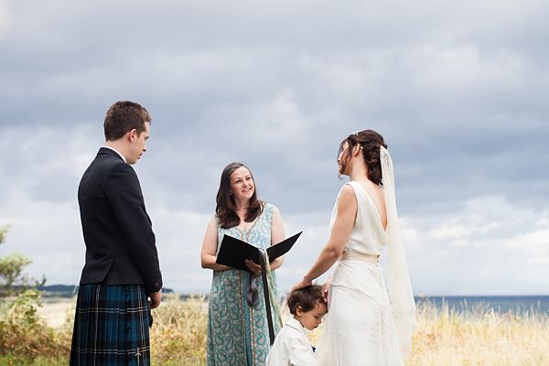
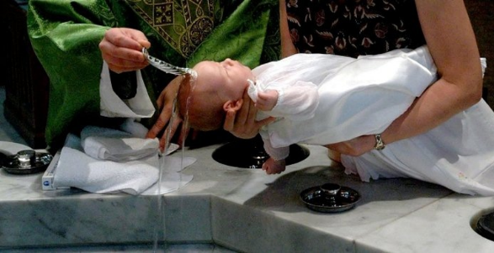
Recap – Silent Starter
On your whiteboards
A) Explain what a rite of passage is. (2)

Slide 2
Our Learning Journey
Objective – To evaluate the importance of rites of passage.
Define using examples what a rite of passage is. | To consider the importance of the rites of passage from secular and non religious ceremonies. | Evaluate the claim that ceremonies to mark rites of passage are a waste of time.
2-3 | 3-4 | 4-9
EPR Vocabulary | Meaning
Secular | Unrelated to religion or non religious

Slide 3
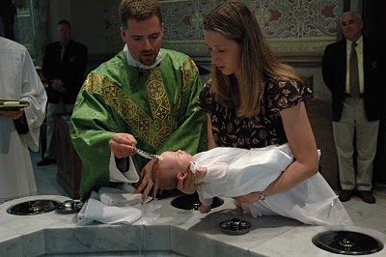
Why are religious naming ceremonies important?

Slide 4
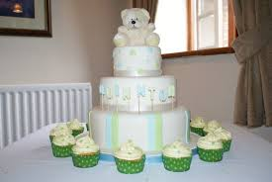
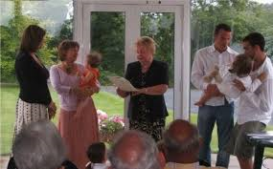
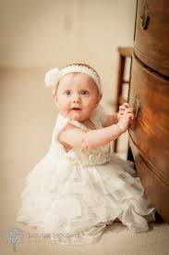
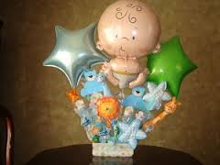
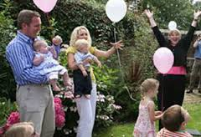
Humanist Naming Ceremony
Watch the following clip and note down why this ceremony is important for humanists.
Naming Ceremony
https://www.youtube.com/watch?v=YIPzuBeIgDg

Slide 5
Our Learning Journey
Objective – To evaluate the importance of rites of passage.
Define using examples what a rite of passage is. | To consider the importance of the rites of passage from secular and non religious ceremonies. | Evaluate the claim that ceremonies to mark rites of passage are a waste of time.
2-3 | 3-4 | 4-9
EPR Vocabulary | Meaning
Secular | Unrelated to religion or non religious

Slide 6
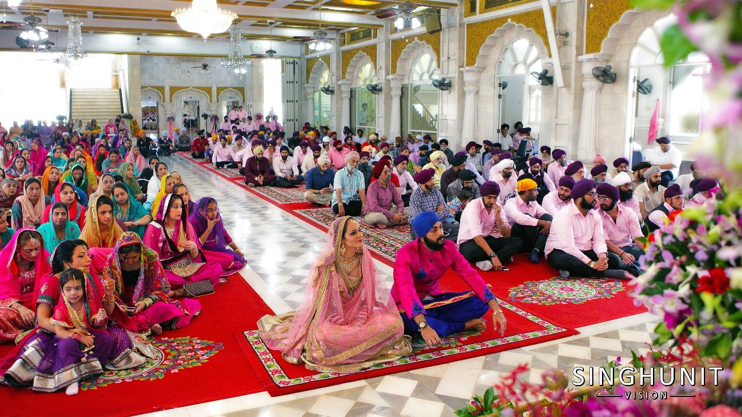
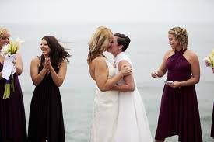
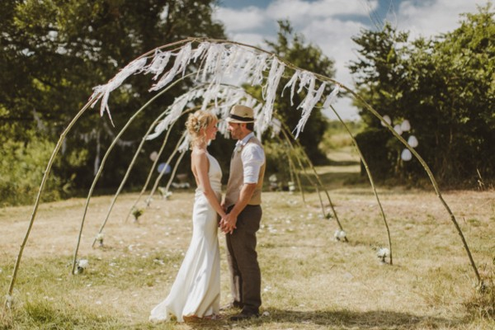
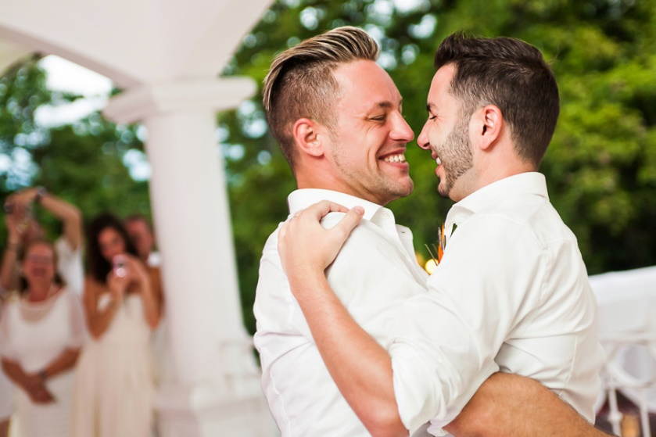
Why do people get married? Why is marriage important?
https://www.youtube.com/watch?v=C_xSxRms1XY
https://www.truetube.co.uk/film/christian-marriage

Slide 7
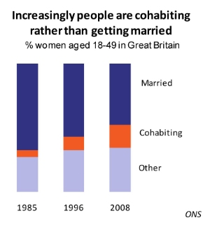
Is marriage important in 2016 in Great Britain?
What does this graph show about marriage in Great Britain?
What do you think does cohabitation means?
Why do you think less people are choosing to get married?

Slide 8
Our Learning Journey
Objective – To evaluate the importance of rites of passage.
Define using examples what a rite of passage is. | To consider the importance of the rites of passage from secular and non religious ceremonies. | Evaluate the claim that ceremonies to mark rites of passage are a waste of time.
2-3 | 3-4 | 4-9
EPR Vocabulary | Meaning
Secular | Unrelated to religion or non religious
https://www.youtube.com/watch?v=wzTXicmkrQ4&feature=share

Slide 9
D. “ Ceremonies to celebrate rites of passage are a waste of time”
Discuss the statement showing that you have considered more than one point of view.
(You must refer to religion and belief in your answer.) 15 Marks
You must use the DAADOS Framework for all part D GCSE questions.

Slide 10
Our Learning Journey
Objective – To evaluate the importance of rites of passage.
Define using examples what a rite of passage is. | To consider the importance of the rites of passage from secular and non religious ceremonies. | Evaluate the claim that ceremonies to mark rites of passage are a waste of time.
2-3 | 3-4 | 4-9
EPR Vocabulary | Meaning
Secular | Unrelated to religion or non religious

Slide 11
GCSE Evaluation skills: DAADOS
Define
Agree
Another view
Disagree
Other views
Summary
This should be a clarification of the question and a definition of any key terms.
No more than two sentences
Two PEE paragraphs that MUST be linked to teachings /beliefs/practices
One/Two PEE paragraphs making points which may not agree but give another thought on the quote.
Two PEE paragraphs that MUST be linked to teachings/beliefs/practices
One/Two PEE paragraphs Can you think of any other views on this quote they do not have to be religious.
Two sentences This should just be a short summary/ conclusion. What is the impact of the statement on individuals or society.

Slide 12
Define
Agree
Another view
Disagree
Other views
Summary
Writing Frame: 15 mark Evaluation Questions
This question is asking for a discussion about…
[define any key term] means……
Some [say who] may agree with this quote… [include a belief, teaching or practice]… this means…… and so…… [link back to the quote, how does it agree?]
In addition [say who] may also agree with this… [include a belief, teaching or practice] … this means…. and supports the quote by/because…. [link back to quote how does it agree?]
Others such as [say who if you can] may say… [make your point doesn’t have to agree or disagree] this means…. for example….
Some [say who] may disagree with this quote… [include a belief, teaching or practice] … this means…… therefore … [link back to the quote, how does it agree?]
In addition [say who] may also disagree with this… [include a belief, teaching or practice] … this means…. and argues against the quote by/because…. [link back to quote how does it agree?]
A [Humanist/ atheist] may say… [make your point doesn’t have to agree or disagree] because… this means that…
There are many different views on those issue, if this quote was true then… [explain the affect of it being true on individuals or society]

Slide 13
‘Ceremonies to celebrate rites of passage are a waste of time.’
Discuss this statement showing you have considered more than one point of view.
(You must refer to religion and belief in your answer) (15 marks)
Answer this using DAADOS framework.
In the exam you would have one minute per mark. So you would only have 15 minutes for this task.
15 minutes
End

