Slide 1
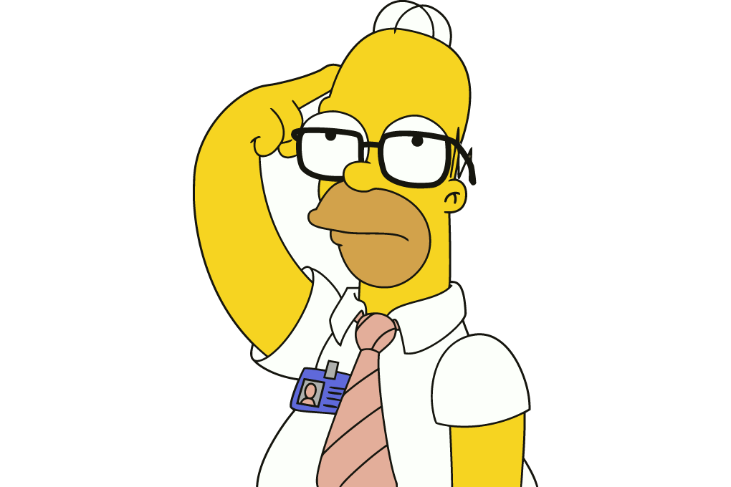
bore da, sut wyt ti. john ydw i a dw i’n byw yn rhuthun. mae gen i brown llygaid a gwallt melyn. dw i’n mnd i Ysgol Brynhyfryd a dw i’n dosbarth 7F. Dw i’n hofi ysgol acos mae’n hwly.
S
X
//
~~~~~~~~~

Slide 2
x
x
bore da, sut wyt ti. john ydw i a dw i’n byw yn rhuthun. mae gen i brown llygaid a gwallt melyn. dw i’n mnd i Ysgol Brynhyfryd a dw i’n dosbarth 7F. Dw i’n hofi ysgol acos mae’n hwly.
x
x
~~~~~~~~~~~~~~~~~~~~~~
s
s
s
s
S
X
//
~~~~~~~~~

Slide 3
Bore da, sut wyt ti? John ydw i a dw i’n byw yn Rhuthun. Mae gen i llygaid brown a gwallt melyn. Dw i’n mynd i Ysgol Brynhyfryd a dw i’n dosbarth 7F. Dw i’n hoffi ysgol achos mae’n hwyl.
S
X
//
~~~~~~~~~

Slide 4
Gwaith Dosbarth
Dyddiad
Treiglad Trwynol / Nasal Mutation
D.D: I will learn what the nasal mutation is and will be able to mutate words after ‘fy’.

Slide 5
D.D: I will learn what the nasal mutation is and will be able to mutate words after ‘fy’.
I will understand what ‘mutation’ means and why it happens.
I will know what letters change and how they change when there is a nasal mutation.
I will be able to use the nasal mutation after ‘fy’.

Slide 6
Tymor Byr / Short Term
Understand the rule
Hir Dymor / Long Term
Use the mutation rule in my work.

Slide 7
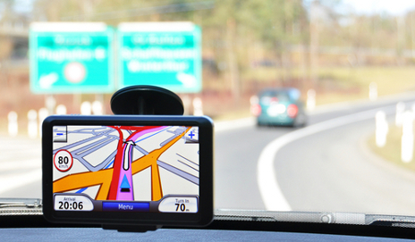
Taith y Wers

Slide 8
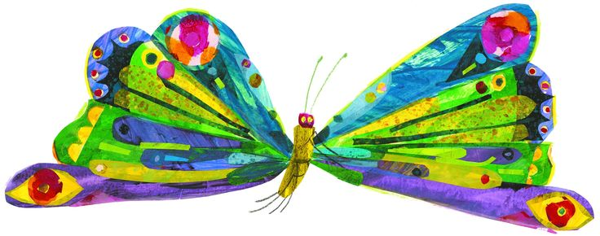
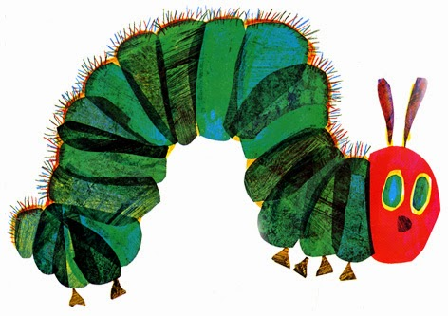
What does mutation mean?
In Welsh, the first letter of a word sometimes changes. This is called a mutation.
They’re rules about when to change letters (mutate).

Slide 9
I will understand what ‘mutation’ means and why it happens.
I will know what letters change and how they change when there is a nasal mutation.
I will be able to use the nasal mutation after ‘fy’.

Slide 10
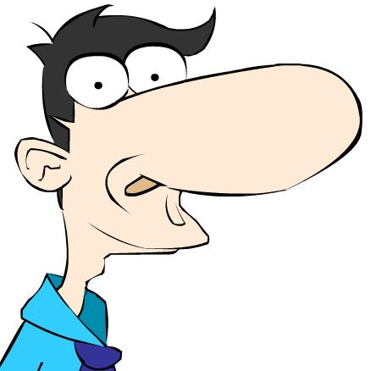
Treiglad Trwynol
Nasal Mutation
p
t
c
b
d
g
>
>
>
>
>
>
mh
nh
ngh
m
n
ng
The nasal mutation affects 6 letters

Slide 11
p
t
c
b
d
g
>
>
>
>
>
>
n
m
ng
mh
nh
ngh

Slide 12
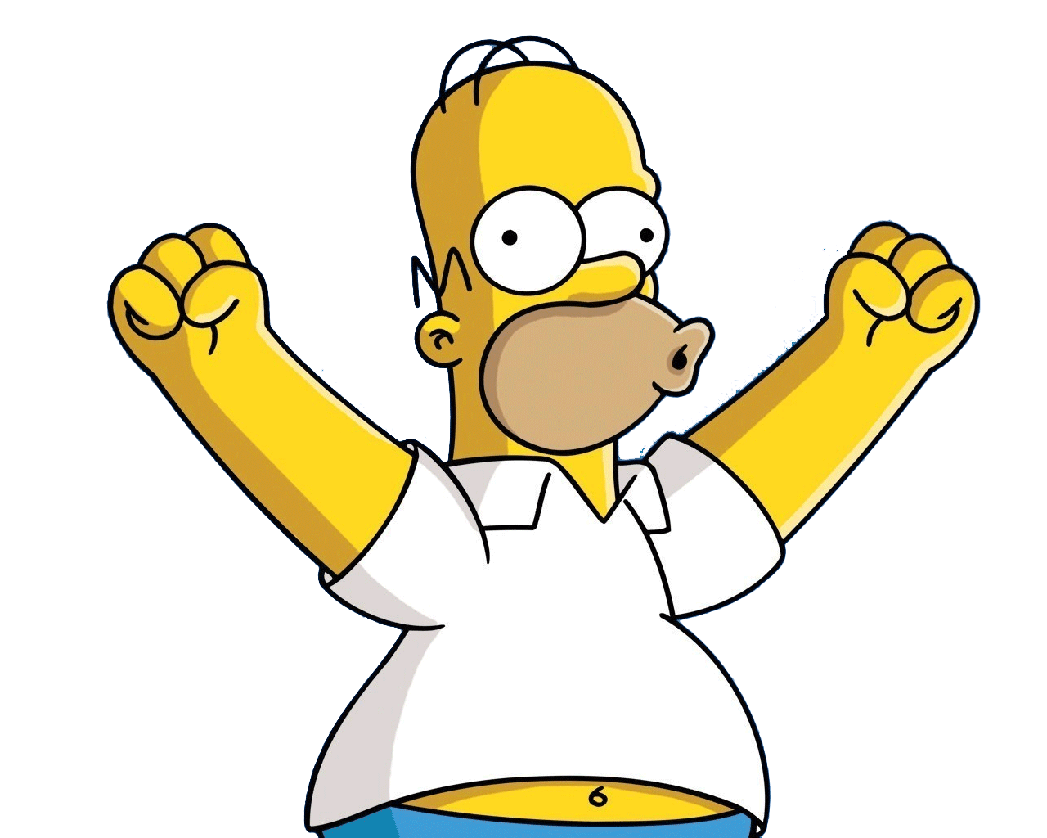
p
t
c
b
d
g
>
>
>
>
>
>
mh
nh
ngh
m
n
ng

Slide 13
I will understand what ‘mutation’ means and why it happens.
I will know what letters change and how they change when there is a nasal mutation.
I will be able to use the nasal mutation after ‘fy’.

Slide 14
RHEOL / RULE
Mae treiglad trwynol ar ôl ‘fy’.
There is a nasal mutation after ‘fy’ (my).

Slide 15
Byrddau Gwyn Bach
Mini Whiteboards

Slide 18
I will understand what ‘mutation’ means and why it happens.
I will know what letters change and how they change when there is a nasal mutation.
I will be able to use the nasal mutation after ‘fy’.

