Slide 1
WJEC
GCSE
Computer Science
Geraint Jones
Principal

Slide 2
Structure of qualification
Course is linear with 3 units
Theory examination
Practical examination
NEA (non-exam assessment)
Summer examinations only (No winter resit opportunities)
Programming languages have been limited to:
Component 2 – Java in Greenfoot
Component 3
Basic derived (e.g. VB, Small Basic, Qbasic)
C derived (C, C++, C#)
PHP
Python
Pascal/Delphi

Slide 3
Structure of qualification
Unit 1: Understanding Computer Science
Written Examination: 1 hour 45 minutes
50% of qualification
100 marks
Comprises hardware, logical operations,
communication, data representation and data types, operating systems, principles of programming, software engineering, program construction, security and data management and the impacts of digital technology on wider society

Slide 4
Structure of qualification
Unit 2: Computational Thinking and Programming
On-screen examination: 2 hours
30% of qualification
60 marks
Comprises problem solving, algorithms and
programming constructs, programming languages, data
structures and data types and security and authentication

Slide 5
Structure of qualification
Unit 3: Software Development
Non – exam assessment
20% of qualification
80 marks
This component requires learners to produce a programmed solution, analyse the problem, design a solution to the problem, develop a final programmed solution, test the solution and give suggestions for further development of the solution.
Throughout the production of the solution learners are required to produce a refinement log that evidences the development of the solution.

Slide 6
Structure of qualification
Unit 1:
Theory paper, written examination
Unit 2:
On-screen examination
Secure accounts
Questions on paper, answers required electronically (an on-screen booklet)
HTML
Assembly (mnemonics in spec)
Algorithms (writing, debugging, dry running) Functionality of algorithm could be drawn from across spec.
Programming in Java within the Greenfoot environment - will need to install the IDE
Submission by electronic media
Files required in examination supplied in advance to centre to install/test (exemplar copies included with CPD file)

Slide 7
Structure of qualification
Unit 3:
Non-examined assessment
Marks submitted via IAMIS
Sample identified automatically
Submission via electronic media
Sample moderated

Slide 8
Resources
Currently in Development/translation
Teacher’s guide provides ideas for teaching and guidance on assessment
Notes/text book covering new specification
WJEC, in conjunction with other bodies provide teaching resources online
http://resources.wjec.co.uk/
Teacher engagement with schools collectively producing materials and support, please sign up (name, email, areas of specific specialism)
CPD offered annually in a cycle with dedicated trainers
Specimen materials and specification available at:
http://www.wjec.co.uk/qualifications/computer-science/

Slide 9
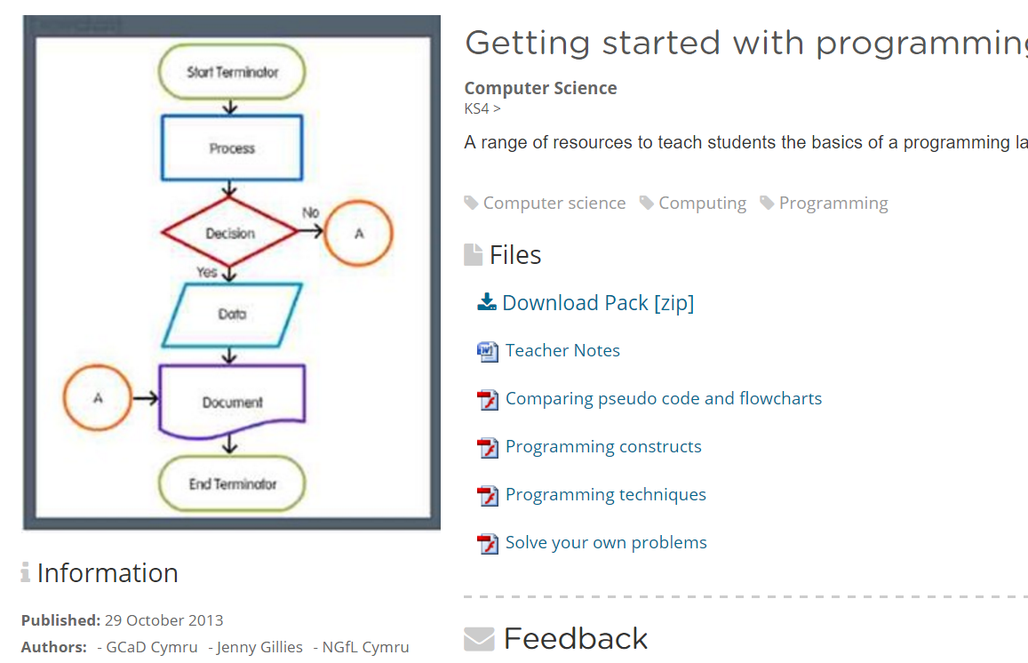
Resources
Also available

Slide 10
Online Exam Review (OER)
This innovative online resource will allow teachers to continue to receive a high standard of Continuing Professional Development (CPD) in a new and interactive way. This is free, additional resource to face to face CPD and examiners’ reports.
Gives clear breakdown of candidate performance, including facility factors of questions, percentage attempt and mean mark
Examiner comments provided on a per-question basis
Provides examples of questions and marks awarded
Links to mark scheme
Can be used as CPD material within a department or as a teaching tool
http://oer.wjec.co.uk/

Slide 11
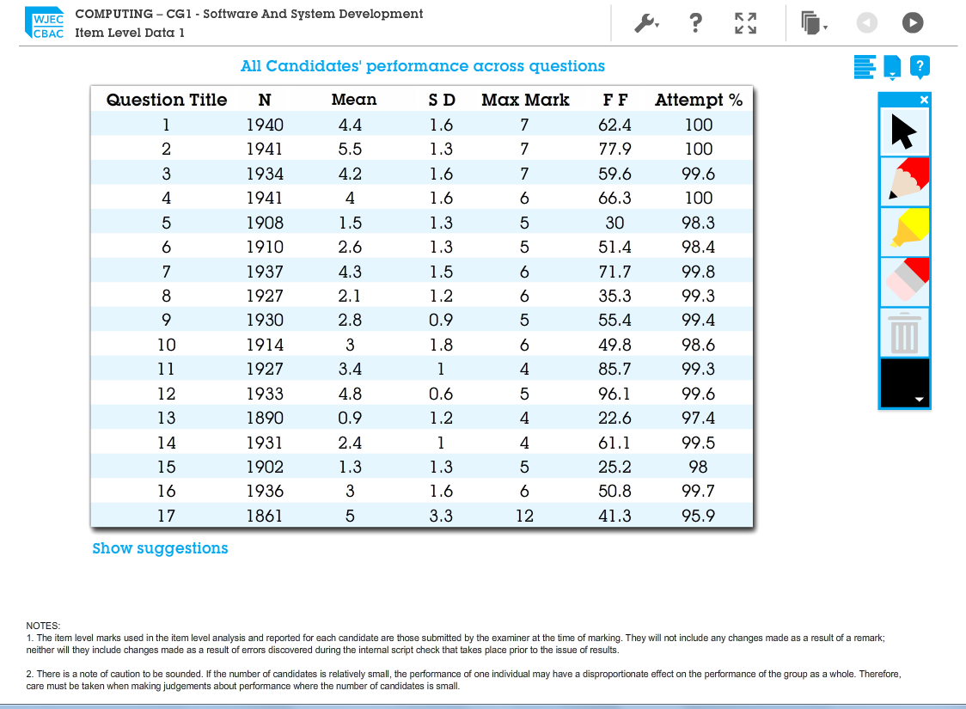
Online Exam Review (OER)
Statistics provided at a granular level for all examinations

Slide 12
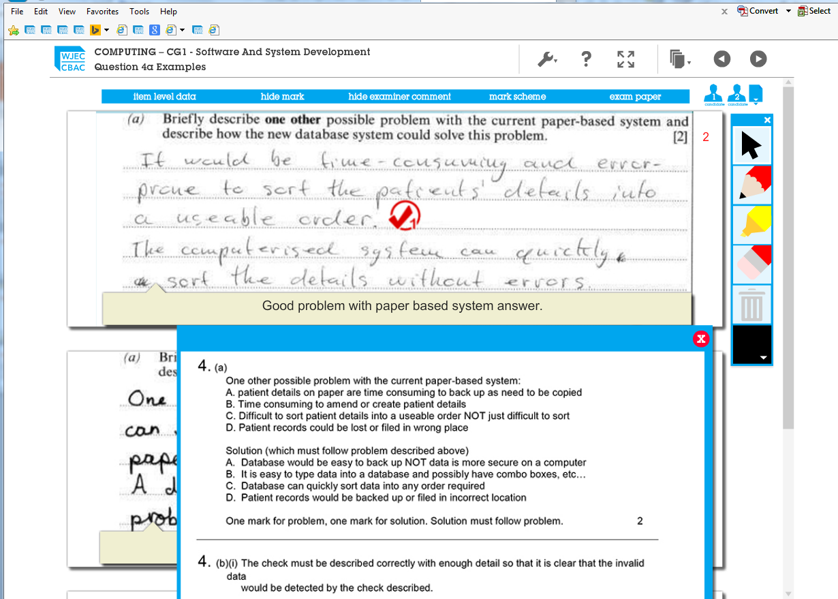
Online Exam Review (OER)
Examples of candidate answers, with marks, discussion and links to mark scheme

Slide 13
Any Questions?
Contact
Subject Officer: Andy Parker
andy.parker@wjec.co.uk
Subject Support Officer: Kwai Wong
kwai.wong@wjec.co.uk

Slide 14
WJEC
GCSE
Computer Science
Geraint Jones
Principal

Slide 15
Structure of qualification
Unit 1: Understanding Computer Science
Written Examination: 1 hour 45 minutes
50% of qualification
100 marks
Comprises hardware, logical operations,
communication, data representation and data types, operating systems, principles of programming, software engineering, program construction, security and data management and the impacts of digital technology on wider society

Slide 16
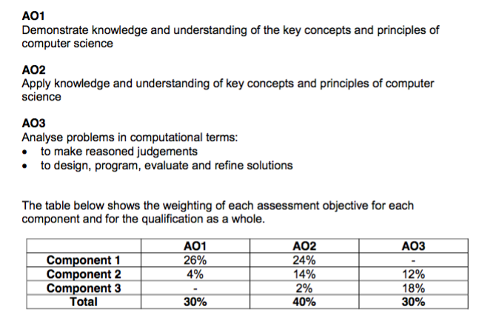
Structure of qualification
AO balance and implications for content examination.

Slide 17
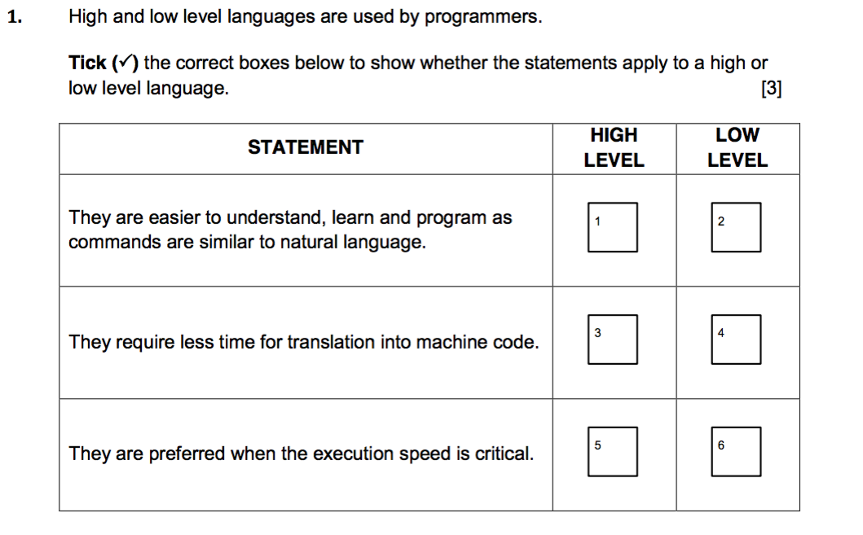
Structure of qualification
Topics that could make essay style answers or:

Slide 18
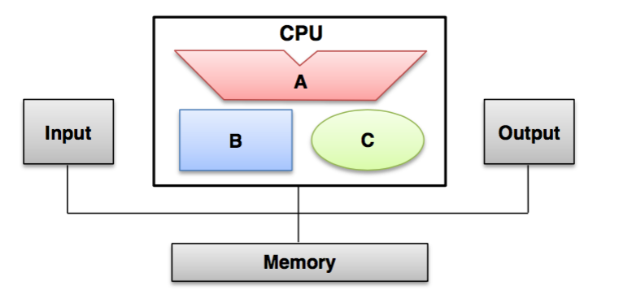
Structure of qualification
Conventions in specification:

Slide 19
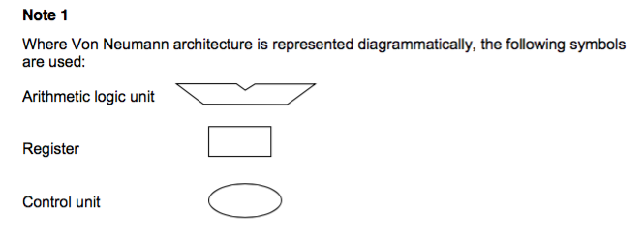
Structure of qualification
Appendix of specification:

Slide 20
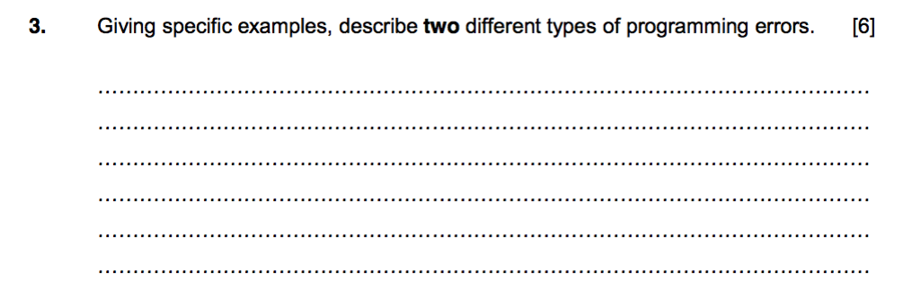
Structure of qualification
Short essay and long form answers:

Slide 21
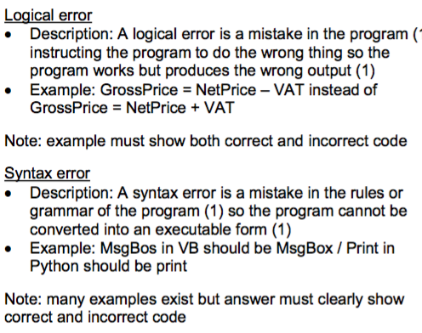
Structure of qualification
Example of mark scheme response:

Slide 22
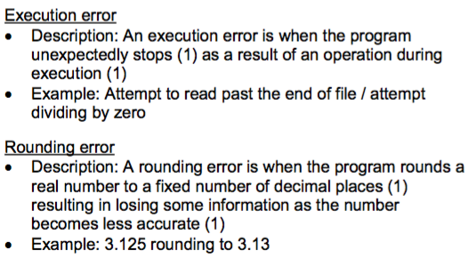
Structure of qualification
Example of mark scheme response:

Slide 23
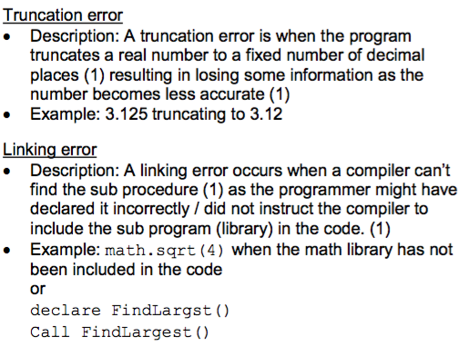
Structure of qualification
Example of mark scheme response:

Slide 24
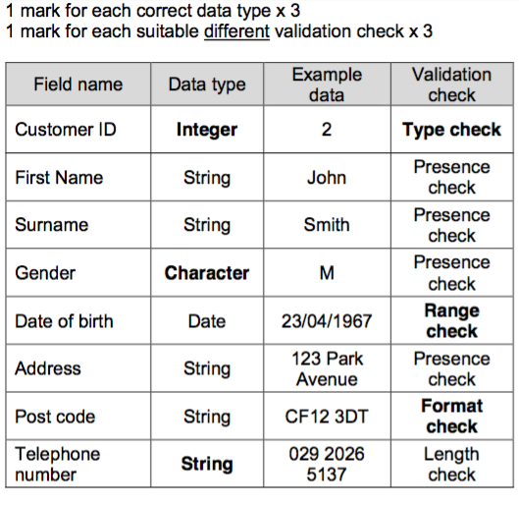
Structure of qualification
Data types can be assessed in many ways:

Slide 25

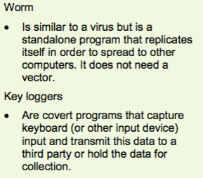
Structure of qualification

Slide 26
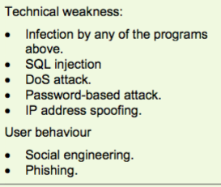
Structure of qualification
All will be available in teacher guide – page 26 & 27 & 28

Slide 27
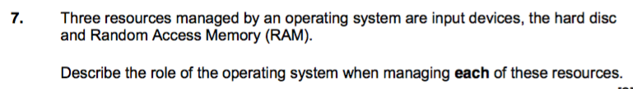
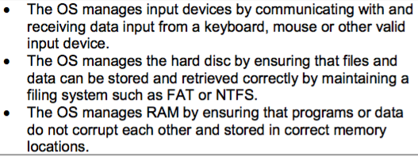
Structure of qualification
Considered a difficult topic by candidates:

Slide 28
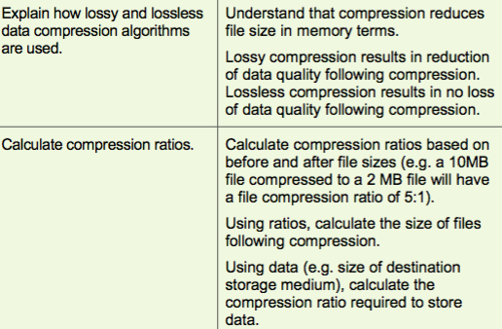
Structure of qualification
Compression:

Slide 29
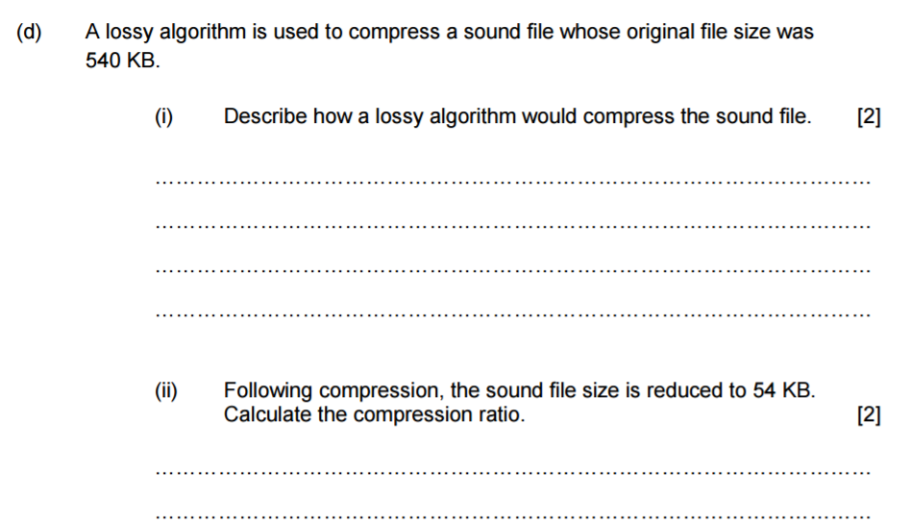
Structure of qualification
Example question on compression:

Slide 30
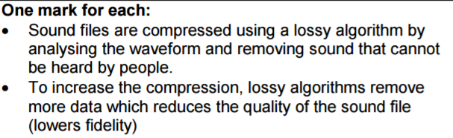
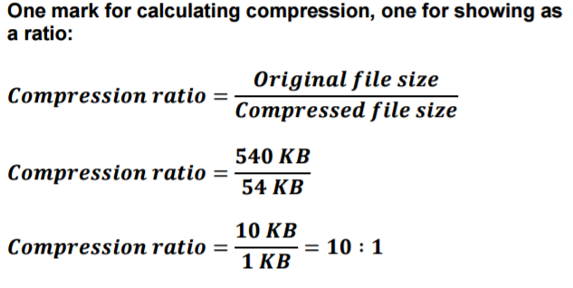
Structure of qualification
Example question on compression:

Slide 31
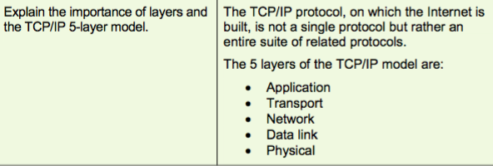
Structure of qualification
TCP IP – consulted with HE/FE, teachers and industry
5 layer model agreed

Slide 32
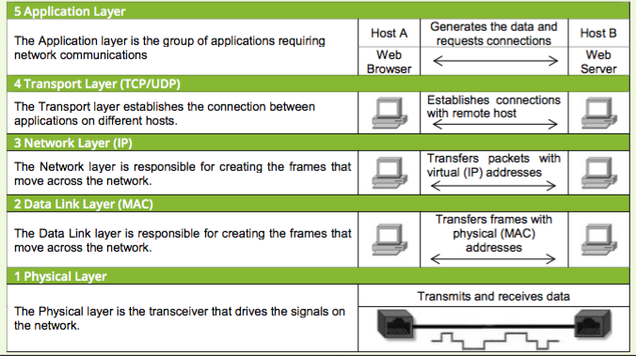
Structure of qualification
Teacher guide:

Slide 33
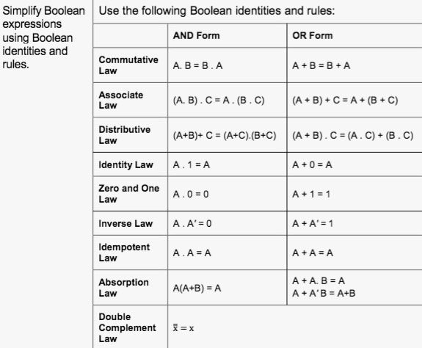
Structure of qualification
Boolean algebra and identities:

Slide 34

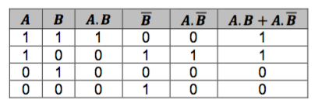
Structure of qualification
Simplify using rules or truth tables, but must use the method stated in the question. If no method is stated then either approach is accepted.

Slide 35
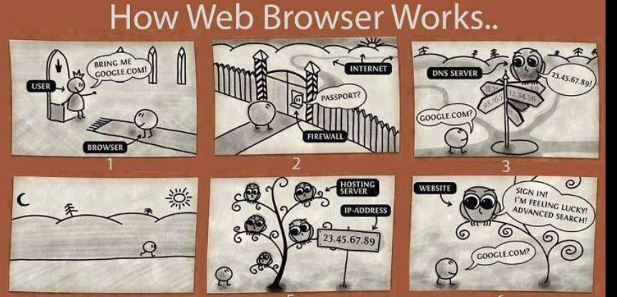
Structure of qualification
DNS System: Conceptual and operational:

Slide 36
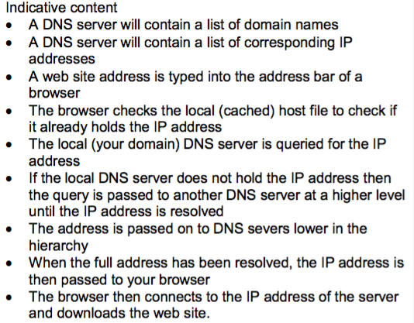
Structure of qualification

Slide 37
Structure of qualification
Questions on Unit 1?

Slide 38
Structure of qualification
Unit 2: Computational Thinking and Programming
On-screen examination: 2 hours
30% of qualification
60 marks
Comprises problem solving, algorithms and programming constructs, programming languages, data structures and data types and security and authentication.

Slide 39
Structure of qualification
Unit 2:
On-screen examination
Secure accounts
Questions on paper, answers required electronically (an on-screen booklet)
HTML
Assembly (mnemonics in spec)
Algorithms (writing, debugging, dry running) Functionality of algorithm could be drawn from across spec.
Programming in Java within the Greenfoot environment - will need to install the IDE
Submission by electronic media (Optical preferred)
Files required in examination supplied in advance to centre to install/test (exemplar copies included with CPD file)

Slide 40
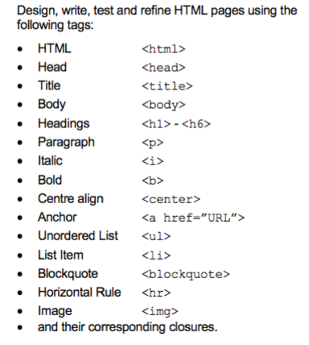
Structure of qualification
HTML – from
specification

Slide 41
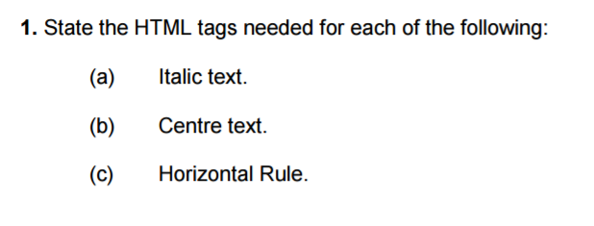
Structure of qualification
HTML:
Staggered approach to question. Identify tags, explain tags, use tags etc.
Markup language being examined not artistic presentation/design flair.

Slide 42

Structure of qualification
HTML – from
SAM

Slide 43
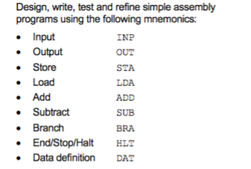
Structure of qualification
Assembly languages

Slide 44
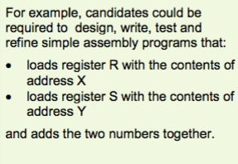
Structure of qualification
Assembly questions

Slide 45
Structure of qualification
Algorithm questions:
A series of questions with a staggered approach:
Identifying,
Dry running,
Fixing,
Writing,
Explaining.

Slide 46
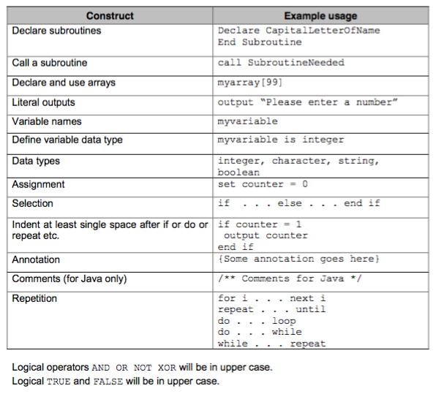
Structure of qualification
Specification gives constructs and usage examples for any algorithms used by the WJEC.
Candidates not required to use this convention and any pseudocode will be accepted.

Slide 47
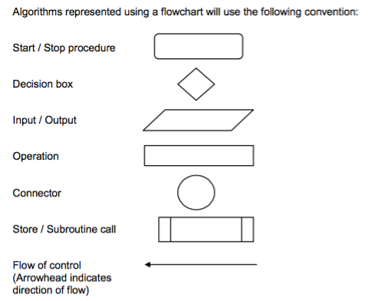
Structure of qualification
Flowcharts

Slide 48
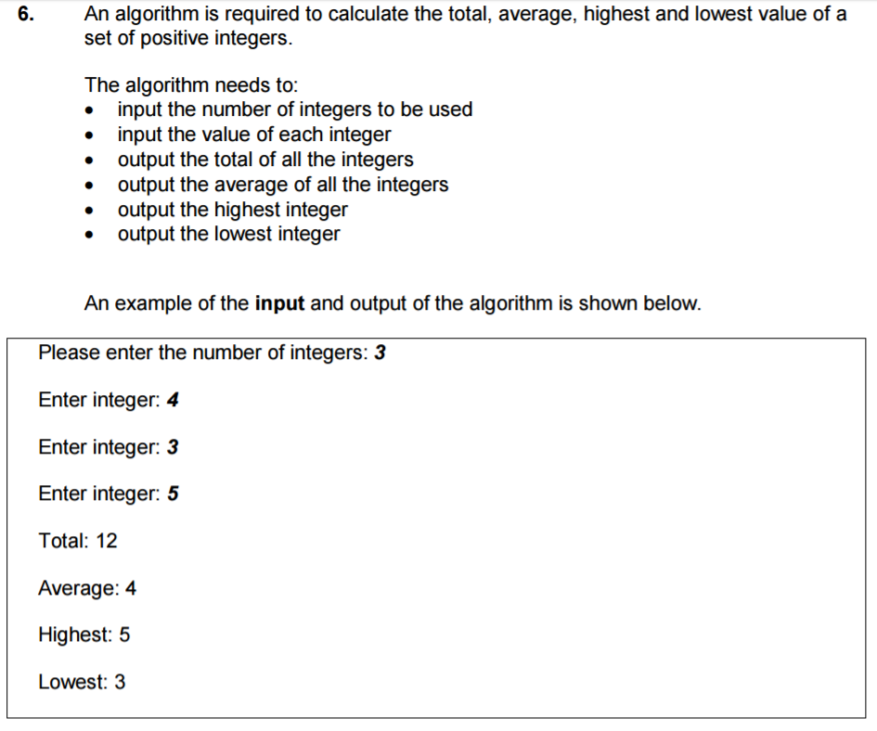
Structure of qualification
Question

Slide 49
Structure of qualification
Java within the Greenfoot environment.
Specification is now explicit in stating JAVA object oriented programs.
Programs may be provided by the WJEC for use within this on screen examination.
Programs from the WJEC should be tested by the technical staff at the Centre before the examination, however, none of the contents should be disseminated/accessed by candidates before the examination.

Slide 50
Structure of qualification
For example, candidates could be required to:
Create a new Greenfoot world
Populate a given world with one or more objects
Edit the objects so that they turn and move randomly
Edit the program code to make the objects move in the direction of the arrow keys when pressed
Edit the objects to detect object collision and remove these objects from the world
Add a sound which will play when objects requires it to
Add objects which can receive messages from other objects
Edit objects so that they can change the image/value displayed on the Greenfoot world
Save completed worlds as file names stated

Slide 51
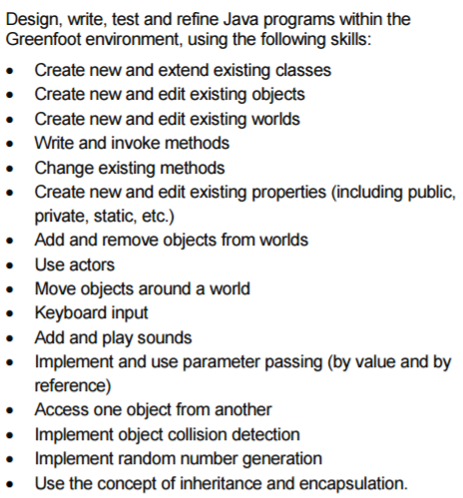
Structure of qualification
Specification

Slide 52
Structure of qualification
Unit 2 – SAM
Materials provided by WJEC include:
SAM example Greenfoot files
Worked Greenfoot SAM example

Slide 53
Structure of qualification
Candidates should be prepared to:
Understand and be able to explain the concepts used within JAVA just like identifying sections of algorithm/HTML (Q1)
Create new Worlds within Greenfoot and populate these worlds using Java code or the environment generated JAVA code.

Slide 54
Structure of qualification
Unit 3: Software Development
Non – exam assessment
20% of qualification
80 marks
This component requires learners to produce a programmed solution. analyse the problem, design a solution to the problem, develop a final programmed solution, test the solution and give suggestions for further development of the solution.
Throughout the production of the solution learners are required to produce a refinement log that evidences the development of the solution.

Slide 55
Structure of qualification
Unit 3:
Non-exam assessment
Marks submitted via IAMIS
Sample identified automatically
Submission via electronic media
Sample moderated
Controlled conditions – No writing frames, guides, documents, templates etc.

Slide 56
Structure of qualification
Administrative aspects of controlled assessment
Assessment grids
Submission of assessments
Annotation and supporting evidence
Supervision and authentication
Collaboration control
See page 15 – 21 of specification and page 39 on Teaching guide.

Slide 57
Structure of qualification
Feedback control
Supervising teachers may only provide support if a candidate’s work is such that it prevents them from progressing
Supervising teachers must not give feedback on how to improve work if they are able to move forward
Only certain sections of the work are suitable for feedback.

Slide 58
Structure of qualification
Feedback control
Scope of the problem
Cannot – break down requirements or decompose the problem
Can - give support to identify high-level data, processing and outputs to allow progression
Design
Can – give support to develop a minimal functional system that may not meet all requirements.

Slide 59
Structure of qualification
Refinement log
Feedback must not be provided
Effectiveness of solution
Supervising teacher must not provide any code for the solution
Can – support candidates in high level terms of the syntax
Cannot – provide examples of their use

Slide 60
Structure of qualification
Technical quality
Feedback must not be provided
Testing strategy
Supervising teacher can give high level indication of areas of the solution that should be tested
Cannot give hints on how to test or provide any test data
Testing and Further Development sections
Feedback must not be provided

Slide 61
Structure of qualification
Unit 3 – Software Development
Scope of the problem
Design
Effectiveness of the solution
Technical quality
Test strategy
Testing
Further development
Refinement log

Slide 62
Structure of qualification
Section 1 – Scope of the problem
Description of the given scenario in terms of input, processing and output
Objectives, including measurable success criteria for the proposed system.

Slide 63
Structure of qualification
Section 2 – Design
Descriptions of:
Input and output facilities required to produce a user interface
Data structures that will be required
Documentation of the following routines using a standard convention (pseudo code or flowchart):
validation routines
data handling and processing
authentication

Slide 64
Structure of qualification
Section 3 – Software development
Annotated listing(s) of all programming code
Evidence of the user interface

Slide 65
Structure of qualification
Section 4 – Test strategy
Description of the test strategy
Description of the purpose of unit, integration and functional testing
Test plan and test data
Section 5 – Testing
Evidence of test outcomes with commentaries

Slide 66
Structure of qualification
Section 6 – Further development
Discussion of the outcomes of the testing
Description of the successful features of the solution and identification of areas for further development
Suggestions for extensions to the solution

Slide 67
Structure of qualification
The Refinement Log
The refinement log is an integral part of the project and should be completed during each session.
The purpose of the log is for candidates to demonstrate that they are working in a logical and systematic manner.
Candidates are expected to record any issues encountered and how these issues were addressed.

Slide 68

Structure of qualification
Coursework
Help files
Only help files native to the programming language
Where help files are online, relevant help file image may be installed locally
Can use a clean copy of pseudo code conventions (Page 36)
Can use a glossary of syntax of a language but must be high level with no examples of segments of code

Slide 69
Structure of qualification
Coursework
Use of libraries
Should avoid the use of pre-compiled units, libraries or modules
However, can be used where functionality is beyond scope of GCSE – would not be acceptable to use a library function to sort data.
Where when used, candidates must explain the functionality of the code used.
Candidates must record the source of the library in their report and the function(s) used and supply an electronic version of the library with their program

Slide 70
Structure of qualification
Assessment:
Assessment grids use a best fit approach
Horizontal grids in the Teachers’ Handbook
Explain assessment decisions where necessary

Slide 71
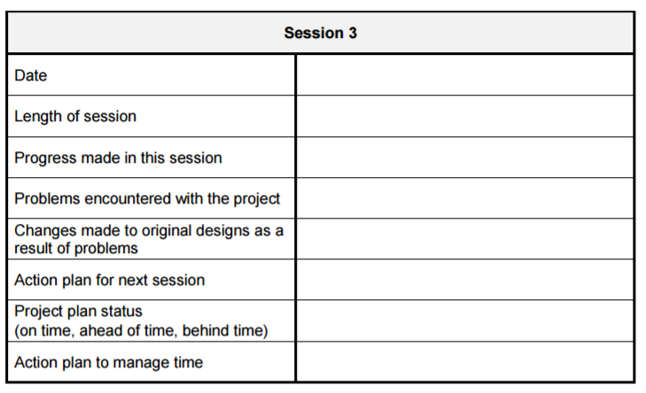
Board set scenario
One scenario will be available for each cohort – issued at the beginning of the GCSE study in Y10. SAM scenario.
Through the controlled task the candidates are required to complete a design log.

Slide 72
Any Questions?
Contact
Subject Officer: Andy Parker
andy.parker@wjec.co.uk
Subject Support Officer: Kwai Wong
Kwai.wong@wjec.co.uk

