Slide 1
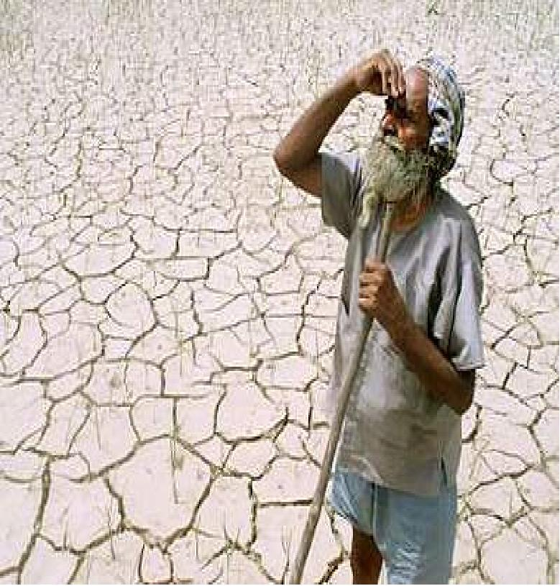
Caption needed.

Slide 2
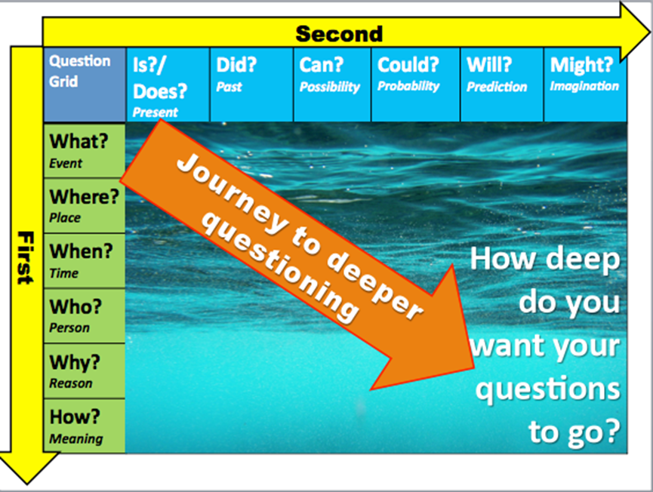

Slide 3
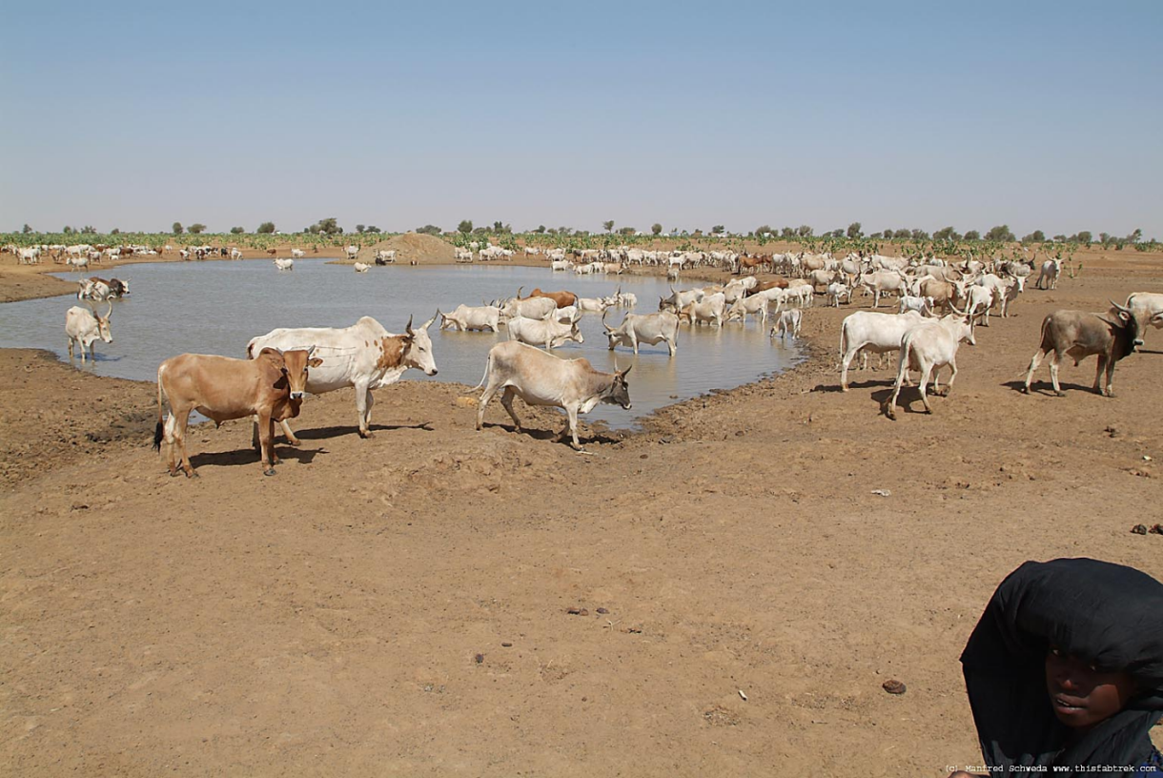
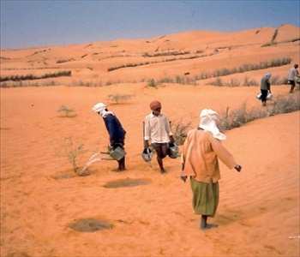
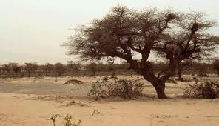
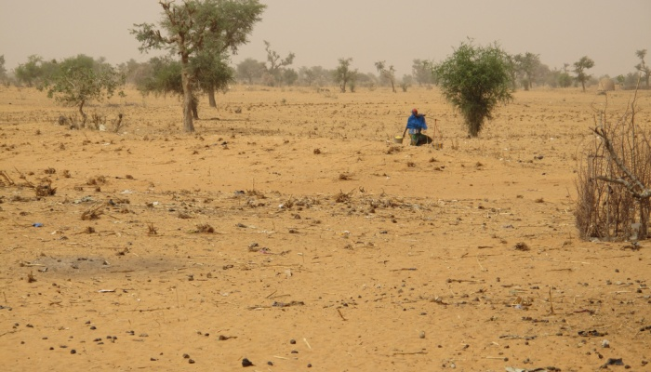

Slide 4
Desertification.
How can a lack of rainfall and/or water deficit cause drought and desertification?

Slide 5

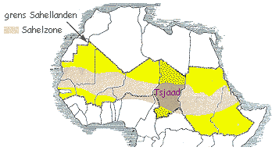
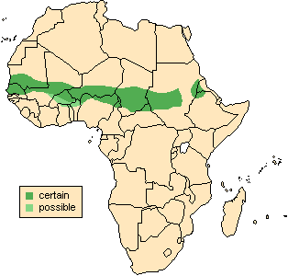
The SAHEL
The Sahel is located in the southern region of the Sahara desert, Africa. Look at the following pictures. In pairs discuss where you think the Sahel is located.

Slide 6
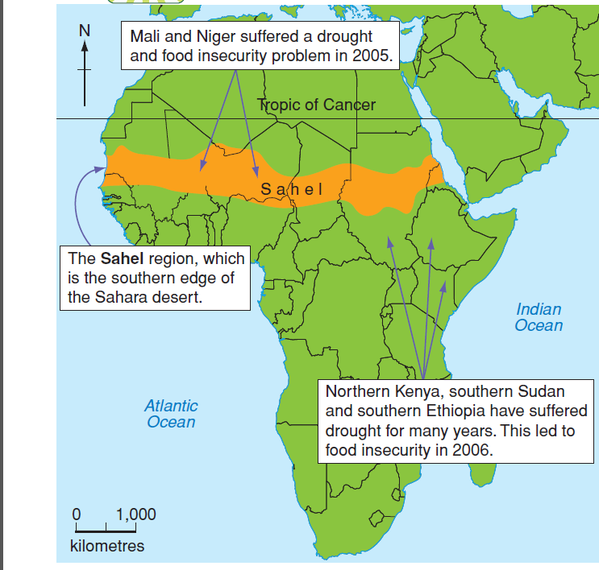

Slide 7
Water deficit; lIc’S
Many countries experience a pronounced wet and dry season. If the rains fail during one year, the result for crops, animals and people can be disastrous.
The most vulnerable are desert margins and tropical interiors where the average rainfall amounts are low and the rainy season is short.
The rain when it does fall is torrential which give it insufficient time to infiltrate into the ground.
Instead, surface runoff causes flash floods and water is lost to the local community.

Slide 8
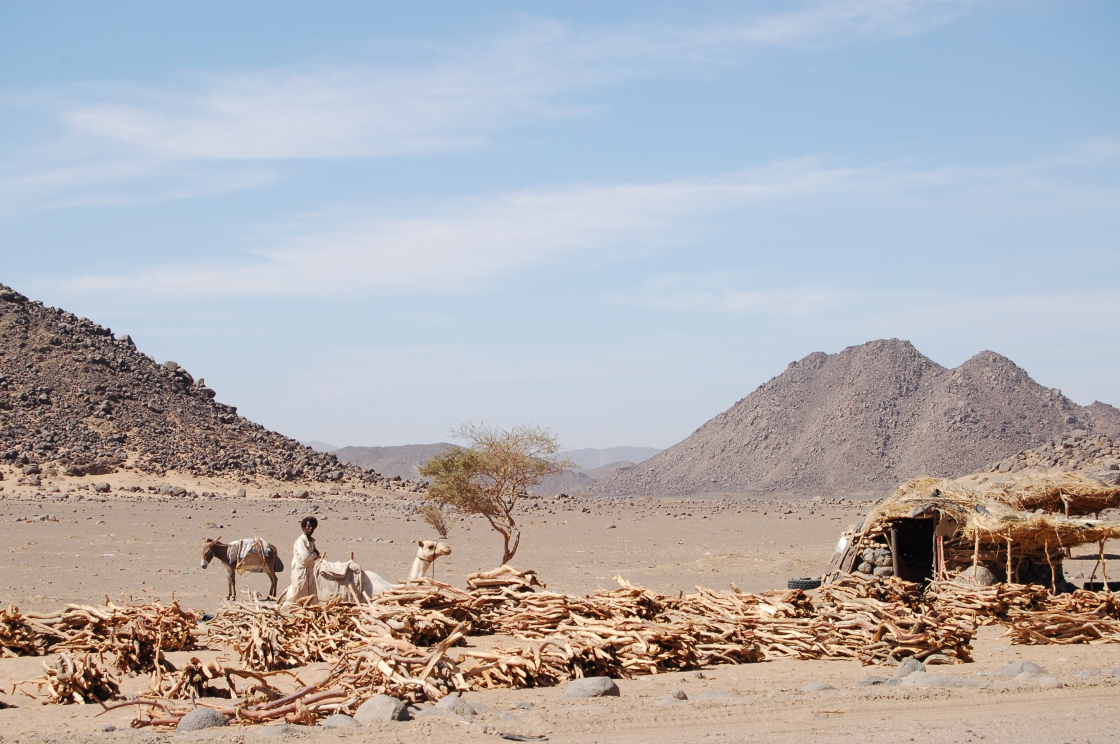
WATER DEFICIT; in LIC’s.

Slide 9
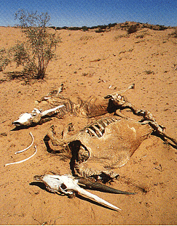
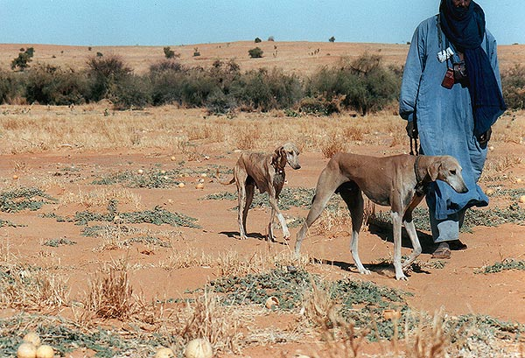
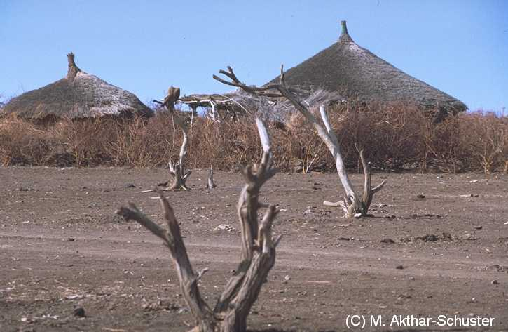
The Sahel regions are areas which experience
desertification.

Slide 10
http://www.bbc.co.uk/education/clips/zqwnvcw
Annotate the cartoon strip to explain the causes of desertification.

Slide 11
Why does the Sahel suffer from desertification?
DESERTIFICATION
Increase in population
Increase in cattle
Deforestation for fire wood
Grassland grazed more intensively
Roots no longer hold soil together
Roots may be eaten as well as grass
Less vegetation means less protection from weather
Leaves no longer protect soil from weather
Loose top soil blown away by wind
(Soil Erosion)
=
Loose top soil blown away by wind
(Soil Erosion)
=
DESERTIFICATION

Slide 12
Impact on human activity
Crops are unable to grow, people are unable to feed cattle
Lack of vegetation means soil loses its protective cover and contains less humus and moisture.
People travel further to find water and food.
As the ground cracks and dries up the ground subsides.

Slide 13
Watch this video;
http://www.youtube.com/watch?v=8mUhtFe2ApE
Expanding Deserts Consume Farmland

Slide 14
Management of drought and desertification.
Reducing the demand for water by;
Education; use less water in washing, showers use of “bog hogs”.
Restrictions; hose pipe bans, swimming pools closed at times of shortage.
Water saving store rainwater, repair old pipes.

Slide 15
Management of drought and desertification.
Increasing the supply of water by;
Construction, dams and reservoirs
Extraction from aquifers identify new underground sources of water.
Desalination, use the sun’s energy to evaporate sea water.
Cloud seeding
Add certain chemicals to encourage cloud formation and produce precipitation.

Slide 16
Management of drought and desertification.
Planting trees and shrubs to create a “green belt” along the fringe or edge of the desertified area.
Constructing stone lines to try to capture what moisture becomes available.
Fencing off areas to prevent overgrazing and to allow vegetation to grow.
Water management schemes to allow water for irrigation.

