Slide 1
Weather and Climate
Year 11
GCSE

Slide 2
What is the evidence for climate change?

Slide 3
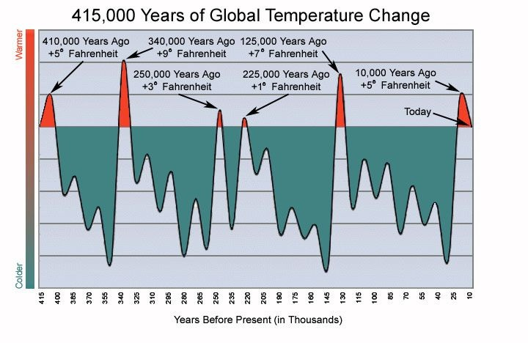

Slide 4
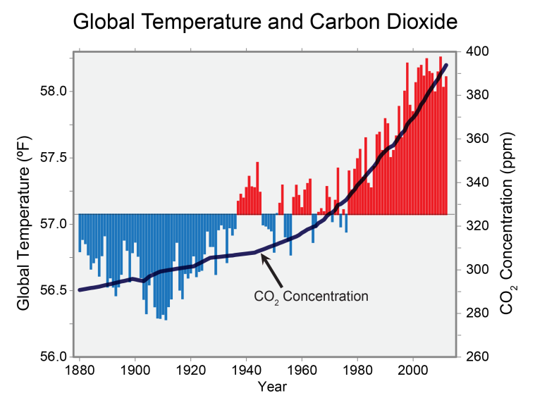
Living graphs?

Slide 10
Climate Change: How do we know?

Slide 11
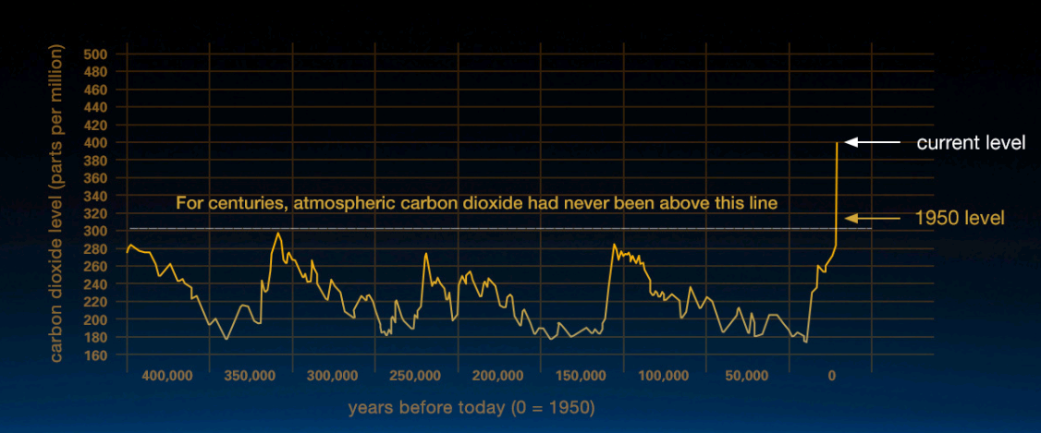
Temperature Rise- how do we know?
http://www.bbc.co.uk/education/clips/zj8hfg8

Slide 12
Sea Level Rise

Slide 13
Global Temperature Rise

Slide 14
Warming Oceans

Slide 15
Shrinking Ice Sheets

Slide 16
Extreme Weather Events

Slide 17
Ocean Acidication

Slide 18
Causes of Climate Change

Slide 19
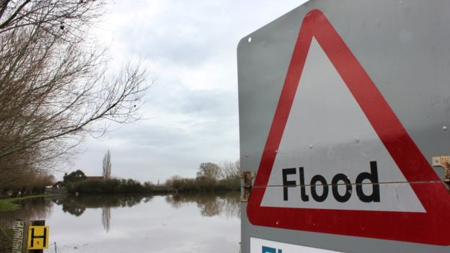
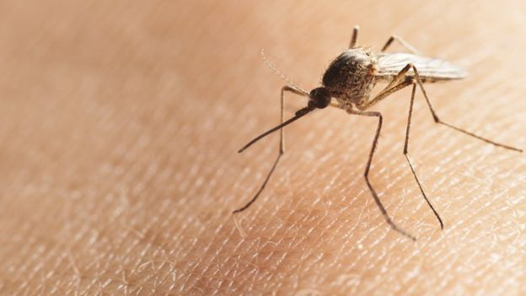
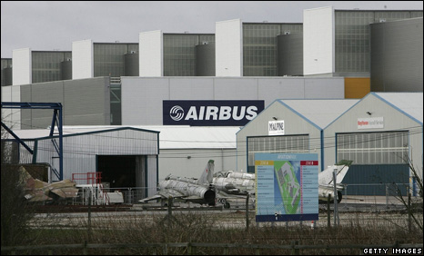
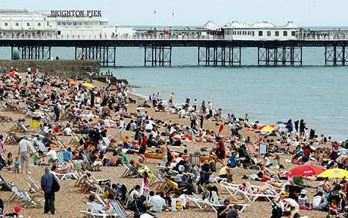
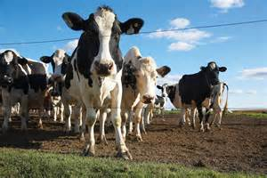
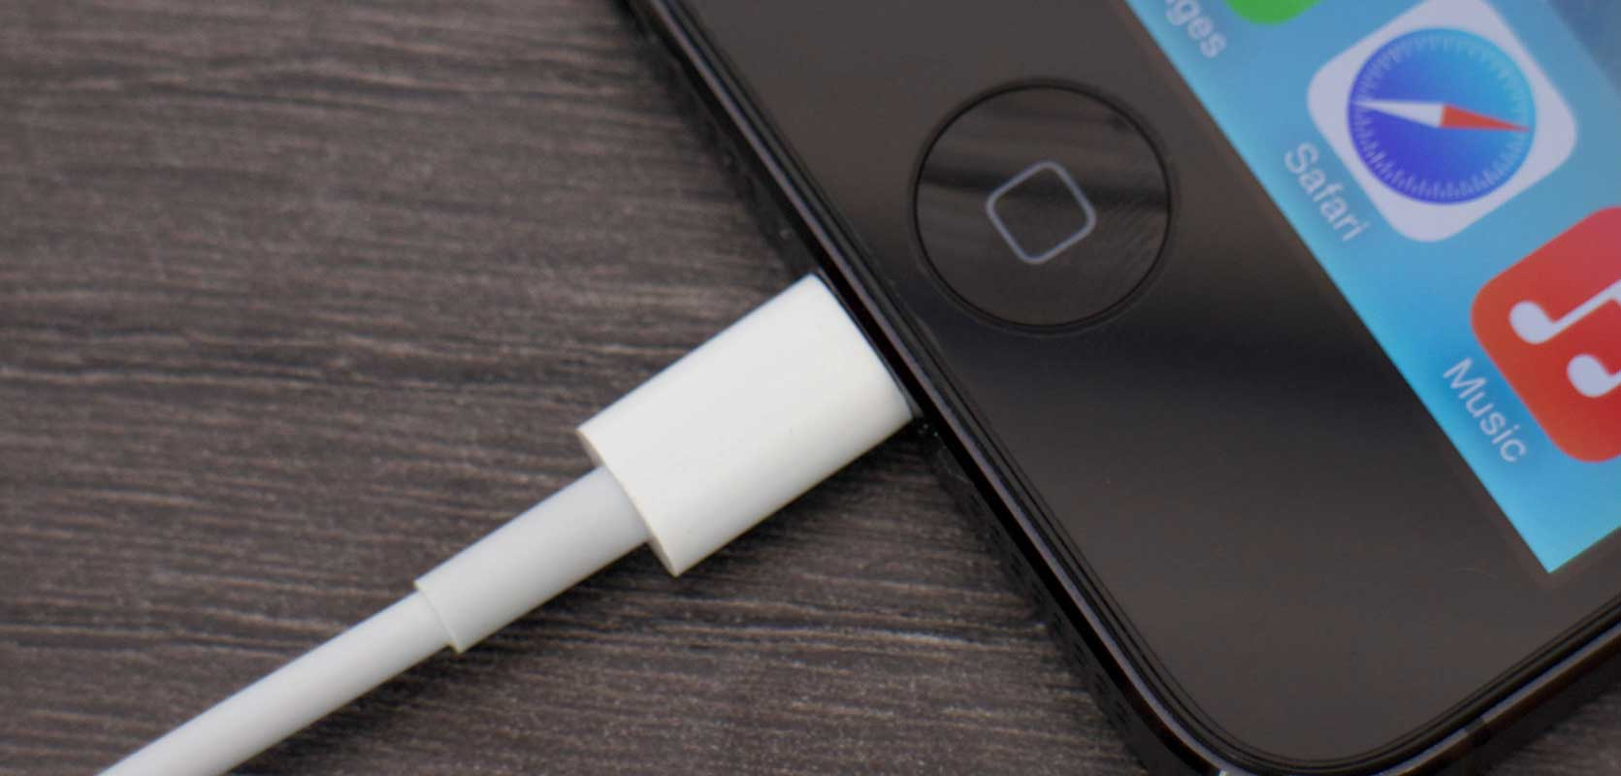
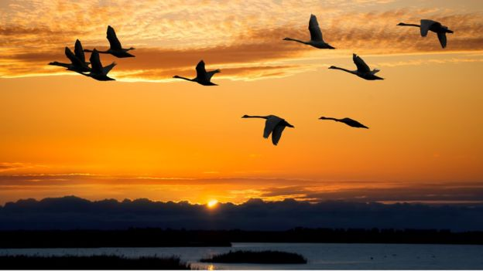
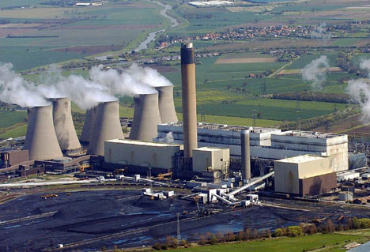
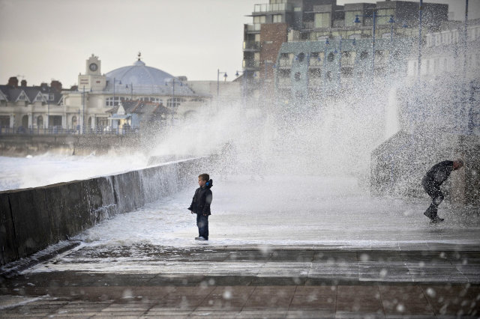
Cause or Effect?
Image copyright Thinkstock
Sea levels don't rise uniformly, says Haigh, and are "hard to predict".
Image copyright Thinkstock
Sea levels don't rise uniformly, says Haigh, and are "hard to predict".
Image copyright Thinkstock
Sea levels don't rise uniformly, says Haigh, and are "hard to predict".

Slide 20
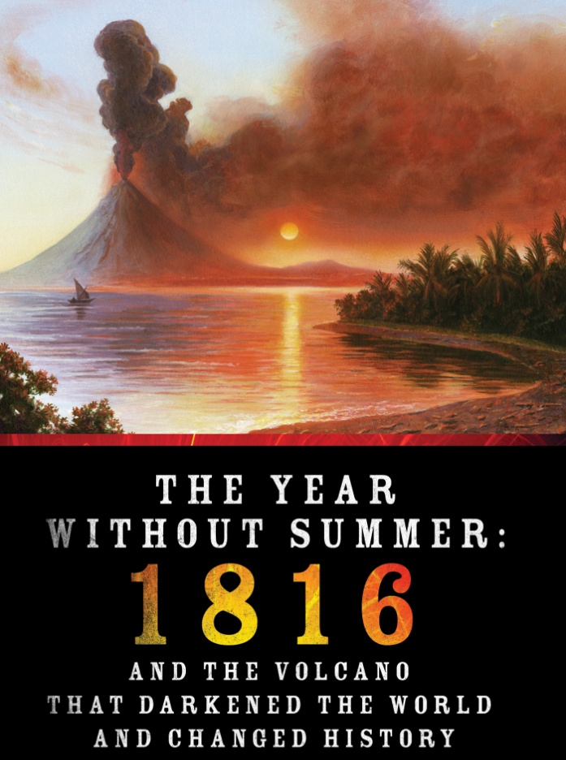
Natural Cause of Climate Change
“The Year Without a Summer.”

Slide 21
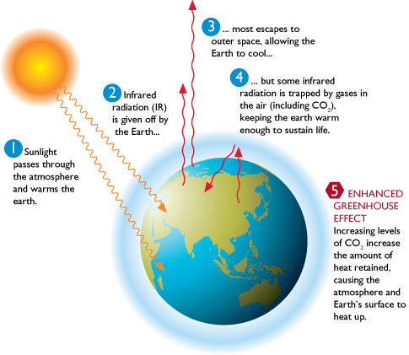
Global Warming

Slide 22
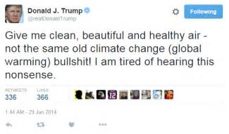
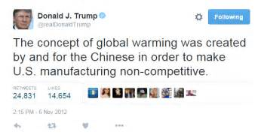
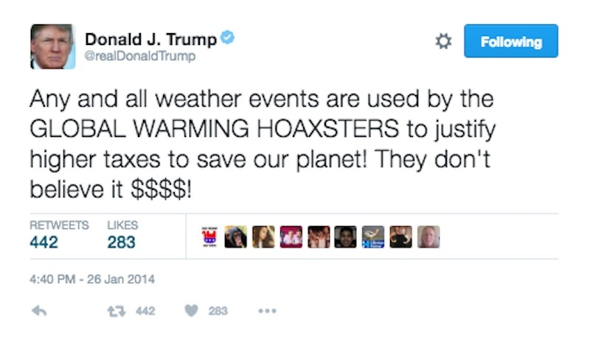
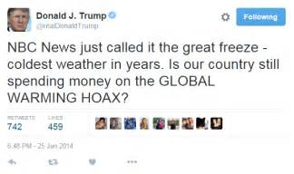
Dear Donald Trump...

Slide 23
Success Criteria
Explain to President Trump what climate change is.
What are the effects of climate change?
What evidence is there to prove climate change is real- how do we know?
Persuasive / convincing language.

Slide 24
Variations in Weather and Climate in the UK

Slide 25
Weather or Climate?

Slide 26
Air Masses

Slide 27
How does latitude affect temperature and rainfall in the UK?

Slide 28
How does altitude affect temperature and rainfall in the UK?

Slide 29
How do ocean currents affect rainfall and temperature in the UK?

Slide 30
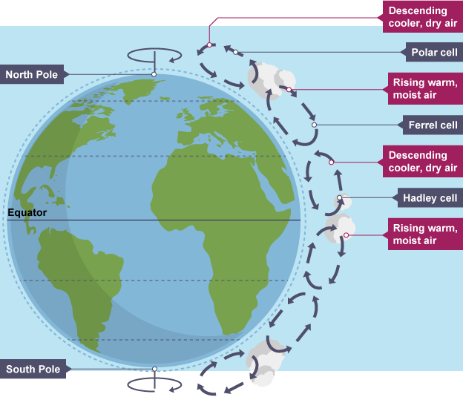
Global Circulation of the Atmosphere

Slide 31
Causes and Consequences of Tropical Storms
Low Pressure Systems

Slide 32
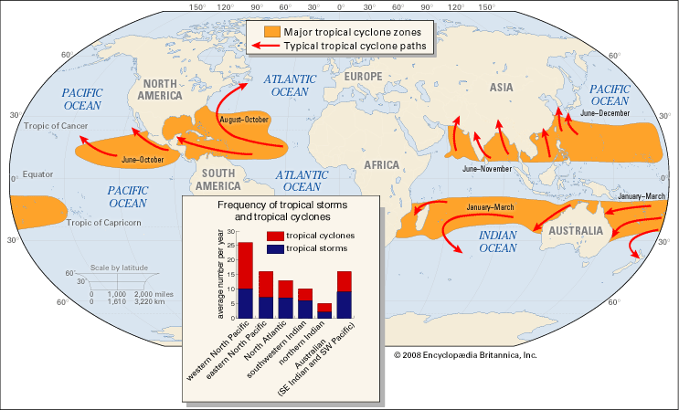
Locations

Slide 33
Annual Seasonality

Slide 34
Long terms changes to frequency and magnitude

Slide 35
Case Study
Causes & consequences for people, the economy and the environment.

Slide 36
Causes and Consequences of Drought and Heatwaves

Slide 37
Global Distribution

Slide 38
Changing Patterns Over Time

Slide 39
Case Study

Slide 40
Causes

Slide 41
Consequences for people, the economy and the enviornment

