Slide 1


Unit 2 Exam Question Help-Sheet/PowerPoint
Please note this PowerPoint is only one possible way to answer the questions.

Slide 2
You can sit this exam at the end of Year 10.
This exam tests your source skills and knowledge and understanding in the topic.
There are 5 questions.
Each question is based from a key question.
Question 1- Source A and knowledge
Question 2 – Describe – knowledge based
Question 3 – What is the purpose…? Source based
Question 4 – Which source is more useful? Source based
Question 5 – Extended writing essay style – knowledge based

Slide 3
Exam Question Help-Sheet/PowerPoint Question 1
Study the source below and then answer the question which follows. Use Source A and your own knowledge to describe … [6]
You have to analyse the source and show your knowledge and understanding of the period.
You need to describe the key features in the context.

Slide 4
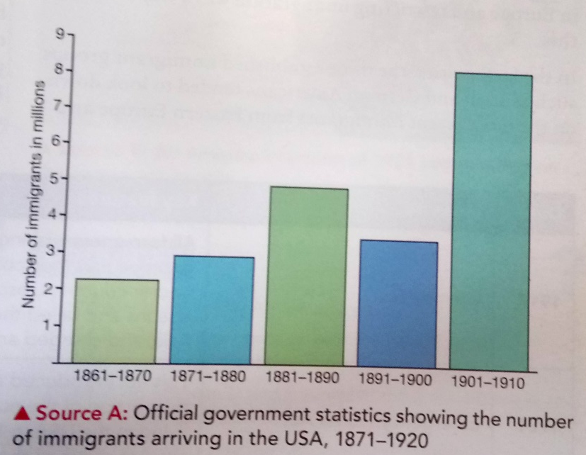
Step 1 – Use the source and describe what you can see.
Step 4 – Use specific historical detail to provide context.
Step 2 – Use the caption to describe what is happening.
Step 3 – Use your knowledge about the topic and expand what you have said.
Describe what you can see in the source.
Use Source A and your own knowledge to describe immigration into the USA between 1870 and 1910.
Use the information from the caption

Slide 5
Exam Question Help-Sheet/PowerPoint Question 2 Describe … [8]
You have to demonstrate your own knowledge and understanding of a key feature. You should include specific details and facts.

Slide 6
Describe the KKK during the 1920s [8]
1 – Introduce the topic – making sure you are clear.
The KKK were an organisation which was founded in ………………..
The beliefs they believed in were …….
2 – Provide specific factual detail covering a range of key points.
The aims were….
Membership had increased during the 1920s because…….
3 – Aim to provide good historical context to the event you are describing.
The KKK was established after the ………..
There was a decline after 1925 because…

Slide 7
Exam Question Help-Sheet/PowerPoint Question 3
Study the source below and then answer the question which follows.
What was the purpose of Source B? [8]
You must show knowledge and understanding through analysing and evaluating the historical source.
You must explain its purpose – why it was produced.

Slide 8
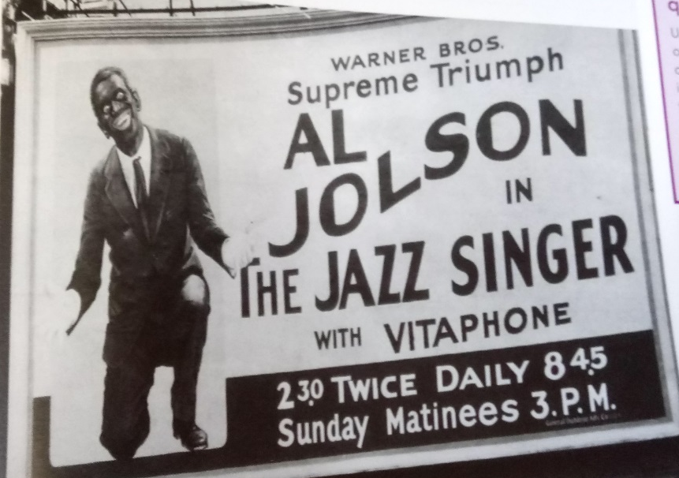


What is the purpose of Source B?
You need to use the source.
You need to refer to the time period
You need to use your knowledge and understanding of the historical context – think what is happening at the time?
Use the words in the source to help you.
3 – Suggest reasons why the source was produced at the time.
1 – Pick out details from the caption
What can you see? What does it say?
Make a judgement on its purpose.
2 – Use your topic knowledge – develop the main message
Pick out details and explain .
An advertisement from 1927 for the film The Jazz Singer.

Slide 9
Exam Question Help-Sheet/PowerPoint Question 4 Study the sources below and then answer the question that follows. Which of the sources is more useful to an historian studying the issue…? [12]
You must show your knowledge and understanding to provide a judgement about the usefulness to an historian. You must analyse and evaluate the content of the source before you reach a judgement.

Slide 10
The stock market hysteria reached its peak in 1929. Everyone was playing the market…On my last day in New York, I went down to the barber. As he removed the sheet he said softly, ‘Buy Standard Gas’, I’ve doubled …its good for another double.’ As I walked upstairs, I reflected that if the hysteria had reached the barber level, something must soon happen.
[Cecil Roberts wrote about the Wall Street Crash in The Bright Twenties, 1938]
Is it useful? Why?
Who said it and why?
Why was the source produced? What is its purpose?
Link the source to the bigger picture
What is the content? What does the source tell you about the issue?

Slide 11
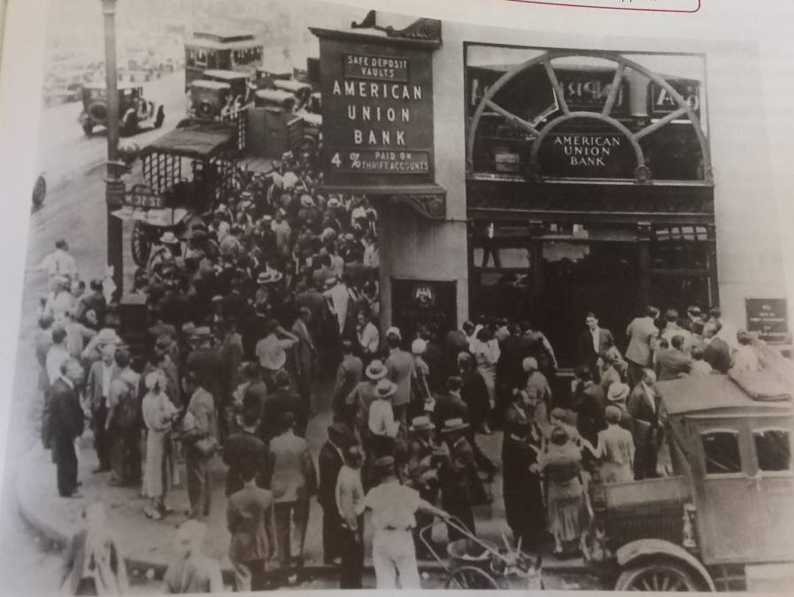
Is it useful? Why?
[Depositors outside a bank in New Jersey, trying to get in to withdraw their deposits on Black Tuesday, 29 October 1929]
Who said it and why?
Why was the source produced? What is its purpose?
Link the source to the bigger picture
What is the content? What does the source tell you about the issue?

Slide 12


Possible Steps how to answer the question:
Step 1 – provide initial judgement and contextual knowledge
Both sources are useful to an historian studying the issue …. One source outlines…..The other source….
Source C is useful because ….
Step 2 – Evaluate Source C
Step 3 – Provide judgement on usefulness – accuracy of content and purpose
The author of Source C was ….. It was published …..
Step 4 – Evaluate Source D
Source D is useful because ….
Step 5 – Provide judgement on usefulness – accuracy of content and purpose
The author of Source D was ….. It was published …..
Overall, both sources are useful because…. /
Overall, Source ? is more useful because…. /
Step 6 – Overall judgement
You must decide which is the most useful!
Notes:
This is a possible way of answering this question. There are many ways it can be answered.
Examples are on WJEC site

Slide 13
Exam Question Help-Sheet/PowerPoint Question 5 Was …. ? [16] Use your own knowledge and understanding of the issue to support your answer. Marks for spelling, punctuation and the accurate use of grammar and specialist language are allocated to this question. [3]
You need your own knowledge to debate an issue. You should look at both sides of the arguments. You should provide a reasoned judgement at the end.

Slide 14
Was organised crime the biggest problem facing American society during the 1920s? [16]
Was organised crime the biggest problem facing American society during the 1920s? [16]
Highlight/underline the key words in the question.
You need a two sided answer which is balanced and supported with evidence.
Step 4 – Other factors
Relevant and factual details
Step 2 – Issue in the question
Discussion of key factor
Relevant and factual details
Step 1 – Introduction
Make links to the question
Step 3 – Counter-Argument
Discussion of other factors
Use terms – ‘however’, ‘on the other hand’
Step 5 – Conclusion
Provide a reasoned judgement
Was it the key factor? OR were other factors more important?

Slide 15
Was organised crime the biggest problem facing American society during the 1920s? [16]
Organised crime | Other factors

Slide 16
Remember there are sample answers on the WJEC website (coming Feb/March 2018)

