Slide 1
Welcome & Introductions

Slide 2
Role of the Lead Practitioner
Analyse the new GCSE Business specification
Review assessment material
Set and organise meetings
Identify and respond to support required by schools

Slide 3
Issues arising & Resources

Slide 4
Unit 2 Business Perceptions

Slide 5
Unit 2 – Business Perceptions
Designed to replace NEA
1.5 hr written examination
37.5% of GCSE
60 marks
Data response Q’s covering all elements of the specification

Slide 6
What students like….
Having a sizeable case study to help support their response/ obtain AO2 marks
Mix of different types of question

Slide 7
What students don’t like…..
Quantity of information
Questions having two parts e.g. Specimen Q1c (i)
Similarity of Q’s e.g. Q1c (i) & (ii)
Wording of questions – different to Unit 1
12 mark Q’s

Slide 8
What students want….
Time spent on command words
How many points needed for lower mark analyse Q’s
Case study exemplars
Opportunity to practise extended reading/ writing tasks

Slide 9
Exemplars
Take a look at the exemplars
Make a note of your observations

Slide 10
Sharing Good Practice

Slide 11
WAGOLL
(What a Good One Looks Like)

Slide 12
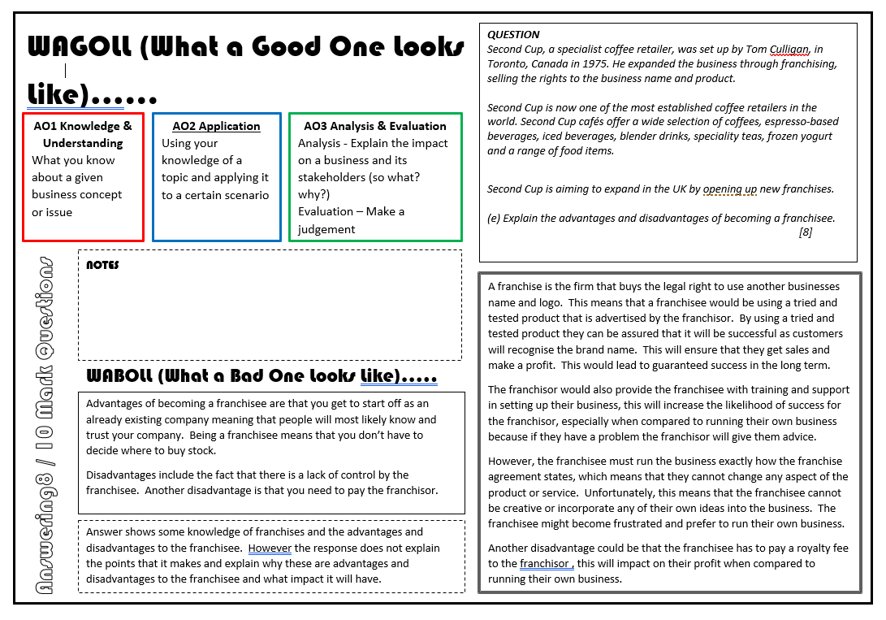
WAGOLL
Provide students with a model answer
Use to help students understand assessment objectives
Use actual responses

Slide 13
Developing Literacy Skills

Slide 14

Getting students to write more…
Change what they write on and with
Give regular opportunities to write
Allow free writing on a set topic for a set amount of time
Written responses to questions in class
Get students to write, teach skills, revise/ revisit

Slide 15
“To stop burglars you could buy a dog” Discuss…

Slide 16

Take 3/4 doilies……

Slide 17


Developing paragraphs
P – make a POINT
E – use EXAMPLES and EVIDENCE
E – EVALUATE
L – LINK BACK to the QUESTION
#poundlandpedagogy

Slide 18

Paper Chain Connectives
Discuss the idea of connectives
Get students to write their answer on strips of paper with the connectives on different coloured pieces
Examples of connectives you could introduce
  Therefore…
  Leading to…
  Because…
  However…

Slide 19

Put students into teams – Green Peppers and Red Tomatoes
Give students a ‘bag’ with ingredients
Ingredients are words to include in the answer including connectives
Have a certain amount of time to construct answer

Slide 20
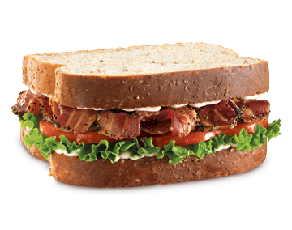
The BLT
Ask students to construct their answer using
  Because….
  Leading to …
  Therefore….

Slide 21
Debates
Ask students to debate a topic
This will allow them to develop their oral and aural skills
Also allow them to verbally construct and argument
You can then work on getting it on paper

Slide 22
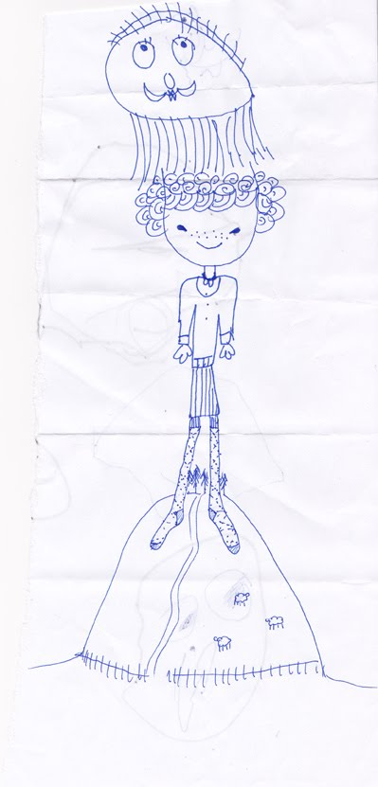
Consequences
Get students to construct their answer together
One student makes a POINT
Pass it on they must read what is written and EXPLAIN
Pass it on and they EVALUATE
Pass it on and they LINK TO QUESTION

Slide 23

Evaluation Skills
Take AIM in your final paragraph
  A – Answer/ Address the trigger words and justify your reasoning
  I – It depends. Discuss what the overall issue depends upon.
  M – Most important. What is the most important issue when considering the conclusion.
Also may consider short v long term

Slide 24
Structure Strips

Slide 25
Structure Strips
Scaffold Tasks minimising explanation time
Allow for ‘live marking’
Reusable and adaptable to different examination questions and extended written tasks

Slide 26
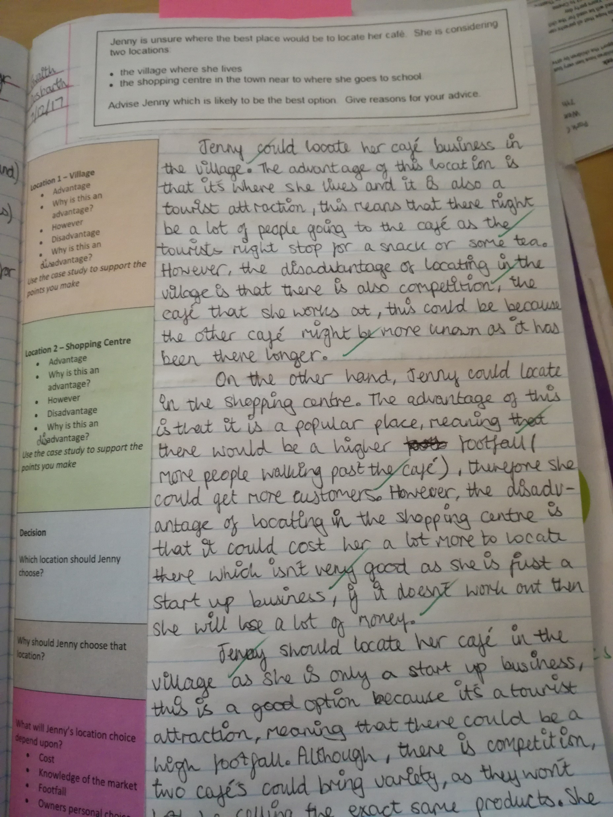
Structure Strips
Students follow framework to structure paragraphs and extend written skills

Slide 27
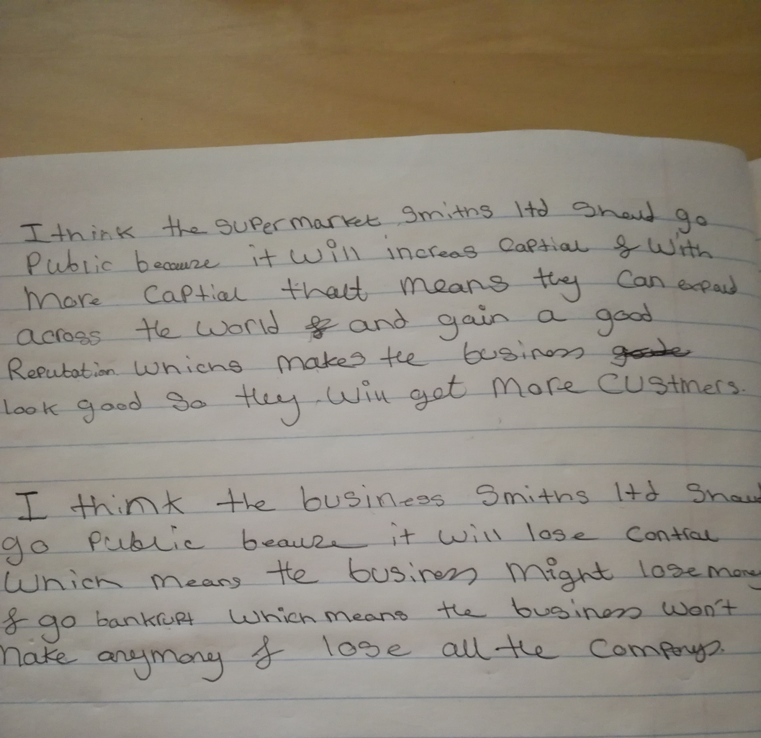
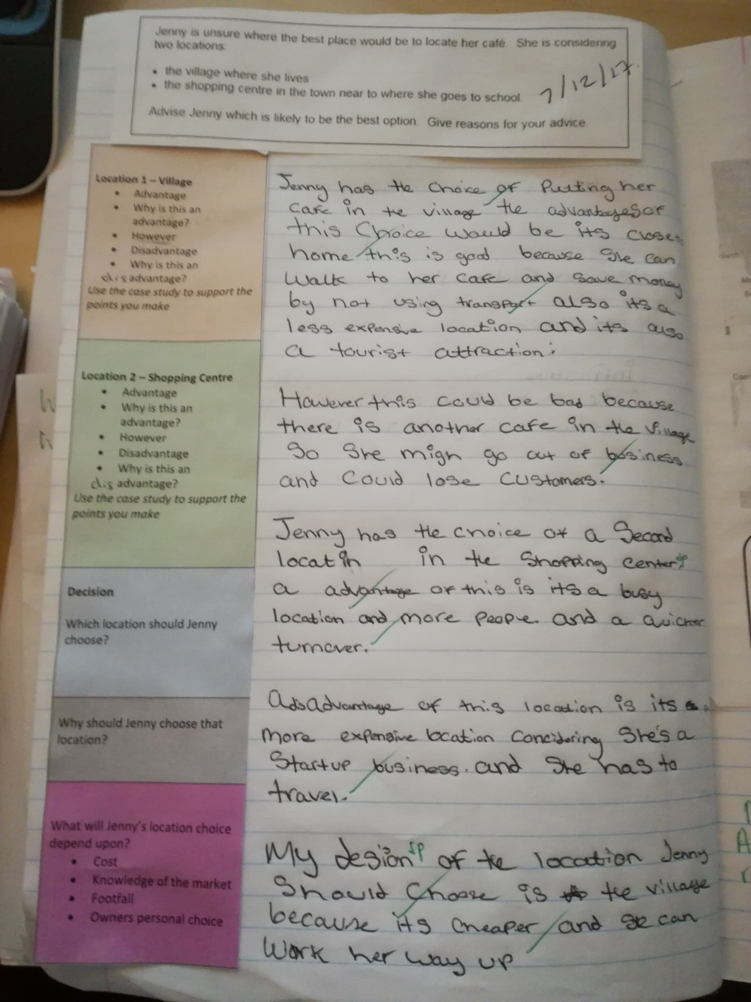
Structure Strips
Help to develop extended writing skills in weaker students
Provide the confidence to attempt and structure questions
8 Mark Q - Attempt 1
8 Mark Q - Attempt 2 – 3 weeks later

Slide 28
Next Steps?

