Slide 1
Why was there a Civil War?

Slide 2
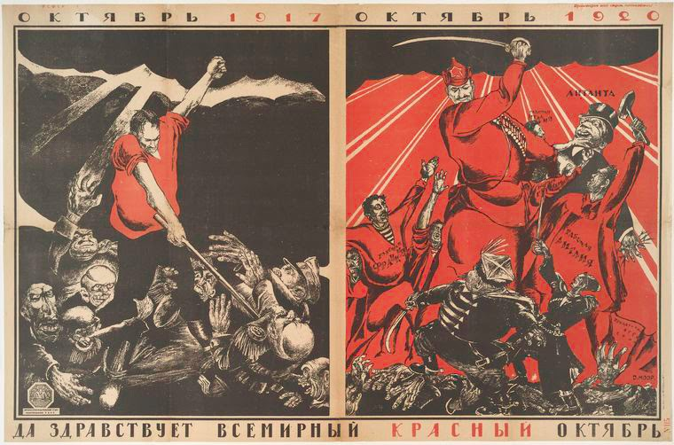

Slide 3
was there so
Why was there so much opposition to the Bolsheviks?
Economic
Political

Slide 4
Group | Why were they angry with the Bolsheviks? | What were their strengths? | What were their weaknesses?
The Czech Legion
The Whites
The Greens
Foreign Powers

Slide 5
Foreign Powers fighting in the Russian Civil War
Countries | Explain the motive for joining the Civil War.
The Czech Legion
The Whites
The Greens
Foreign Powers

Slide 7
How did Trotsky inspire the Red Army?
Positive aspects of Trotsky’s leadership | Negative aspects of Trotsky’s leadership

Slide 8
Civil War Propaganda
Describe what you see: What is the purpose of this propaganda?

Slide 9
was there so
What were the strengths and weaknesses of War Communism?
Strengths
Weaknesses

Slide 10
was there so
What were the weaknesses of the Whites?
Using the information on the pages, create a detailed mind map to explain the weaknesses of the Whites.

Slide 11
The Weaknesses of the Whites
Lack of Unity
Geographical Spread
Nationalist Groups
Weak support from foreign powers
Poor leadership
Arrange the weaknesses of the Whites into an order of importance – the most important should be at the top, the least important should be at the bottom.

Slide 12
REVISION: Explain why the Tsar was murdered
Events leading to Tsar’s death | Reasons for the Tsar’s murder

