Slide 1
Russia in Transition
1905-1924

Slide 2
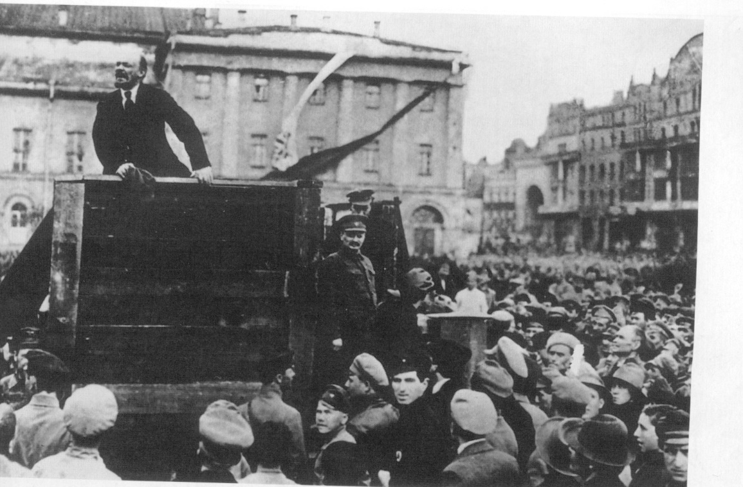

Slide 3
The new Bolshevik Government
Lenin set up a new government called Sovnarkom, short for Council of People’s Commissars.
Lenin was Chairman.
Trotsky was made Commissar for War in 1918.
Soviets across Russia joined in the revolution and took control of towns and cities.
But Lenin and the Bolsheviks did not have total control of Russia.

Slide 4
Why the Constituent Assembly was a problem for the Bolsheviks.
Before being removed the Provisional Government had arranged for Russia’s first free elections with the Constituent Assembly to take place in November 1917.
The Social Revolutionaries gained more seats than the Bolsheviks, meaning power would have to be handed over.
When the Constituent Assembly met for the first time in January 1918, Lenin proposed its power be limited, arguing it was not needed anymore as there were elected Soviets in Russia.
The proposal was refused. Lenin then dissolved the assembly.

Slide 5
Dissolving the Constituent Assembly
Red Guards killed and wounded 100 people who supported the Assembly.
The Red Guards then stopped elected deputies from entering the Assembly.
It was closed down, removing the threat to the Bolsheviks and Sovnarkom.

Slide 6
Why Lenin created the Cheka
Lenin used the Sovnarkom to set up the ‘All-Russian Extraordinary Commission for Combating Counter-Revolution and Sabotage’.
This became known as the Cheka – the Bolshevik’s secret police.
It was set up in December 1917.
Lenin gave the Cheka unlimited powers.

Slide 7
Why Lenin created the Cheka
Lenin used the Cheka to remove opponents of the Bolshevik regime and to shoot army deserters.
Members of the opposing political parties – Socialist Revolutionaries and Mensheviks – were arrested and removed.

Slide 8
The Cheka and the Red Terror
After an assassination attempt on Lenin, the Red Terror started.
By the end of 1918 the Cheka had removed 50,000 people.
It created a climate of fear and terror within Russia AND the Bolshevik party – it was now dangerous to criticize the government.
IMPACT:
The Red Terror enabled the Bolsheviks to hold onto power.

Slide 9
Treaty of Brest-Litovsk
Lenin wanted to stop Russia’s involvement in World War One.
He had promised to bring peace for the Russian people.

