Slide 1
Unit 1 Question 1
Please note these are suggested ways to answer the Unit1 questions.
Possible Guide

Slide 2
What can be learnt from Sources A and B about ……… ?
Visual and written sources ideally contemporary to the period
Comprehension

Slide 3
Sentence starters
Sources A and B both give information on ….
Source A shows ….
Source B shows ….
Both sources show …..

Slide 4
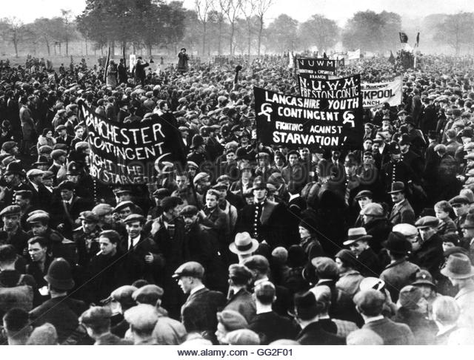
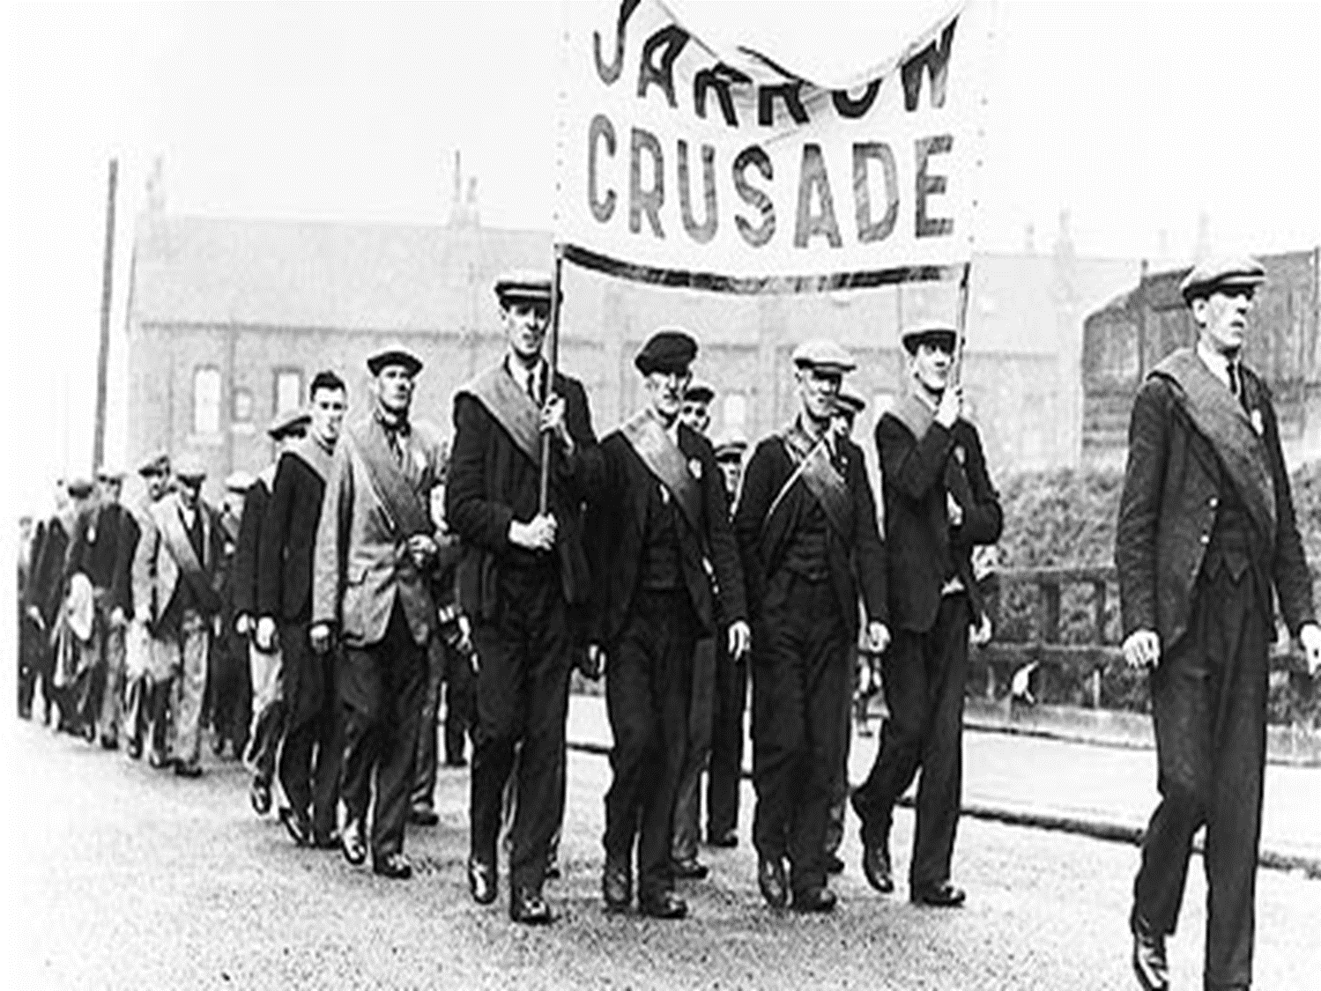
KQ 1 - What can be learnt from sources A and B about life during the Depression in Britain?
Source A
Source B
The Jarrow March. Unemployed men marching in protest, 1936.
A photograph of thousands demonstrators arriving at Hyde Park from all over Britain. This was set up by the National Unemployed Workers’ Movement. 1932.
Think, the question is asking you about two sources. You need to mention both sources and describe what you can see.
Firstly, opening sentence – mention how both sources are useful on the topic
Pick out several facts/describe points from the source and link to the question
I can see from Source A men queuing outside a soup kitchen. This shows me how me are unemployed and this is because of the Depression
Aim to write equal amounts from both sources to ensure your answer is balanced.
This will allow you to get the higher marks.
Now pick out several facts/describe points from the other source and link to the question
I can see from Source B men on strike. This links to the Depression in Britain because.…..
Notes:
Pupils do not need to answer this question – it is introducing them to a different style of question and what is needed to answer it. The following lesson pupils will answer the question using the ebook
- Spaced learning

Slide 5
Example answer 1 (not necessarily correct)
Task: Mark this answer with the mark scheme
Source A and Source B both show me life was difficult during the depression.
It can be learnt from Source A thousands of unemployed workers arrive in Hype Park. The men have protest signs and they have travelled from all over the country. This was in 1932.
It can also be learnt from Source , the depression lasted a while because the photograph shows men on a march. The Jarrow march, 1936.

Slide 6
Example answer 1 (not necessarily correct)
Task: make this answer better
Use your guidance on this question and improve the exemplar answer.

