Slide 1


Rhaglen Genedlaethol i Ddatblygu Darpar Benaethiaid –
Paratoi ar gyfer CPCP
National Aspiring Headteacher Development Programme –
Preparing for NPQH

Slide 2
Mae'r rhaglen ddatblygu hon, dros gyfnod o flwyddyn, yn gyfle dysgu proffesiynol cyffrous i arweinwyr ysgol profiadol, o bob cwr o Gymru, sy'n dymuno bod yn benaethiaid yn y dyfodol agos. Mae cwblhau'r rhaglen hon yn ddisgwyliad ar gyfer pob ymgeisydd CPCP y dyfodol.
Darperir y rhaglen genedlaethol hon ar sail ranbarthol.
This one-year development programme is an exciting professional learning opportunity for experienced school leaders across Wales who wish to become head teachers in the near future. Completion of this programme is an expectation for all future NPQH applicants.
This is a national programme delivered regionally.

Slide 3
Darperir y rhaglen genedlaethol hon gan y Consortia Rhanbarthol a'u partneriaid, sy'n cynnwys Awdurdodau Lleol a Sefydliadau Addysg Uwch.
Mae'r rhaglen wedi'i chymeradwyo gan yr Academi Genedlaethol ar gyfer Arweinyddiaeth Addysgol, gyda chyfle ar gyfer achrediad, mewn partneriaeth â Phrifysgol Cymru Y Drindod Dewi Sant, a Phrifysgol Bangor.
This national programme is delivered by Regional Consortia and their partners, which include Local Authorities and Higher Education Institutions.
It has been endorsed by the National Academy of Educational Leadership with opportunity for accreditation in partnership with UWTSD and Bangor universities.
Notes:
.

Slide 4
Cynulleidfa:
Bydd y rhaglen hon ar gael i bob arweinydd ysgol profiadol sy'n credu ei fod yn cyrraedd y Safonau Proffesiynol ar gyfer Addysgu ac Arweinyddiaeth, ac sy’n ystyried mai prifathrawiaeth yw’r cam nesaf realistig.
Audience :
This programme will be available to all experienced school leaders who believe that they demonstrate attainment against the Professional Standards for Teaching & Leadership and for whom headship is a realistic next step.

Slide 5
Mae'r rhaglen yn hyrwyddo arweinyddiaeth hynod o effeithiol trwy hunanwerthuso a myfyrio, gan archwilio'r berthynas rhwng arweinyddiaeth, ysgolion llwyddiannus a'r gymuned ehangach. Bydd yn sicrhau tegwch o ran mynediad i ymarferwyr ledled Cymru, ynghyd â chynnydd yn nifer yr ymgeiswyr o safon uchel am swyddi penaethiaid mewn ysgolion
The programme promotes highly effective leadership through self-evaluation and reflection, exploring the relationships between leadership, successful schools and the wider community. It will ensure equity of access to practitioners across Wales and an increase in the number of high-quality applicants for headteacher posts in schools.

Slide 6
Bydd y cyfranogwyr yn ymgymryd â gweithgareddau cyfoethogi sy'n adeiladu ar brofiad blaenorol, a hynny er mwyn meithrin:
eu dealltwriaeth o rôl pennaeth effeithiol
eu sgiliau a'u priodoleddau trwy hunan-adolygu yn erbyn y Safonau Proffesiynol ar gyfer Addysgu ac Arweinyddiaeth
eu dealltwriaeth a'u gallu i gymhwyso amrywiaeth o sgiliau arweinyddiaeth mewn modd effeithiol
eu sgiliau cydweithredu trwy gymryd rhan effeithiol mewn rhwydweithiau cyfoedion
eu gwybodaeth a'u sgiliau ar gyfer datblygu eu hysgolion fel sefydliadau sy'n dysgu a sicrhau llwyddiant yr agenda ddiwygio genedlaethol
Participants will undertake enriching activities that build upon previous experience to develop:
their understanding of the role of an effective headteacher
their skills and attributes through self-review against the Professional Standards for Teaching & Leadership
their understanding and effective application of a range of leadership skills
their collaboration skills through an effective engagement in peer networks and
their knowledge and skills for developing their schools as learning organisations and ensuring the success of the national reform agenda

Slide 7
Beth yw’r drefn?
Ymgeisio
Hysbysu
Mynd i fodiwlau gan gynnwys y gweithgareddau cyn y modiwl a’r tasgau rhwng y sesiynau
Asesiad CPCP
What is the process?
Application
Notification
Attendance at modules including pre module activities and intersessional tasks
NPQH Assessment

Slide 8
Ymgeisio (erbyn 03/11/2020)
Croesewir ceisiadau gan uwch arweinwyr ysgolion ledled Cymru, sydd wedi profi eu gallu, sy’n credu eu bod yn cyrraedd y Safonau Proffesiynol ar gyfer Addysgu ac Arweinyddiaeth, ac mai prifathrawiaeth yw’r cam nesaf realistig iddynt.
Dylai ceisiadau am y rhaglen hon gael eu hardystio gan Bennaeth eich ysgol neu gan eich rheolwr llinell, yn dilyn trafodaeth broffesiynol yn seiliedig ar gwblhau Adolygiad Safonau Arweinyddiaeth (ASA).
Cais ar gyfer CPCP yw'r canlyniad disgwyliedig ar gyfer y rhai sy’n cymryd rhan yn y rhaglen hon.
Application (by 03/11/2020)
Applications are welcomed from proven senior school leaders from across Wales who believe that they demonstrate the Professional Standards for Teaching & Leadership and for whom headship is a realistic next step.
Applications for this programme should be endorsed by your school’s Headteacher or line manager following a professional discussion based on a completed Leadership Standards Review (LSR).
Application for NPQH is the expected outcome for participants in this programme.

Slide 9
Dull cyflwyno
Cyflwynir y rhaglen dros flwyddyn, ac mae’n gofyn am ymrwymiad sydd gyfwerth â phum niwrnod rhwng mis Ionawr a mis Rhagfyr.
Cyflwynir holl weithgareddau’r rhaglen yn Gymraeg, yn Saesneg neu’n ddwyieithog.
Rhoddir Hyfforddwr Arweinyddiaeth i bob ymgeisydd, ynghyd ag aelodaeth o grŵp cyfoedion drwy gydol y rhaglen.
Delivery method
The programme takes place over a one-year period and requires a commitment of the equivalent of five days between January and December.
All activities undertaken as part of this programme are delivered in Welsh, English or bilingually.
Each candidate is allocated a Leadership Coach and membership of a peer group for support throughout the programme.

Slide 10
Drwy’r rhaglen, bydd modd i’r cyfranogwyr fyfyrio ar eu harferion proffesiynol a gofalu eu bod nhw’n barod pan ddaw hi’n amser iddynt wneud cais i gael eu hasesu’n ffurfiol ar gyfer y Cymhwyster Proffesiynol Cenedlaethol ar gyfer Prifathrawiaeth.
The programme will enable participants to reflect on their own professional practice and to ensure they are well prepared when applying to undertake formal assessment for the National Professional Qualification for Headteachers (NPQH).

Slide 11
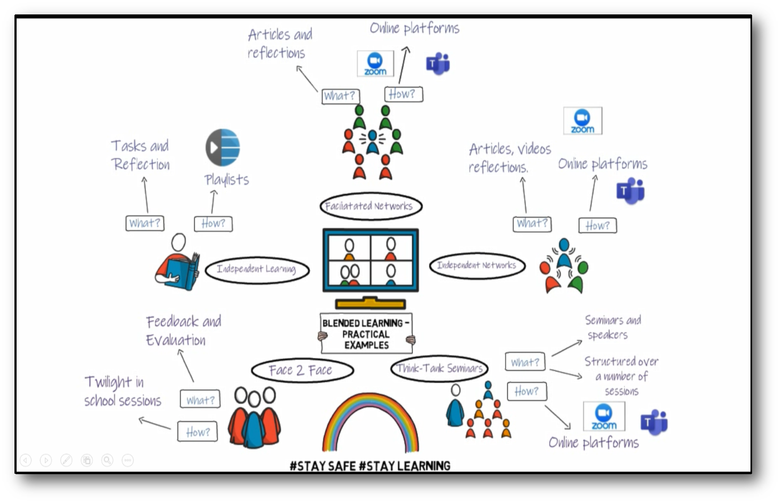
Dysgu Cyfunol
Blended Learning
Gallai’r rhaglen gael ei darparu trwy fodel dysgu cyfunol.
The programme may be delivered through a blended learning model .

Slide 12
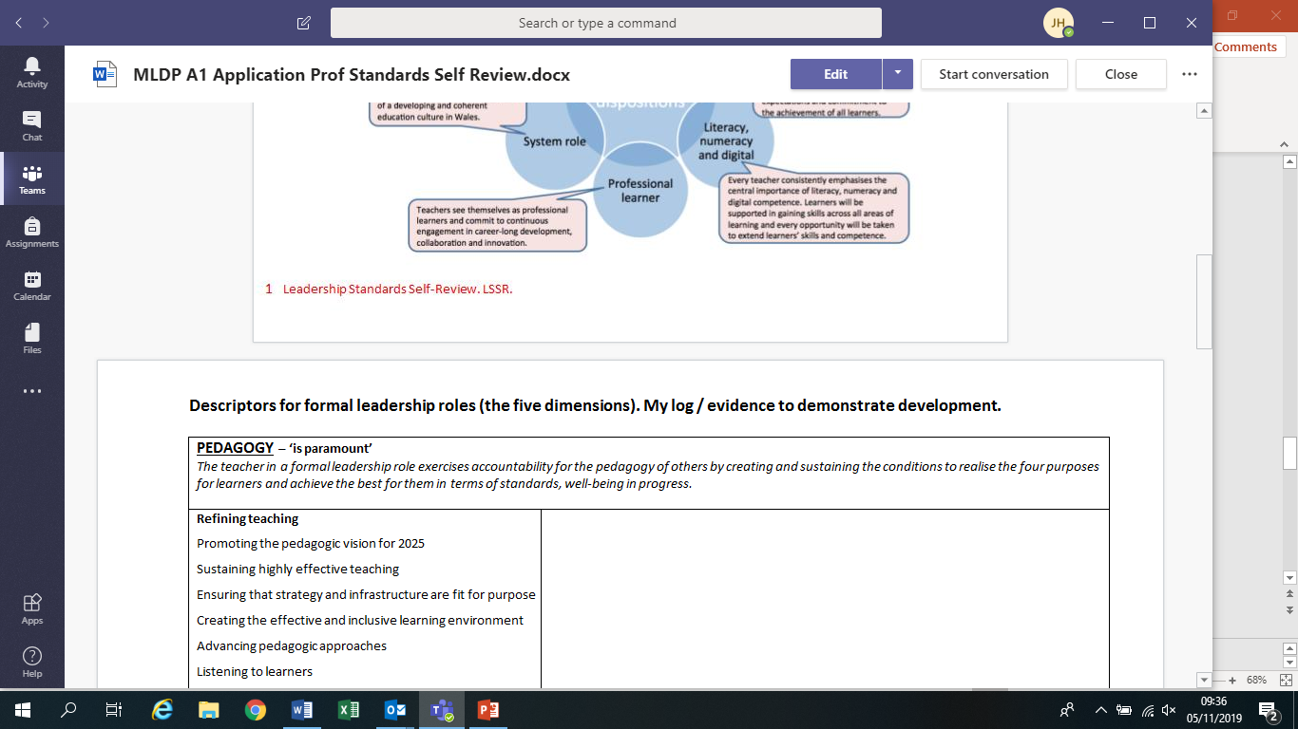
Gofyniad cyn y rhaglen –
Cwblhau’r Adolygiad Safonau Arweinyddiaeth (ASA)
Pre programme requisite –
Completion of a Leadership Standards Review (LSR)
Mynychu sesiwn briffio technoleg ‘Dysgu Cyfunol’
Cwblhau tasgau darllen ymlaen llaw
Attendance at a ‘Blended Learning’ technology briefing
Completion of Pre reading tasks

Slide 13
Y Rhaglen
The Programme
Modiwl Datblygu 1 – Gwneud Gwahaniaeth | Trosolwg o'r Rhaglen, gan gynnwys rôl yr Hyfforddwr Arweinyddiaeth a rhwydweithio Rôl y Pennaeth Ble'r ydym ni? – cyd-destun addysg yng Nghymru Gweledigaeth – beth yw eich gweledigaeth? Datblygu gweledigaeth a rennir Cynllunio Strategol – yr Adolygiad Hunanwerthuso a'r CGY Tasg Profiad Arweinyddiaeth
Development Module 1 – Making a Difference | Programme Overview including role of LC and networking Role of Headteacher Where are we? – the Welsh educational context Vision – what is your vision? Developing a shared vision. Strategic Planning – SER and SIP Leadership Experience Task

Slide 14
Modiwl Datblygu 2 – Arweinyddiaeth (i) | Beth yw arweinyddiaeth effeithiol? Pa fath o arweinydd ydw i? Timau Effeithiol Adnoddau Dynol
Development Module 2 – Leadership (i) | What is effective leadership? What sort of leader am I? Effective Teams Human Resources

Slide 15
Modiwl Datblygu 3 – Arweinyddiaeth (ii) | Arddulliau Arweinyddiaeth – Cydweithredol, Dosranedig, Gweddnewidiol, Sefyllfaol Rheoli Newid Iechyd a Diogelwch
Development Module 3 – Leadership (ii) | Leadership Styles – Collaborative, Distributed, Transformational, Situational Managing Change Health and Safety

Slide 16
Modiwl Datblygu 4 – Arwain Addysgeg | Rôl y Pennaeth mewn Dysgu ac Addysgu Sicrhau Ansawdd Defnyddio Data Mesur ac Adrodd ar effaith Rheoli adnoddau, gan gynnwys cyllid
Development Module 4 – Leading Pedagogy | Role of Headteacher in Teaching and Learning Quality Assurance Use of Data Measuring and Reporting Impact Managing resources, including Finance

Slide 17
Modiwl Datblygu 5 – Datblygu gweithlu'r ysgol yn effeithiol | Ysgolion fel Sefydliadau sy'n Dysgu Cynnal diwylliant cydweithredol yn yr ysgol a thu hwnt iddi Cefnogi twf mewn eraill Meithrin ac arwain diwylliant o arloesi Atebolrwydd eich hun ac eraill, gan gynnwys datblygu dulliau llywodraethu effeithiol Diogelu
Development Module 5 – Effective development of the school workforce | Schools as Learning Organisations Sustaining collaborative culture both within and beyond the school Supporting growth in others Developing and leading a culture of innovation Accountability of self and others, including developing effective governance Safeguarding

Slide 18
Cymorth
Dyddiau rhanbarthol – modiwlau
Cymorth gan Hyfforddwr Arweinyddiaeth
Tasg Profiad Arweinyddiaeth (PA)
Paratoi am y Ganolfan Asesu
Rhwydweithio
Support
Regional days – modules
Support of a Leadership Coach
Leadership Experience Task (LE)
Assessment Centre Preparation
Networking

Slide 19
Mae’n ofynnol bod ymgeiswyr yn gwneud tasg profiad arweinyddiaeth, ac yn cyflwyno’r hyn maent wedi’i ddysgu o’r gweithgaredd yn y ganolfan asesu.
Prosiect, gweithgaredd neu adolygiad fydd y profiad arweinyddiaeth, a fydd yn rhan o waith arferol yr ymgeiswyr yn eu hysgol. Cyflwynir tystiolaeth o’u sgiliau arweinyddiaeth sydd wedi gwella i’r panel.
Candidates are required to undertake a leadership experience task and present what they have learnt from the activity at the assessment centre.
The leadership experience is a project, activity or review as part of candidates’ normal work in their school. Evidence of their improved leadership skills are presented to the panel

Slide 20
Y Dasg Profiad Arweinyddiaeth
Bydd y dasg PA yn rhan ganolog o’r Cynllun Datblygu/Gwella Ysgol a chytunir arni rhwng y Pennaeth a’r Ymgynghorydd Her. Bydd yr ymgeisydd yn dod yn gyfarwydd â’r ymchwil diweddaraf yn y maes hwn, a’i gynnwys yn y cynllun, ble bo’n briodol. Yn y Panel Asesu, bydd ymgeiswyr yn amlinellu’r camau gweithredu, effaith y datblygiad a sut mae eu sgiliau arweinyddiaeth wedi gwella o ganlyniad.
The Leadership Experience Task
The LE task will be an integral part of the School Development / Improvement Plan and will be agreed between the Headteacher and the Challenge Adviser. The candidate will familiarise himself/herself with the latest research regarding this area of work and where appropriate incorporate this into the plan. At the Assessment Panel the candidate will outline the actions taken, the impact the development has had and how their leadership skills have developed as a result.

Slide 21
Datblygiad Personol
Bydd yr Ymgeiswyr yn gweithio efo’r Hyfforddwr Arweinyddiaeth:
I gytuno ar eu ASA, ei gynllunio, ei adolygu a’i werthuso
Caiff Ymgeiswyr y cyfle i ymweld ag ysgol yr HA, neu leoliad arall, i arsylwi neu gysgodi
Caiff Ymgeiswyr gefnogaeth gan yr Hyfforddwr Arweinyddiaeth i baratoi eu cyflwyniadau i’r Paneli Asesu
Dywedir wrth Ymgeiswyr am sicrhau eu bod nhw’n cyfeirio at ddefnyddio data.
Personal Development
Candidates will work with Leadership Coach to:
agree, plan, review and evaluate their LSR
Candidates have opportunity to visit LC school or alternate setting to observe or shadow
Candidates will be supported by the Leadership Coach to prepare their presentations to Assessment Panels
Candidates advised to ensure they cover use of data

Slide 22
Y Ganolfan Asesu
The Assessment Centre

Slide 23
Yn y ganolfan asesu, rhaid i’r ymgeiswyr ddangos:
Eu dealltwriaeth o rôl broffesiynol y Pennaeth
Eu gallu i arwain a rheoli ysgol mewn perthynas â’r holl Safonau Proffesiynol o’r Safonau Arweinyddiaeth ffurfiol
Cynnydd boddhaol yn erbyn pob elfen asesu
Eu parodrwydd am brifathrawiaeth
At the assessment centre candidates must demonstrate:
Their understanding of the professional role of the Headteacher
Their capacity to lead and manage a school in relation to each of the Professional Standards within the Formal Leadership Standards
A satisfactory level of progress against all of the assessment elements
Their readiness for headship

Slide 24
Defnyddir tystiolaeth o’r broses i sicrhau’r Panel bod pob ymgeisydd wedi darparu digon o dystiolaeth o gynnydd yn erbyn y Safonau Arweinyddiaeth ffurfiol, a’u bod yn ymgeisydd credadwy ar gyfer prifathrawiaeth.
Rhennir rhagor o wybodaeth am y ganolfan asesu efo aelodau’r rhaglen yn fuan yn Nhymor yr Hydref, 2021.
Evidence from the process is used to assure the panel that each candidate has provided sufficient evidence of progress against the Formal Leadership Standards and is a credible candidate for headship.
Further information regarding the assessment centre will be shared with participants of the programme early in the Autumn term 2021.

Slide 25
Region | Co-ordinator | Contact
CSC | Emma Coates Matthew Robbins | Emma.coates@cscjes.org.uk matthew.robbins@cscjes.org.uk
EAS | Peter Jenkins Deb Woodward | peter.jenkins@sewaleseas.org.uk deb.woodward@sewaleseas.org.uk
ERW | Tom Fanning Hazel Faulkner | Tom.fanning@erw.org.uk hazel.faulkner@erw.org.uk
GwE | Rhys Williams Ann Grenet | npqh@gwenorth.wales cpcp@gwegogledd.cymru
03/11/2020
Diolch a Phob Lwc!

