Slide 1
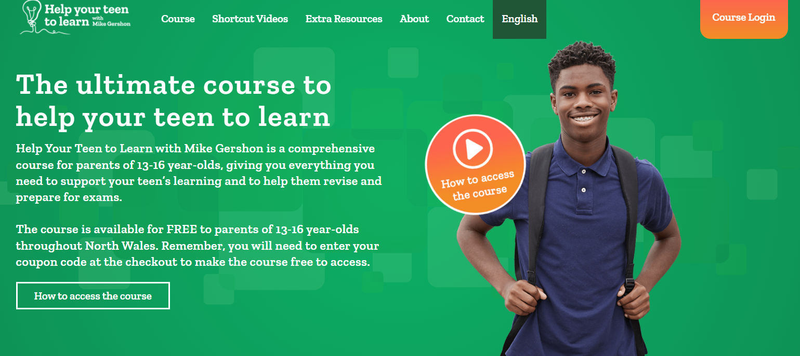
How to Access
the Course
Step One: Visit www.gwe-helpyourteentolearn.com
Step Two: Click on your preferred language option.
Step Three: At the checkout, click ‘Add Coupon Code’.

Slide 2
How to Access
the Course
Step Four: Enter your coupon code.
For example: CONWY-HYTTL-2022. Then, click ‘Apply’.
Step Five: This will make the course free to access.
Step Six: Sign up using your email address.

